Slide 1
Introduction Thermal trapping
Christof Mast
SoSe 24

Slide 2
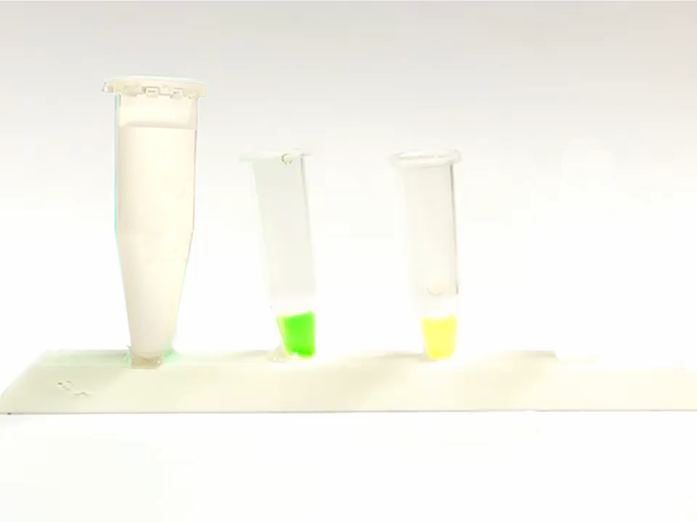
A
+
B
pH 7
pH 5

Slide 3
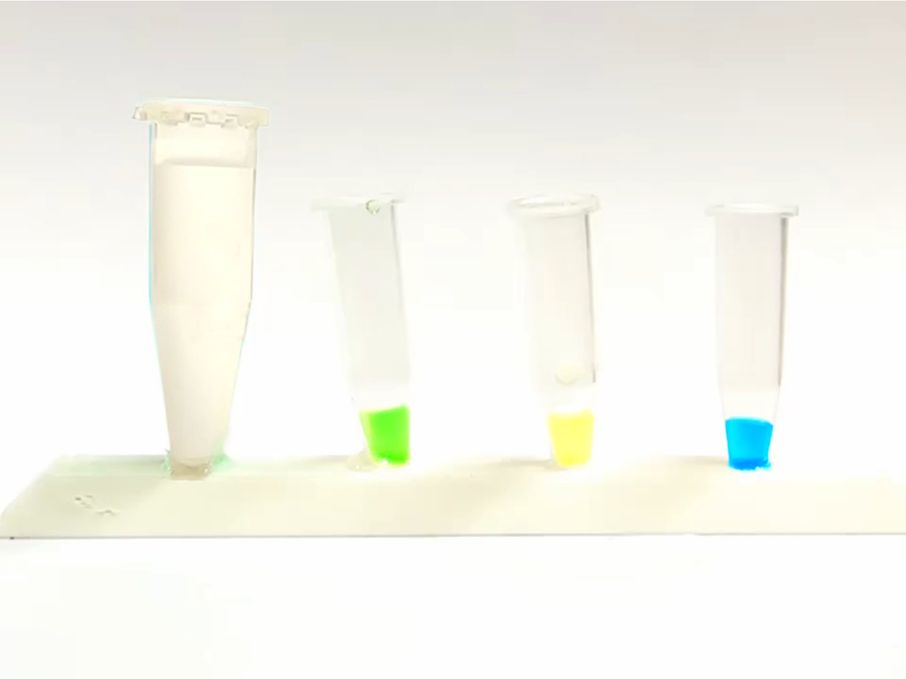
desired product
(high yield)
A
+
B
+
C
pH 7
pH 5
pH 2

Slide 4
Nature:

Slide 5
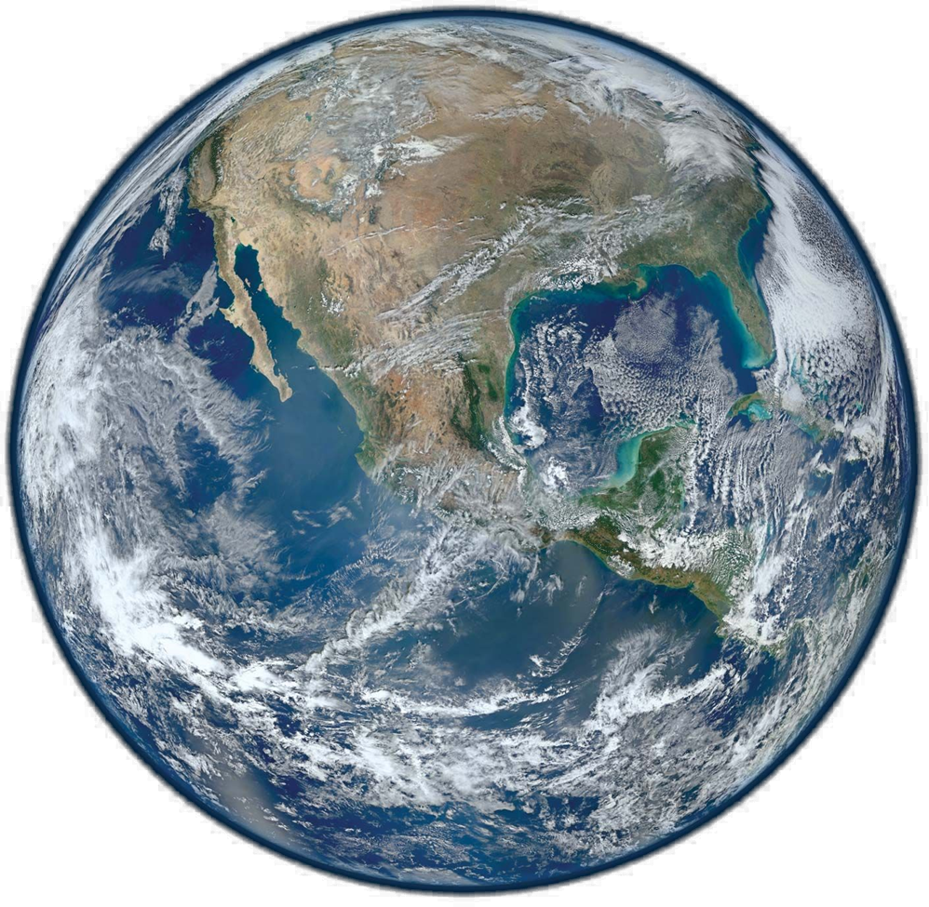
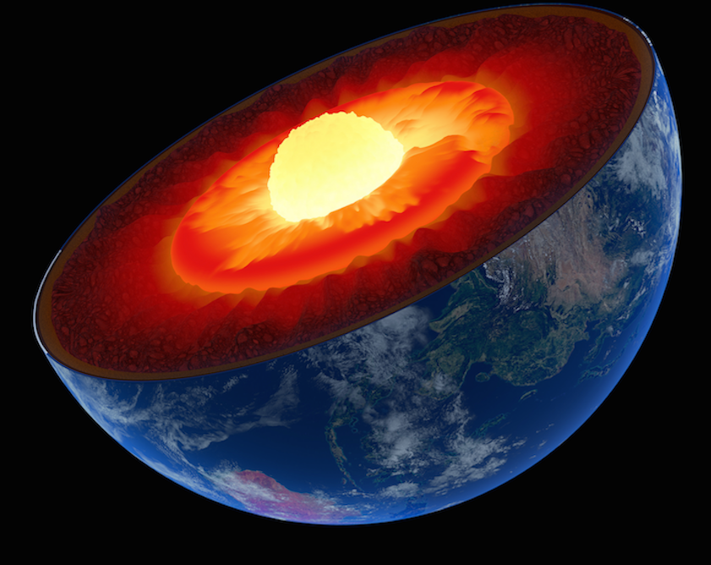
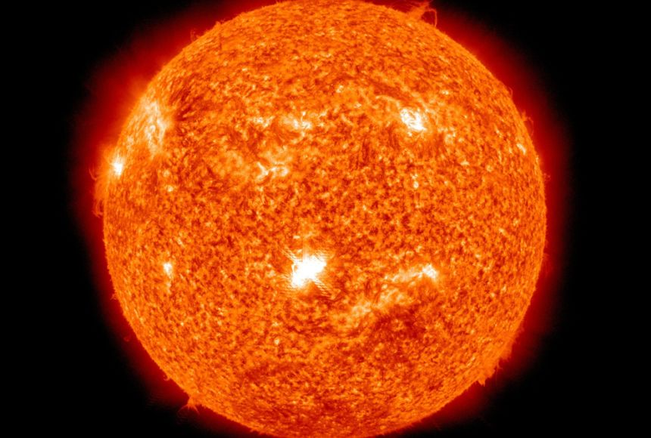
Non-equilibria are necessary!
Just right for life

Slide 6
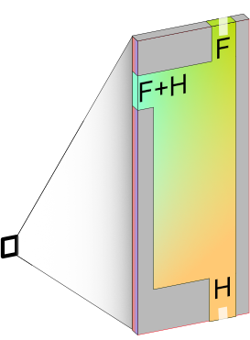
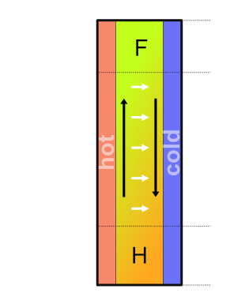
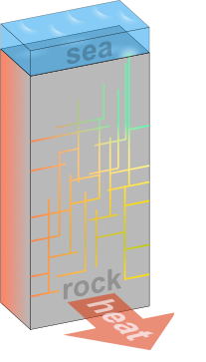
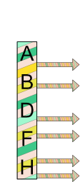
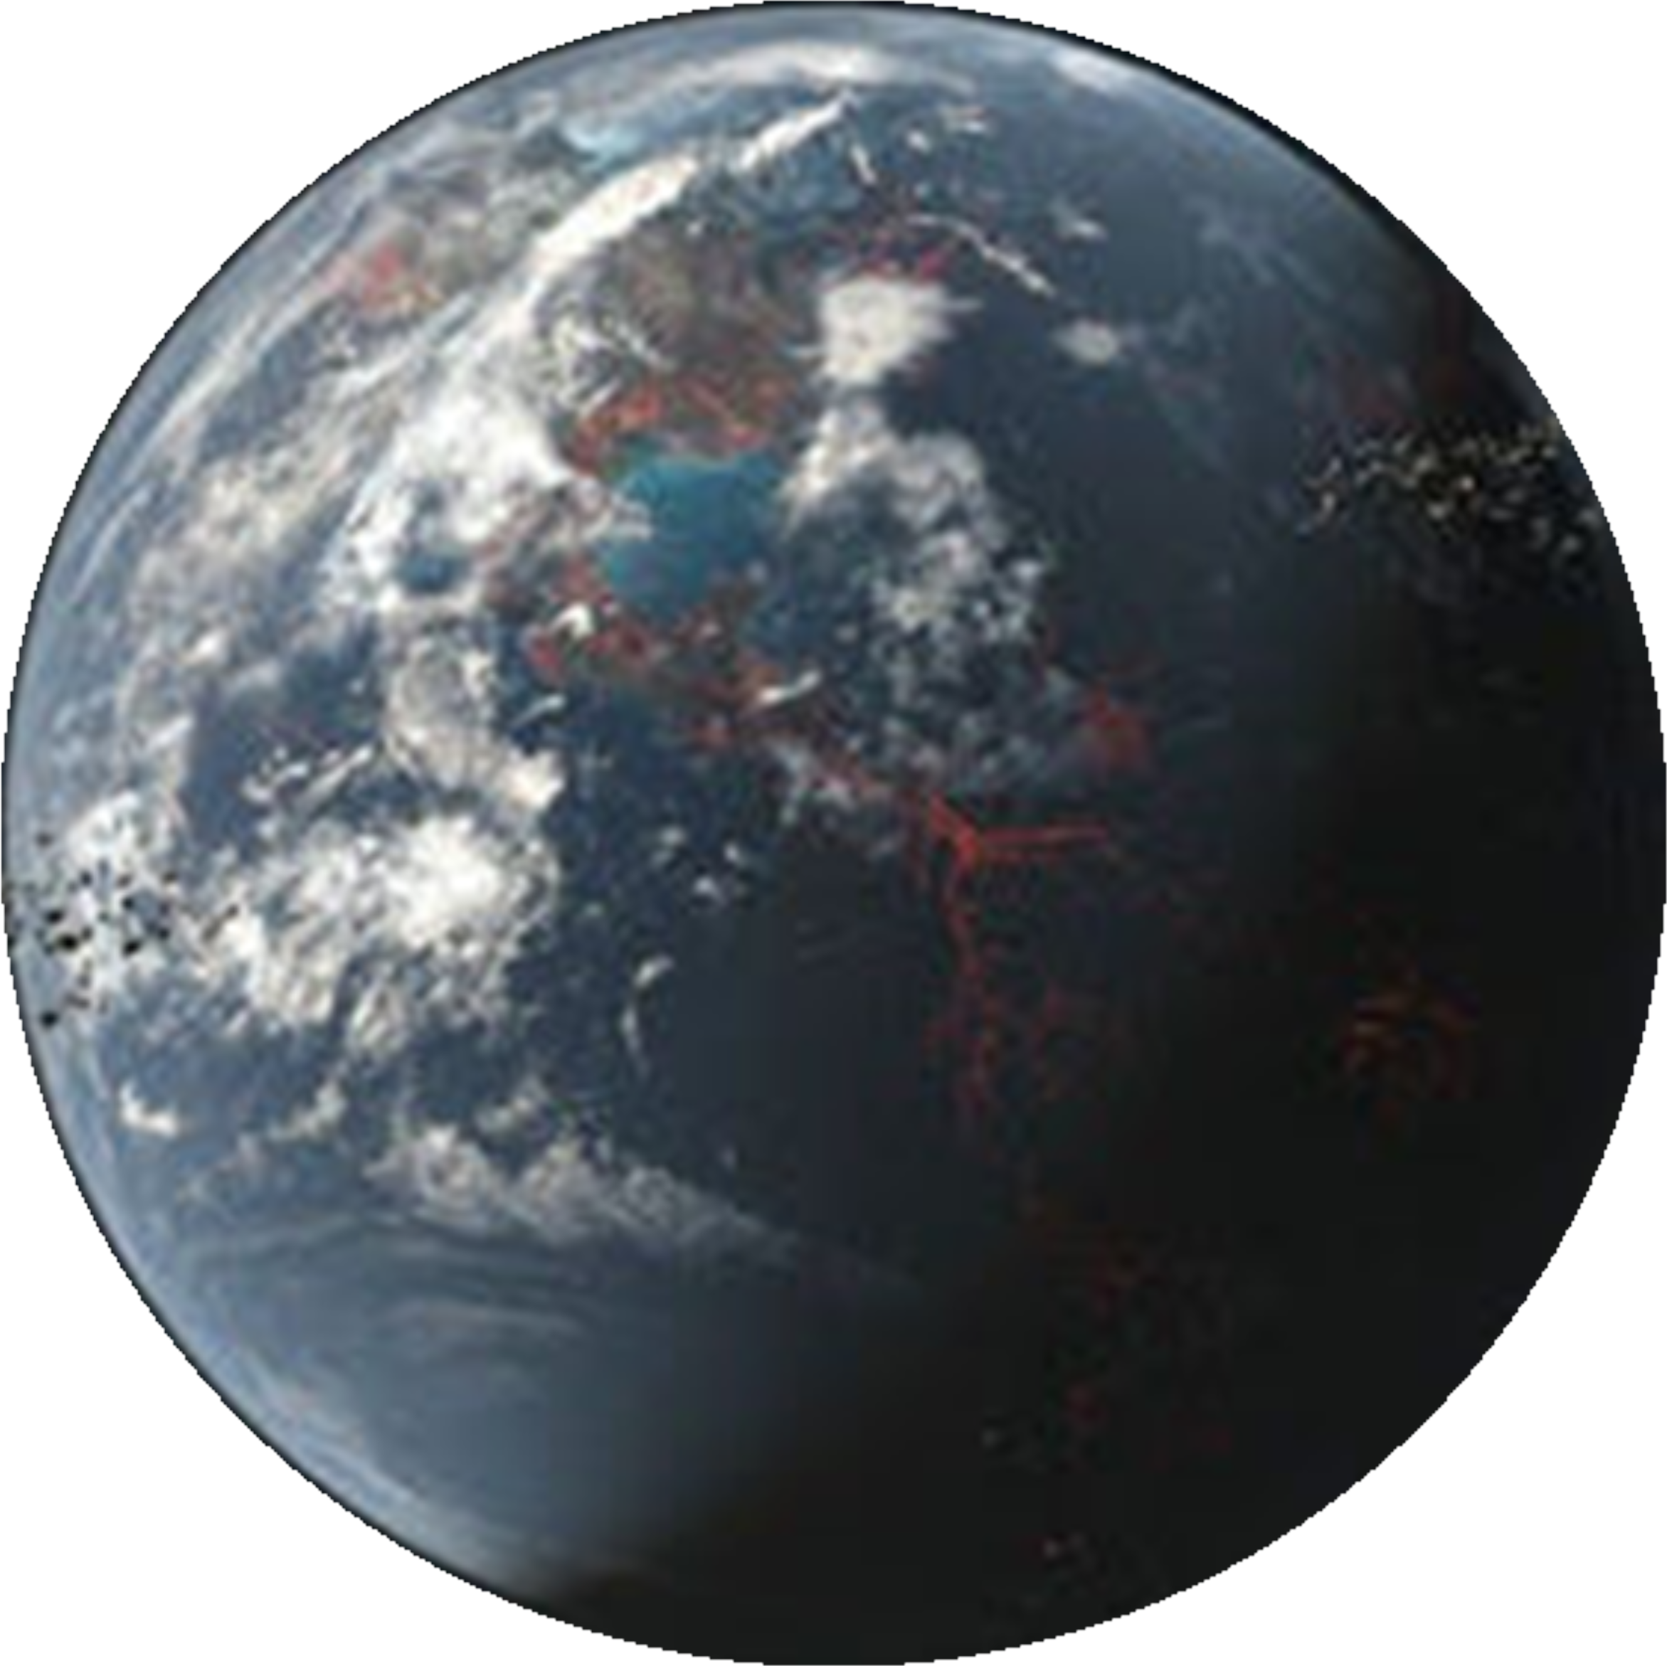
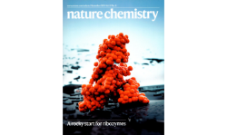
Heat flows help..
Matreux, LeVay, .., Scheu, Dingwell, Braun, Mutschler, Mast, Heat flows in rock cracks naturally optimize salt compositions for ribozymes, Nature Chemistry (2021)

Slide 7
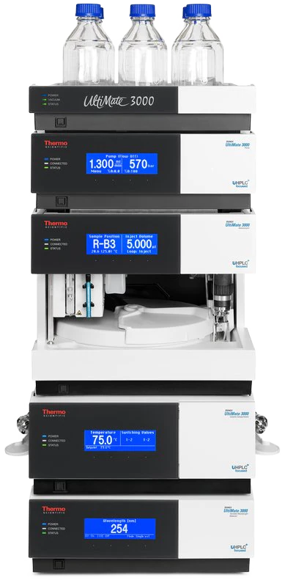
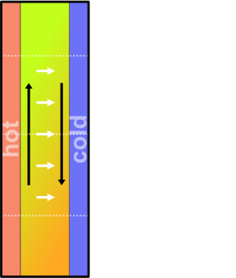
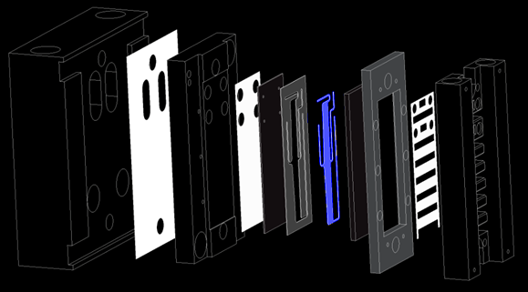
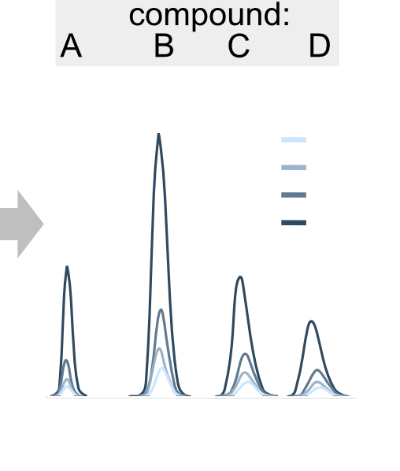
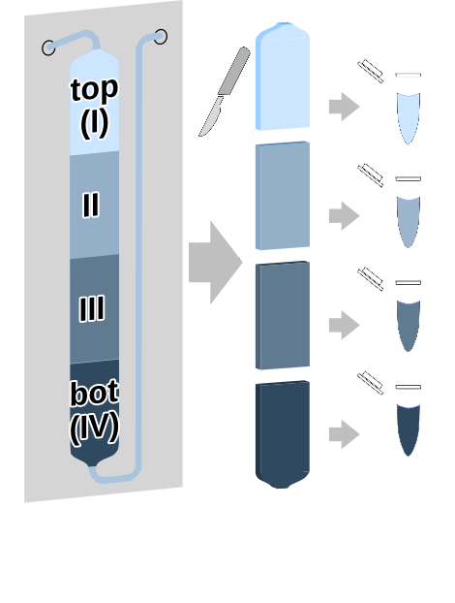
Select prebiotic organics
Thermophoresis measurement
low volume
low conc.
no label
multiple compounds
HPLC
under review

Slide 8
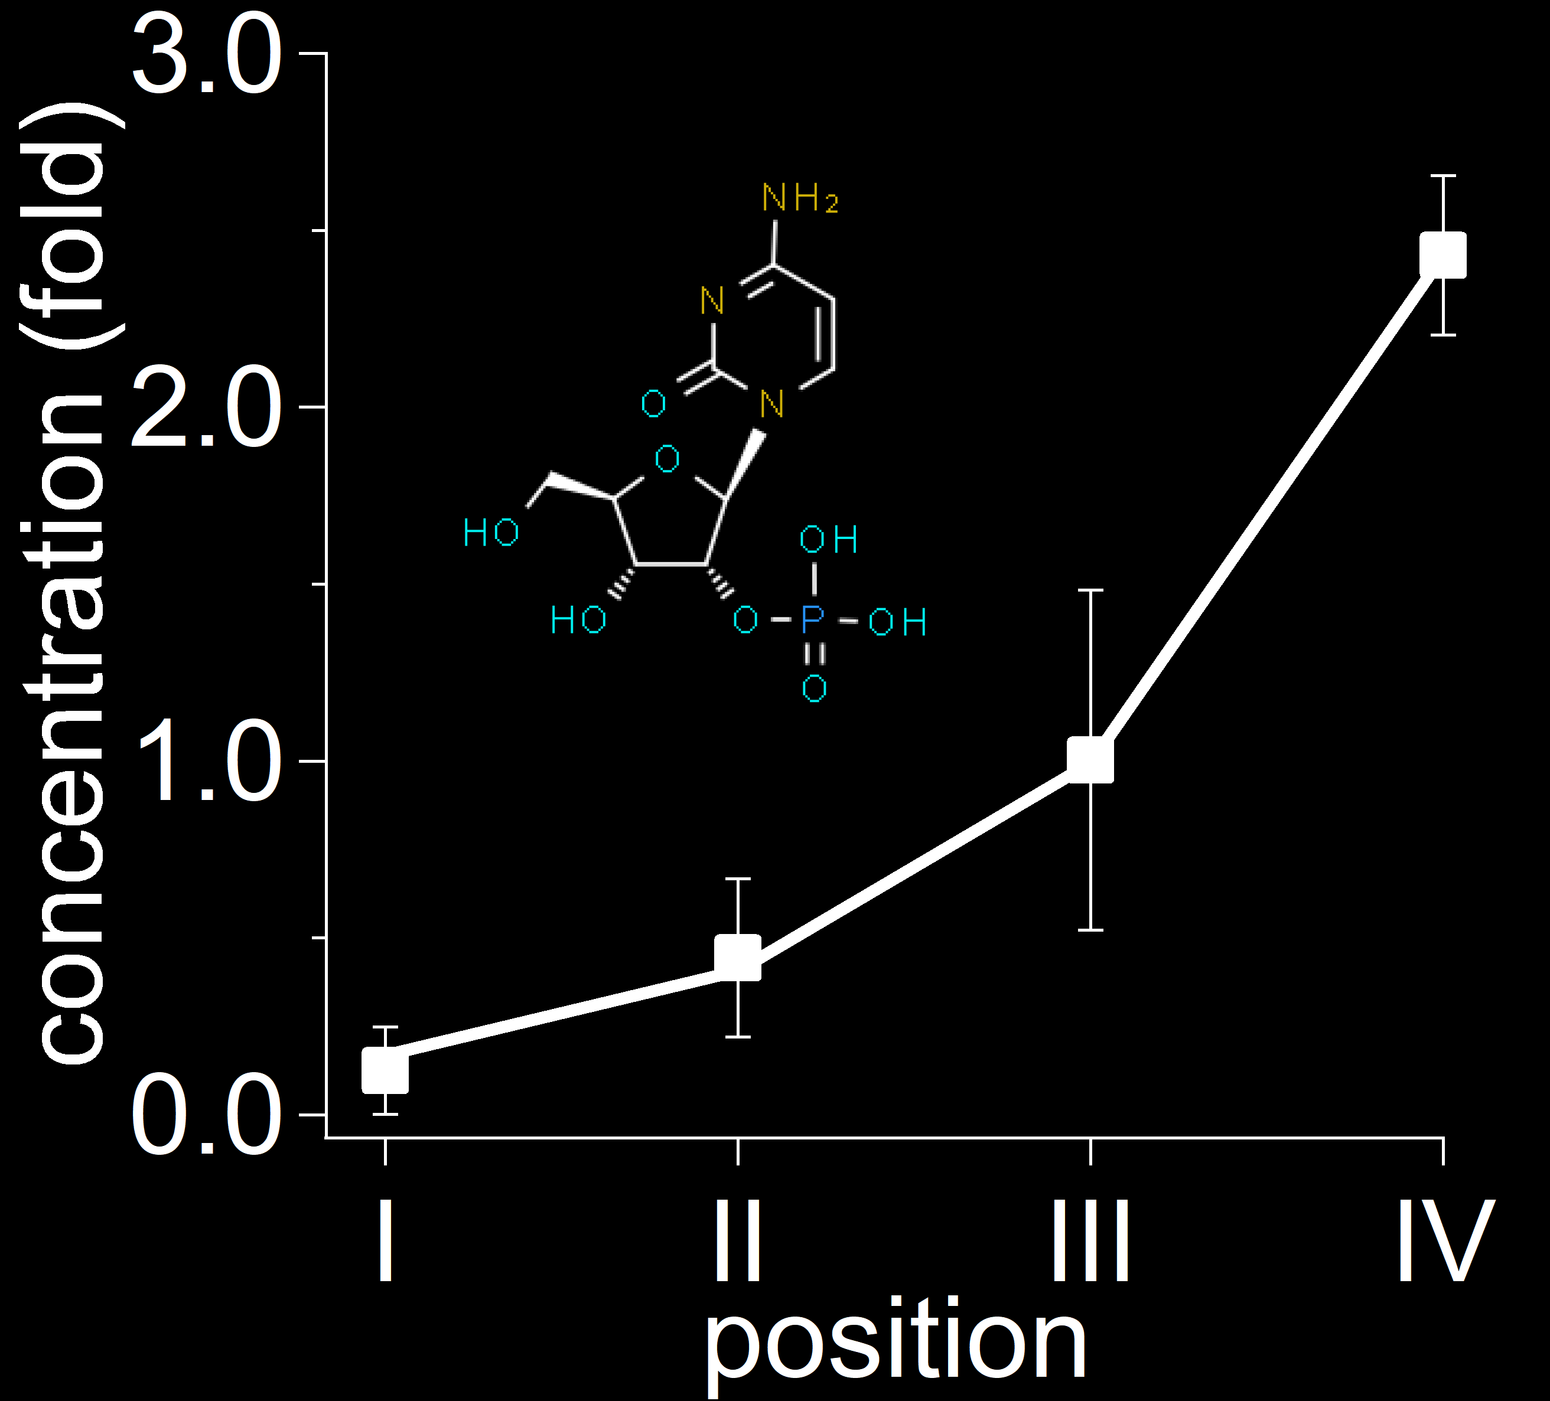
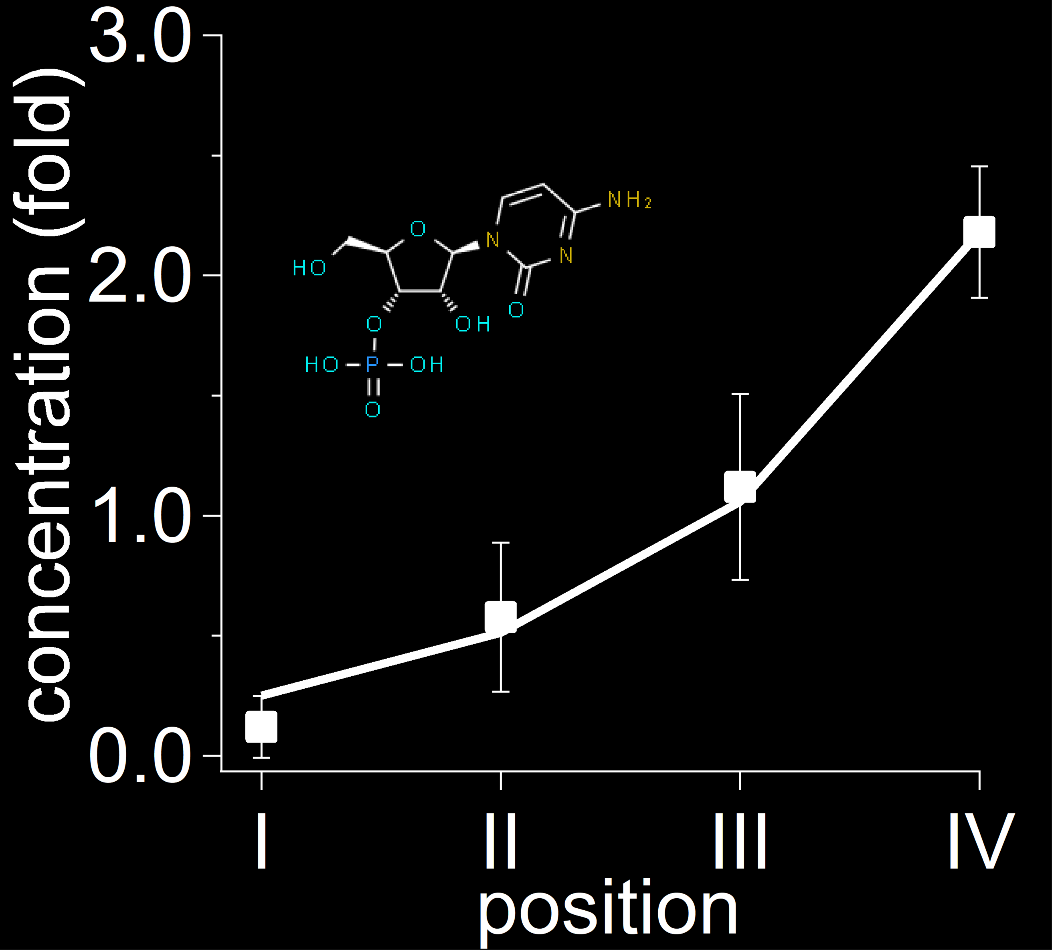
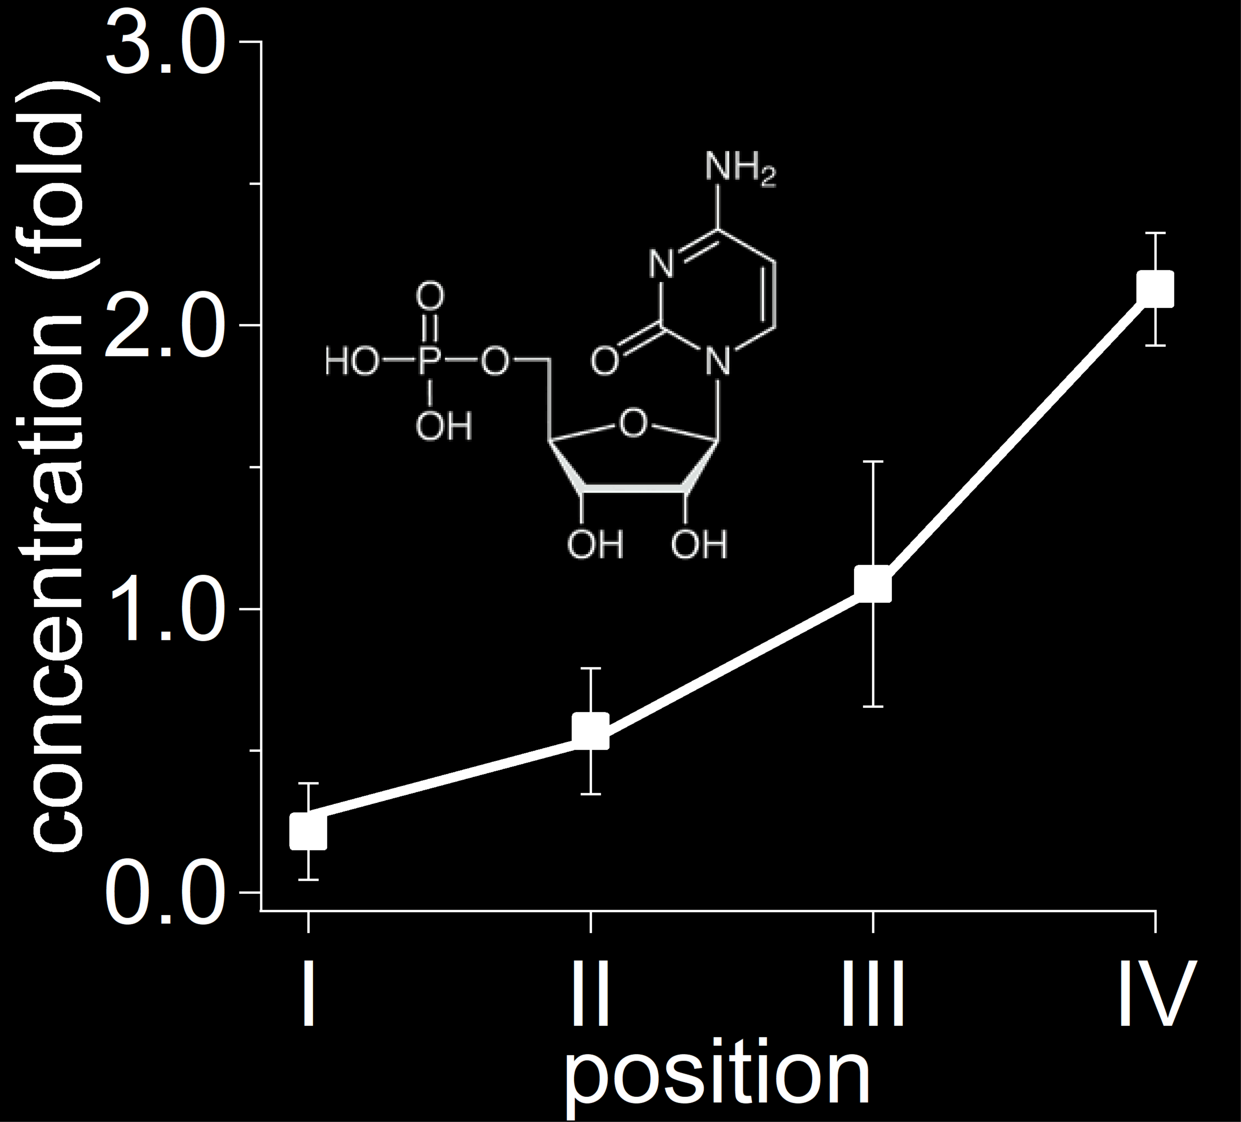
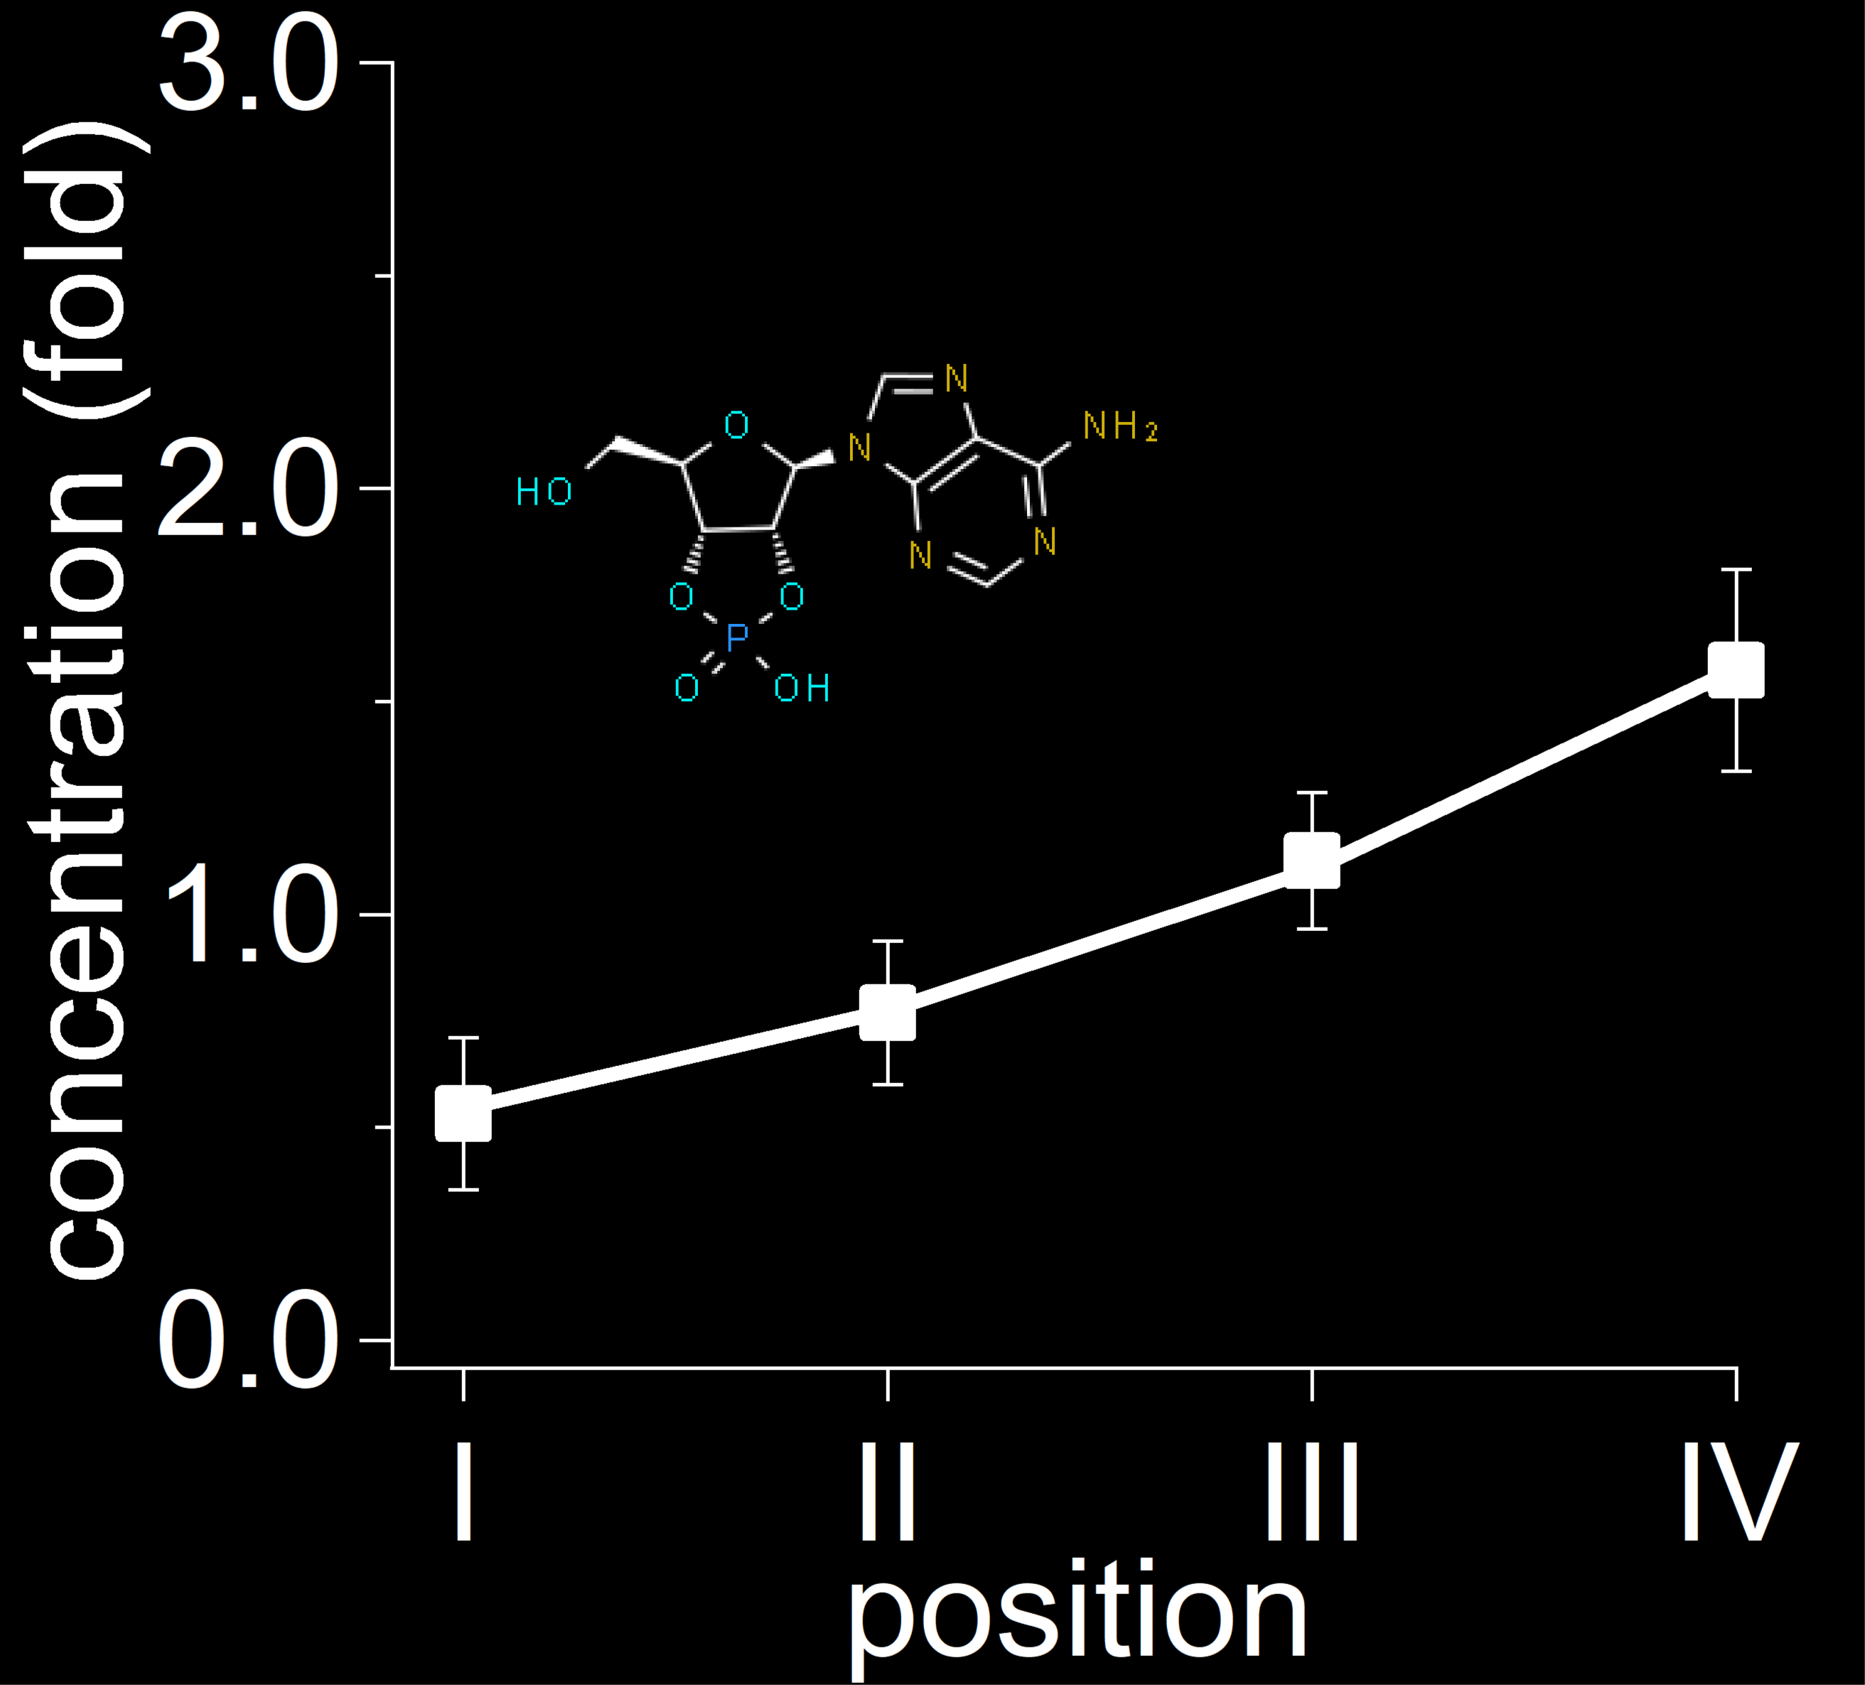
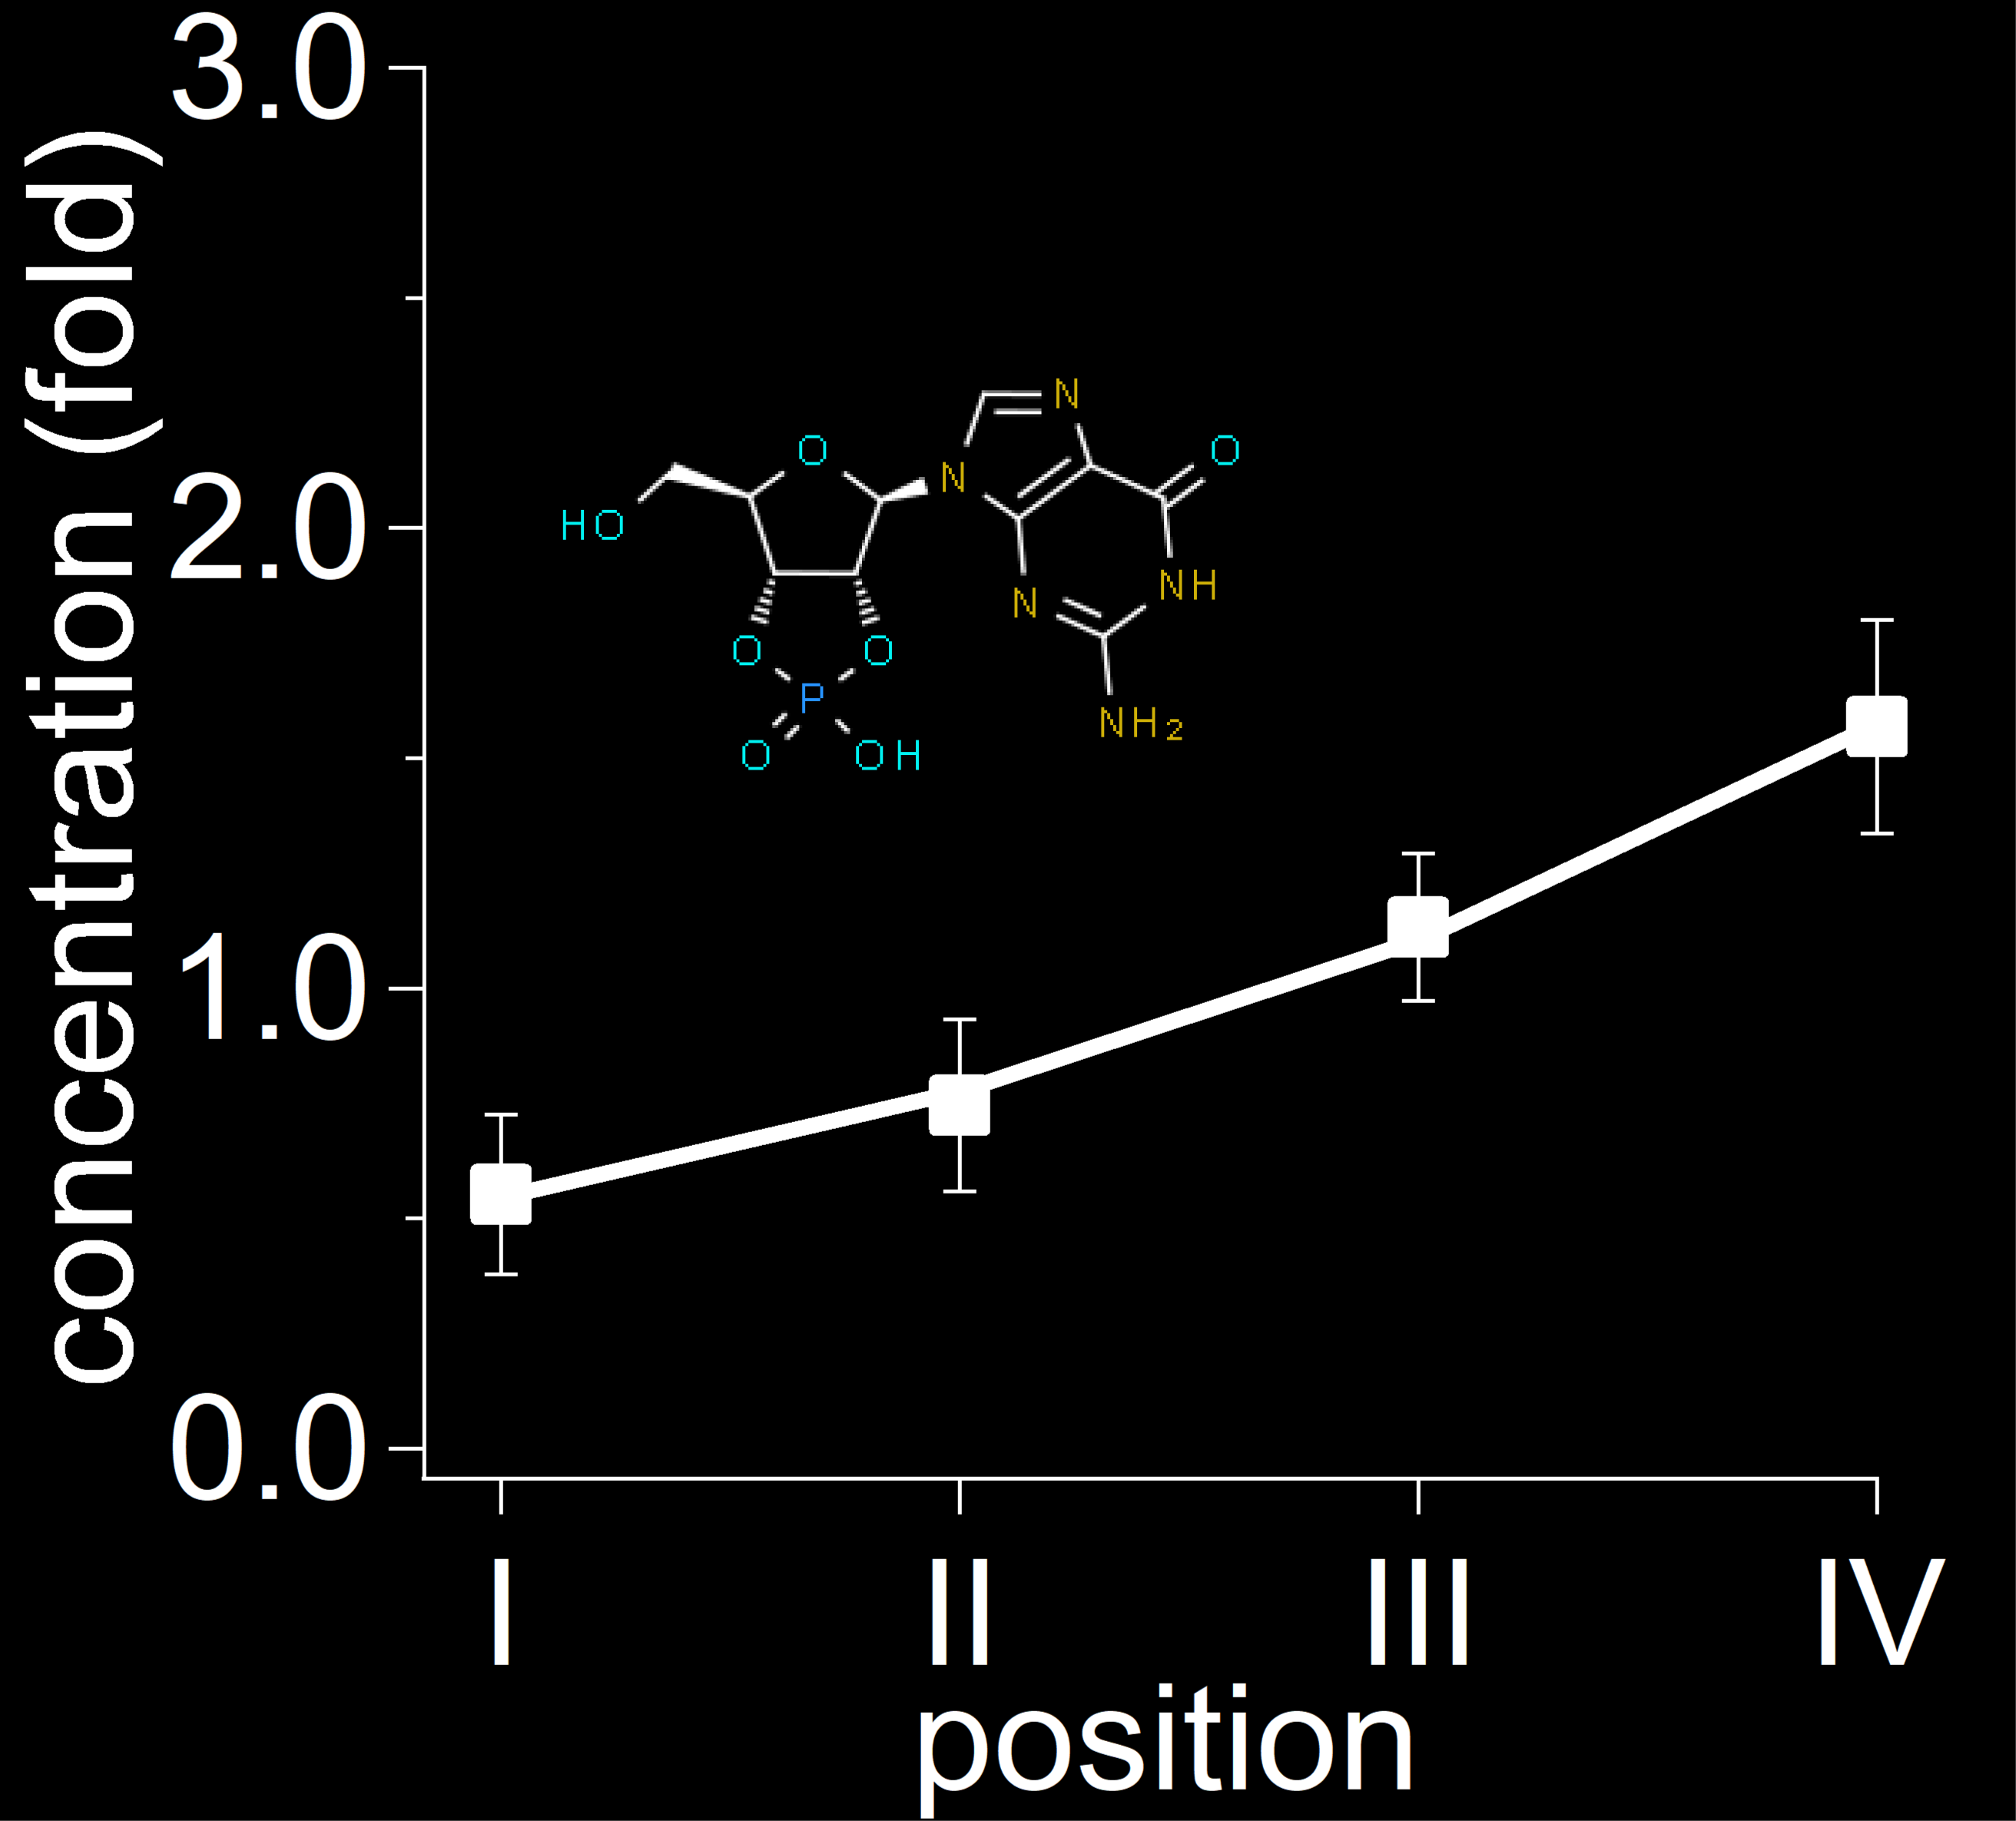
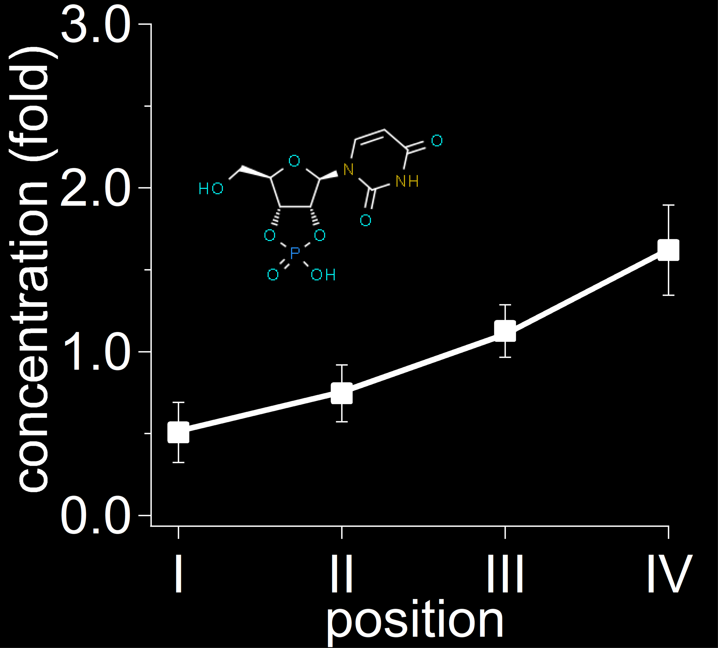
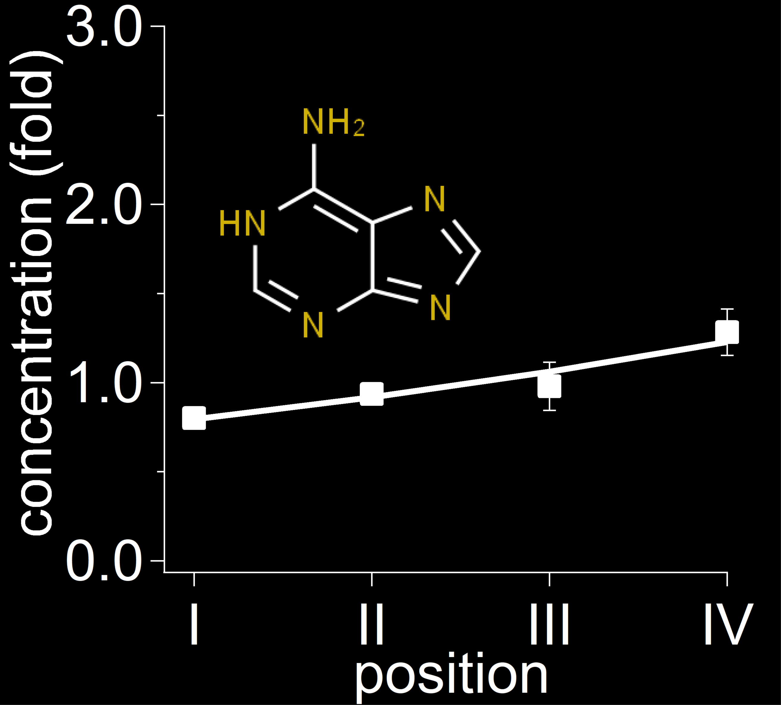
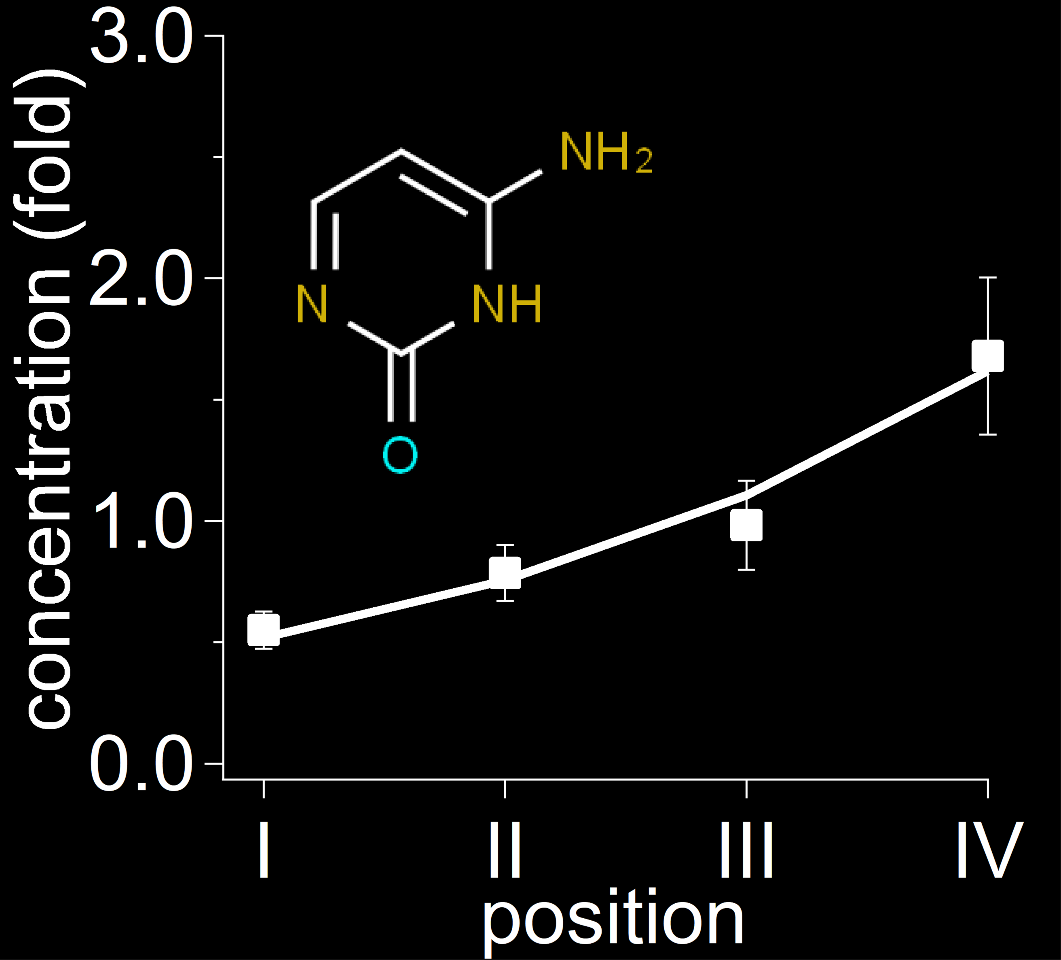
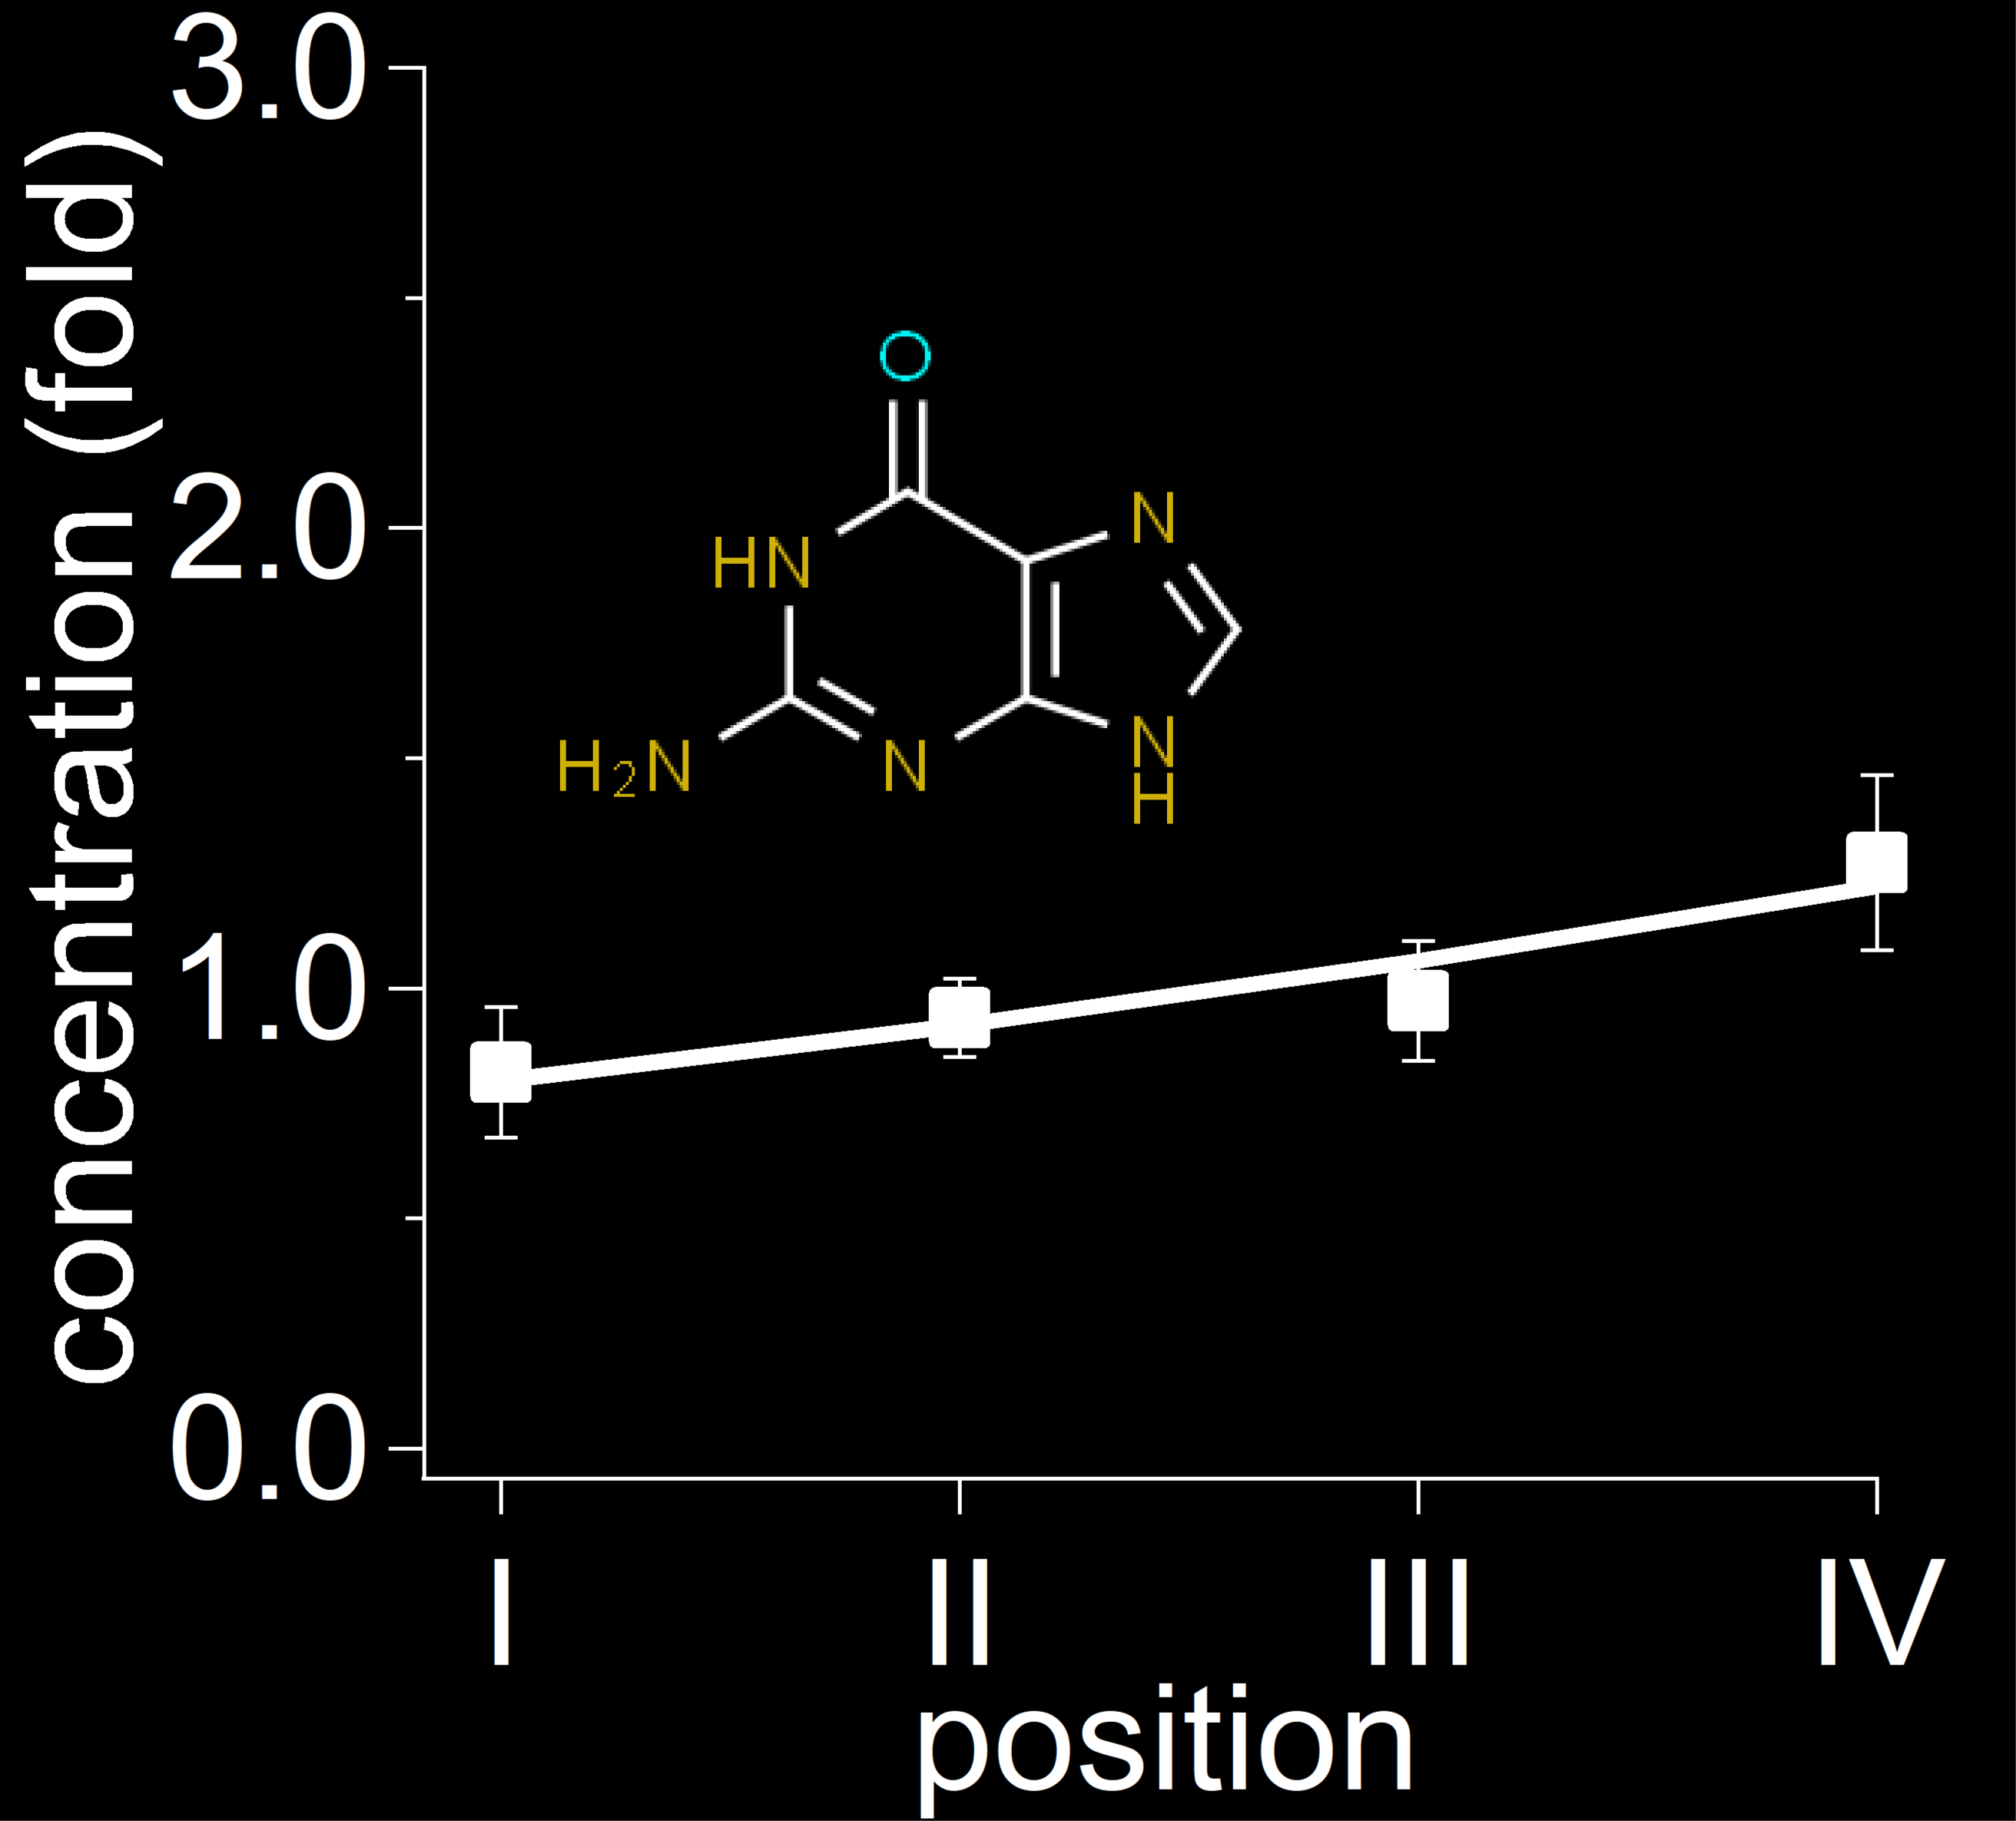
Thermophoretic parameters
The origins of life..
2‘-CMP
position
3‘-CMP
5‘-CMP
Make it vertical
2‘3‘-AMP
2‘3‘-GMP
2‘3‘-UMP
And many more:
Bases: A,G,C,G,U
P: 2‘-, 3‘-, 5‘-, 2‘3‘-, 3‘5‘-
Solvent: water, formamide
pH: 3 – 11
AAs: His, Asn, Ser, Gln, Arg, Asp, Glu, Thr, Ala, Pro, Cys, Lys, Tyr, Arg, Val, Ile, Leu, Phe
2-AO, 2-AT, 2-AI
Adenine
Cytosine
Guanine

Slide 9
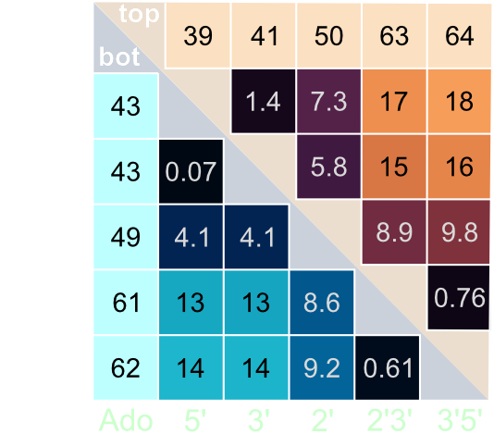
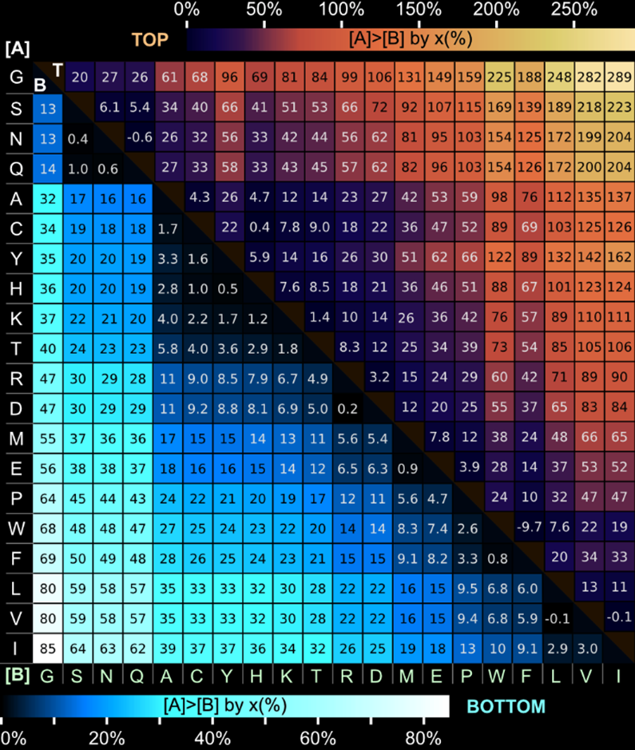
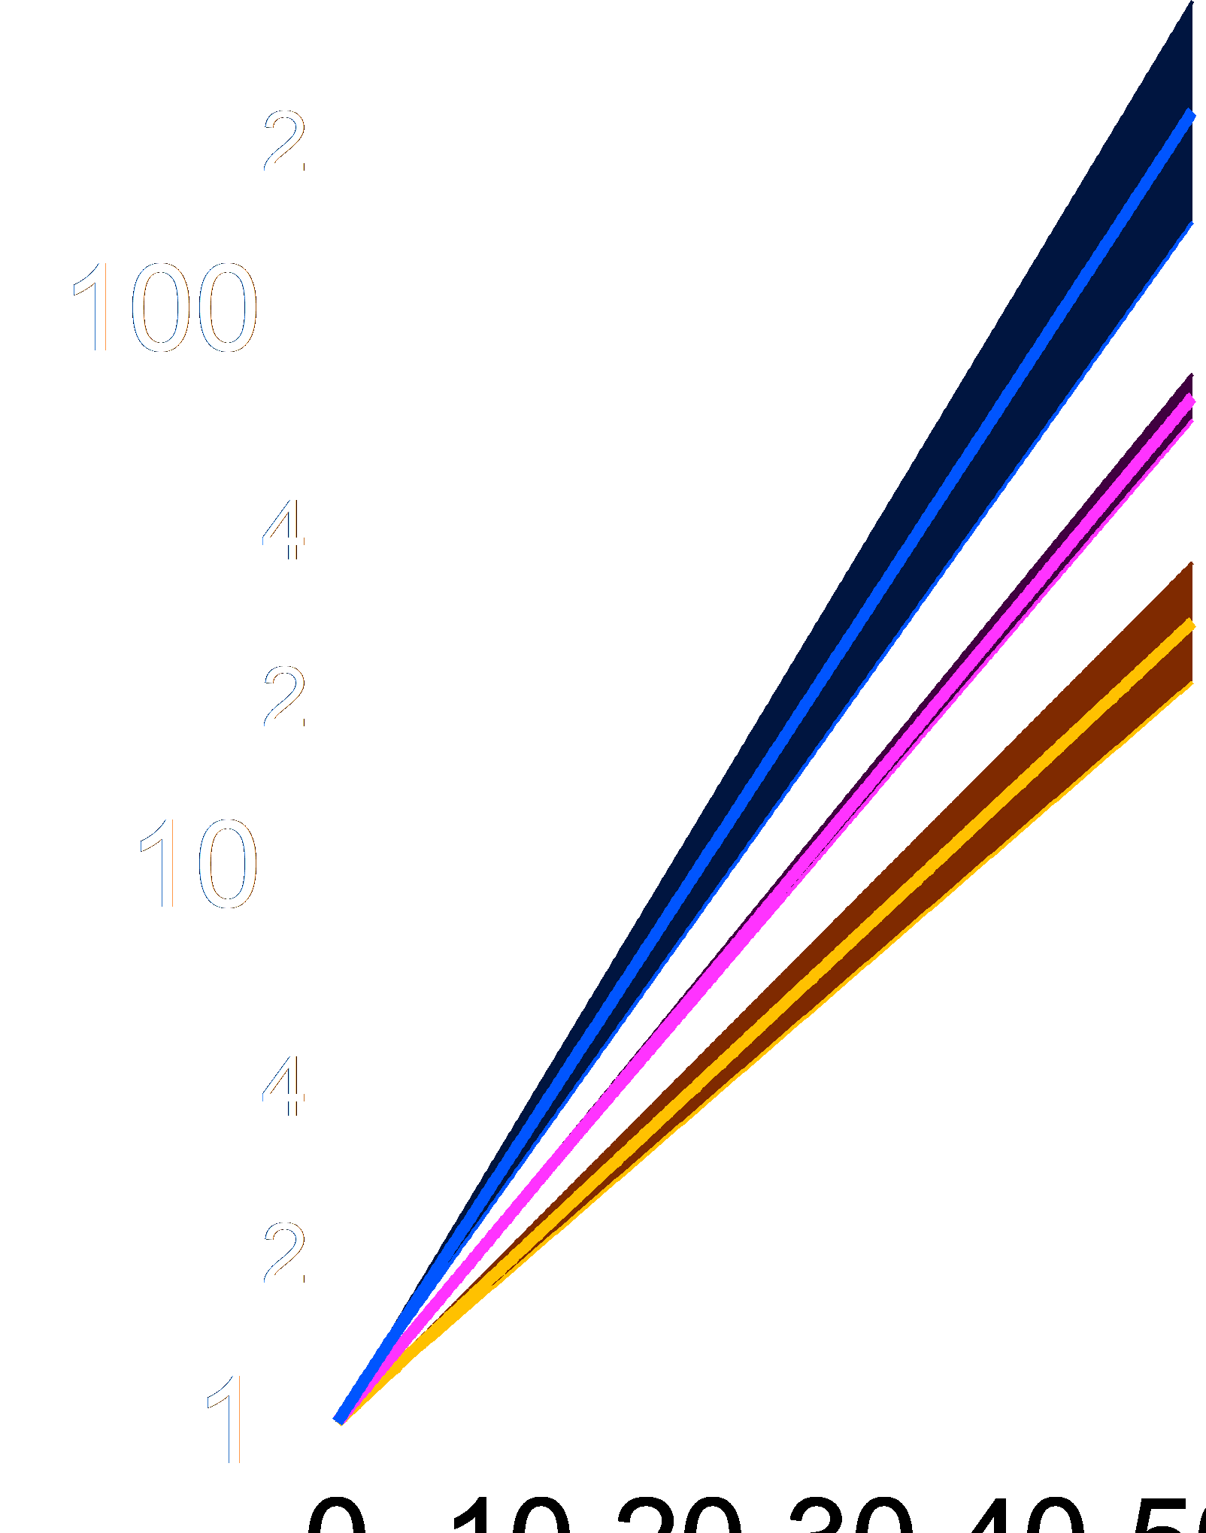
Selective enrichment
AMP (% enrichment):
AAs (% enrichment):
±10%
±4%
ΔT: 22K
top
bottom
Notes:
9

Slide 10
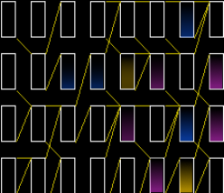
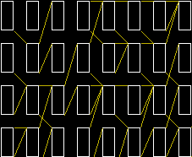
Networks
...
...

Slide 11
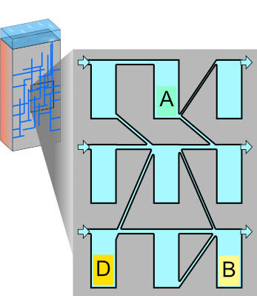
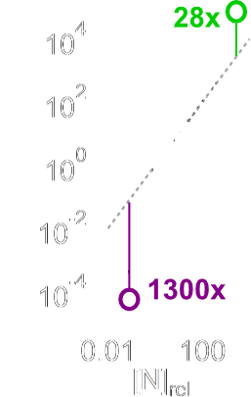
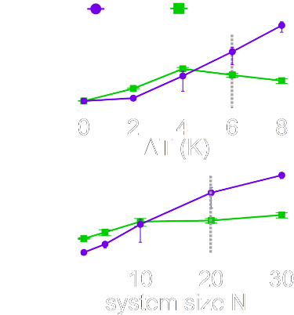
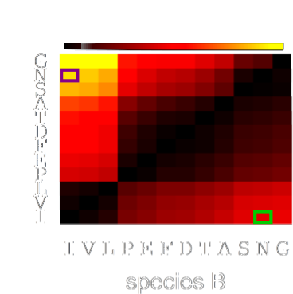
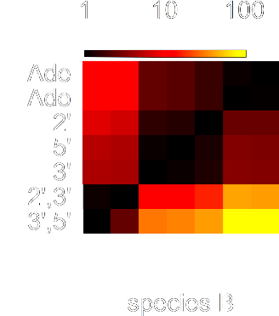
Networks (Model)

Slide 12
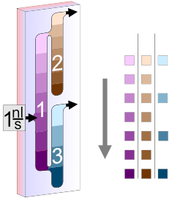
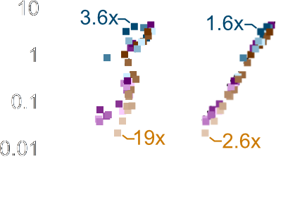
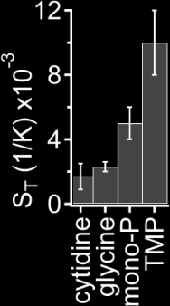
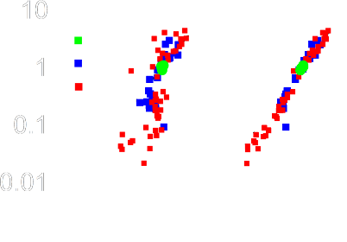
Networks (Experiment)
Notes:
When analyzing different prebiotic compounds, we realized that energy rich species such as TMP are massively favoured by thermal trapping.
12

Slide 13
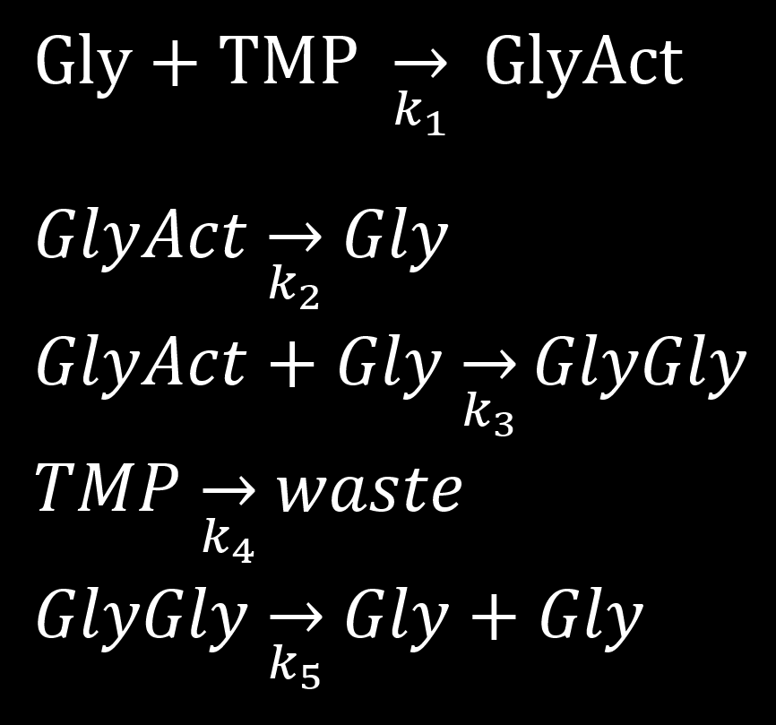
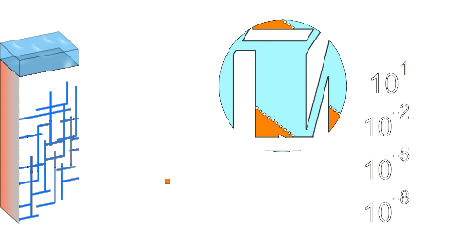
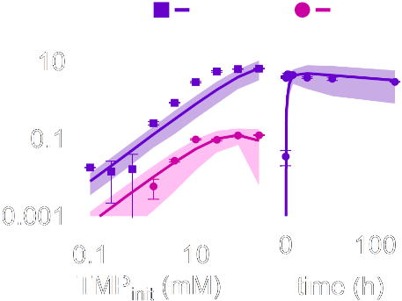
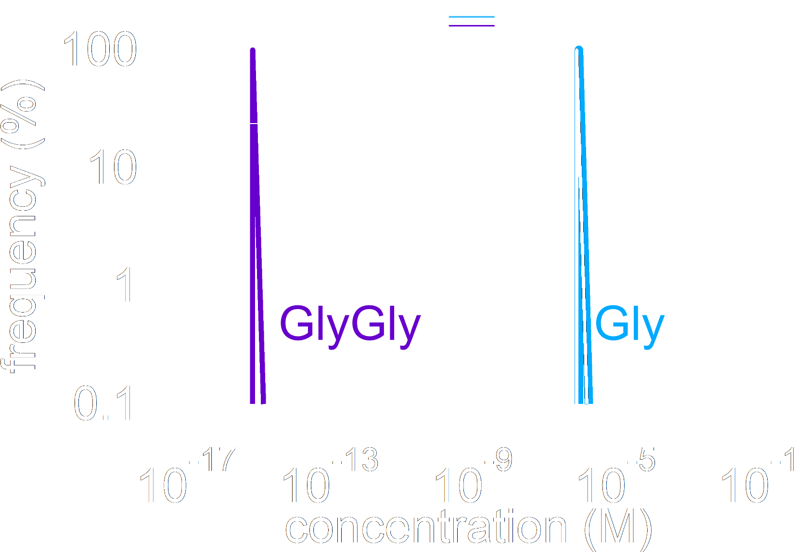
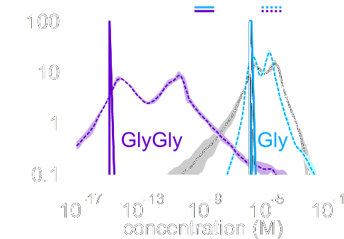
Boosting reactions
Network model:
Calibration @ equilibrium:
Notes:
insert reaction model

Slide 14
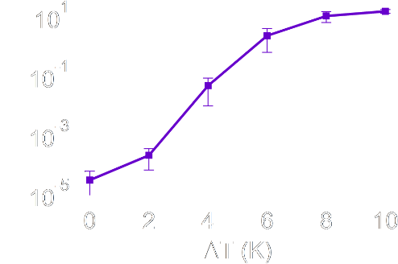
Boosting reactions
Network model:
Calibration @ equilibrium:

Slide 15
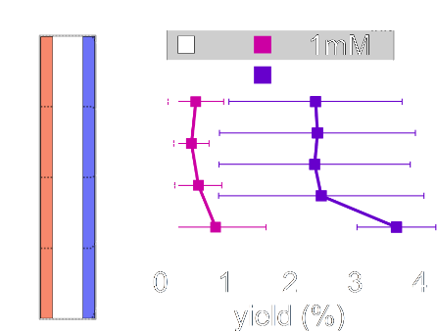
Boosting reactions
Network model:
Experiment in single chamber:

Slide 16
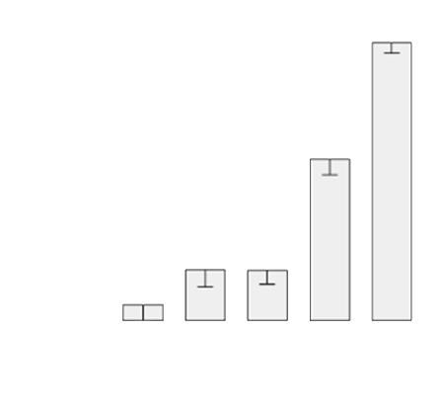
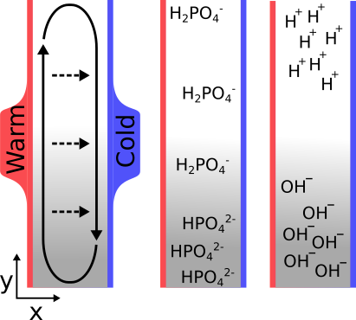
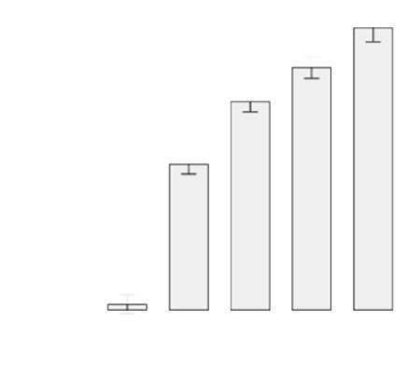
pH-control by heat flows
Keil, Möller, Kieß, Kudella, Mast* (2017). Nature Communications, 8(1).

Slide 17
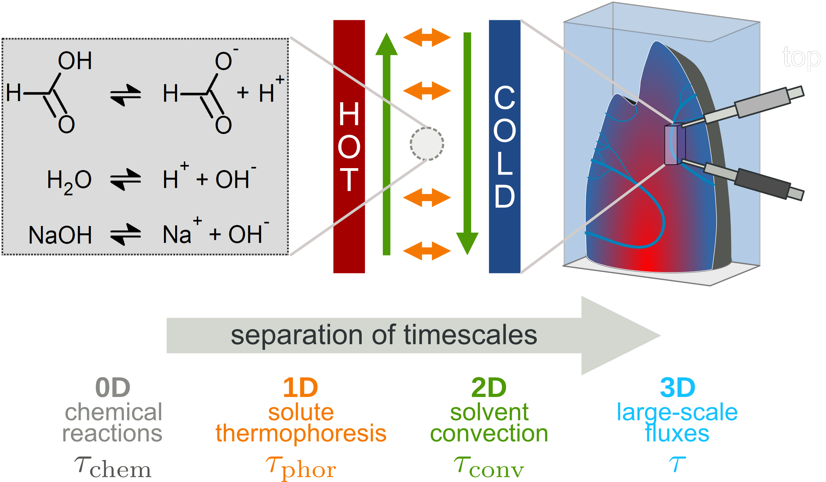
pH-control by heat flows
With Uli Gerland
Keil, Möller, Kieß, Kudella, Mast* (2017). Nature Communications, 8(1). Matreux, .. , Braun, Mast*, Gerland* (2023). Communications Physics, 6(1), 14.

Slide 18
pH-control by heat flows
Keil, Möller, Kieß, Kudella, Mast* (2017). Nature Communications, 8(1). Matreux, .. , Braun, Mast*, Gerland* (2023). Communications Physics, 6(1), 14.

Slide 19
pH-control by heat flows
pH meter
Outlook:
Ribozyme/pH cycling with „plausible“ solutions
physical buffering of reactions
Keil, Möller, Kieß, Kudella, Mast* (2017). Nature Communications, 8(1). Matreux, .. , Braun, Mast*, Gerland* (2023). Communications Physics, 6(1), 14.

Slide 20
Acknowledgments
Thanks to my students:
P. Aikkila, T. Matreux
Thanks to the Braun group:
C. Dirscherl, N. Y. Martin, A. Ianaselli, A. Salditt, P. Schwintek, M. Weingart, P. Aikkila, A. Schmid, A. Sehnem, J. Stein, A. Serrao, A. Salditt, S. Wunnava, J. Langlais, N. Hermis, A. Floroni, F. Dänekamp, D. Braun
Thanks to H. Mutschler (Dortmund)
Thanks to the Gerland group (TUM):
B. Altaner, J. Raith, U. Gerland
Thanks to: D. Dingwell, B. Scheu
CRC 235
Thanks for your attention

