Slide 1
Prebiotic replication of RNA by Ligation
Felix T. Dänekamp
10.06.2024
Advanced Methods for the Physics of Early Evolution

Slide 2
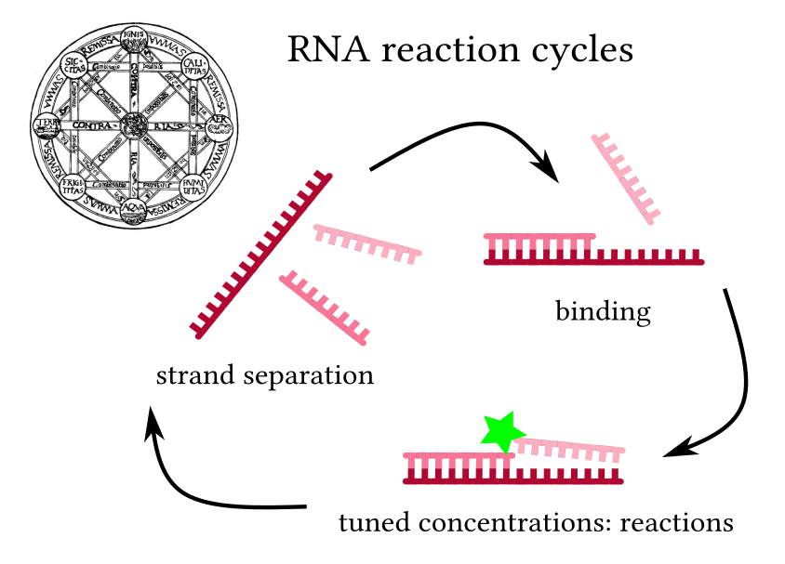
The environment enables the cycle
-> Recreate
The chemistry determines the efficiency
-> Optimize

Slide 3
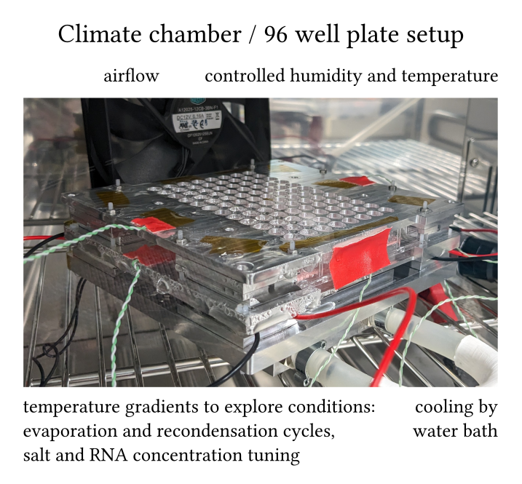
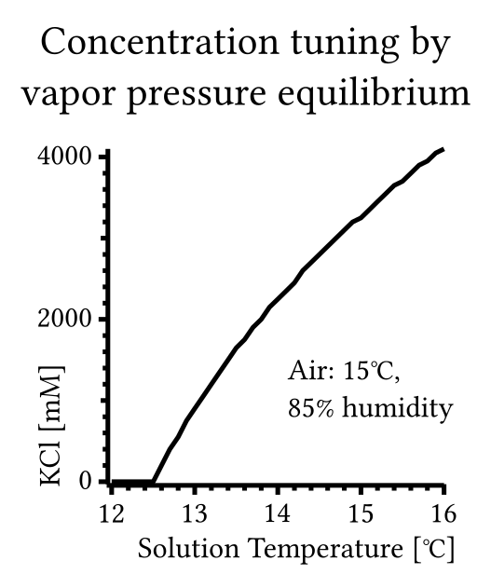
Tuning the concentrations

Slide 4
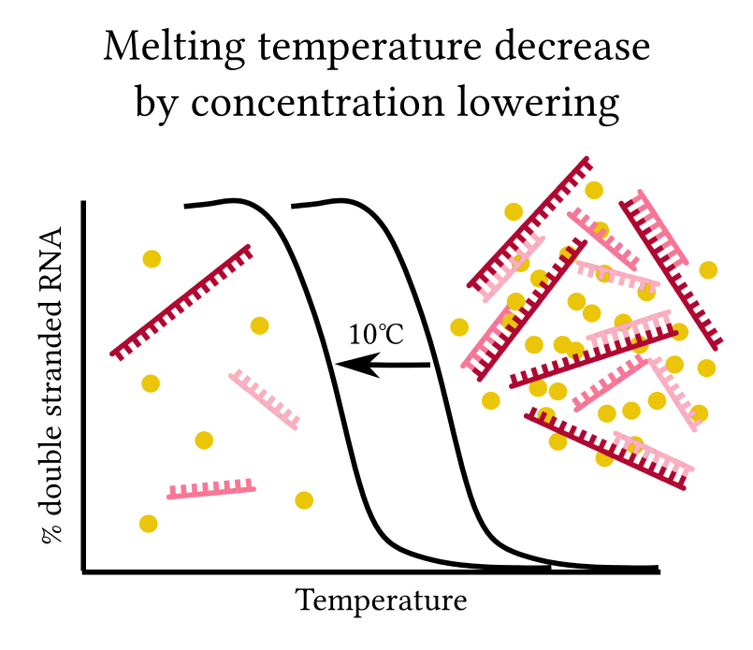
Strand separation:
temperature
RNA concentration
pH
salt concentration

Slide 5
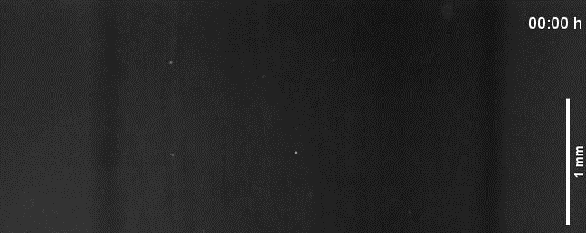
Strand accumulation and separation by acid rain in a thermal trap (PCR model, DNA)

Slide 6
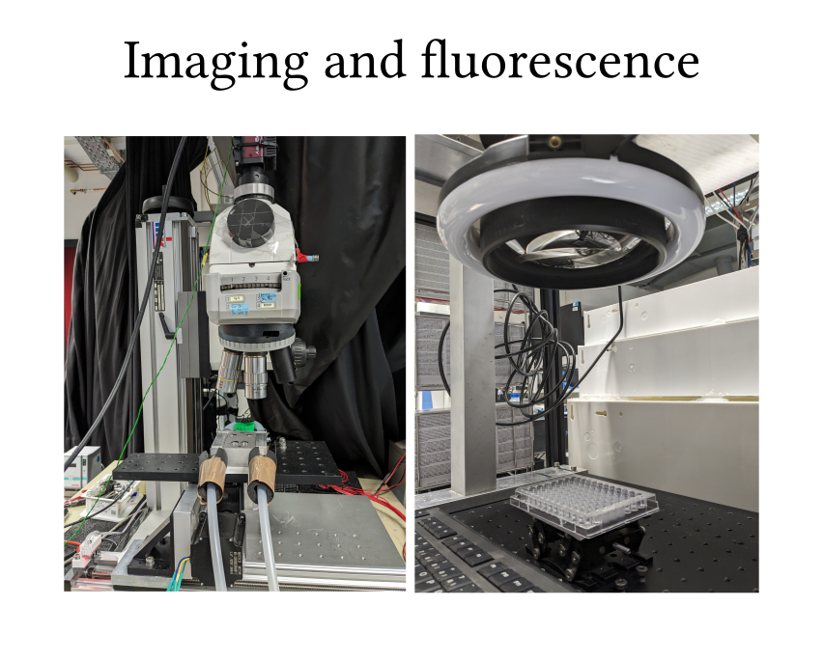
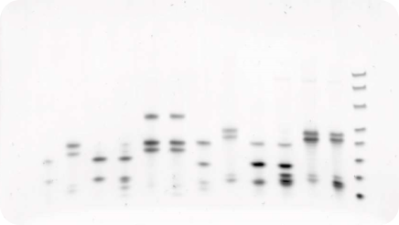
Analysis:
Microscopy
PAGE
HPLC / MS

Slide 7
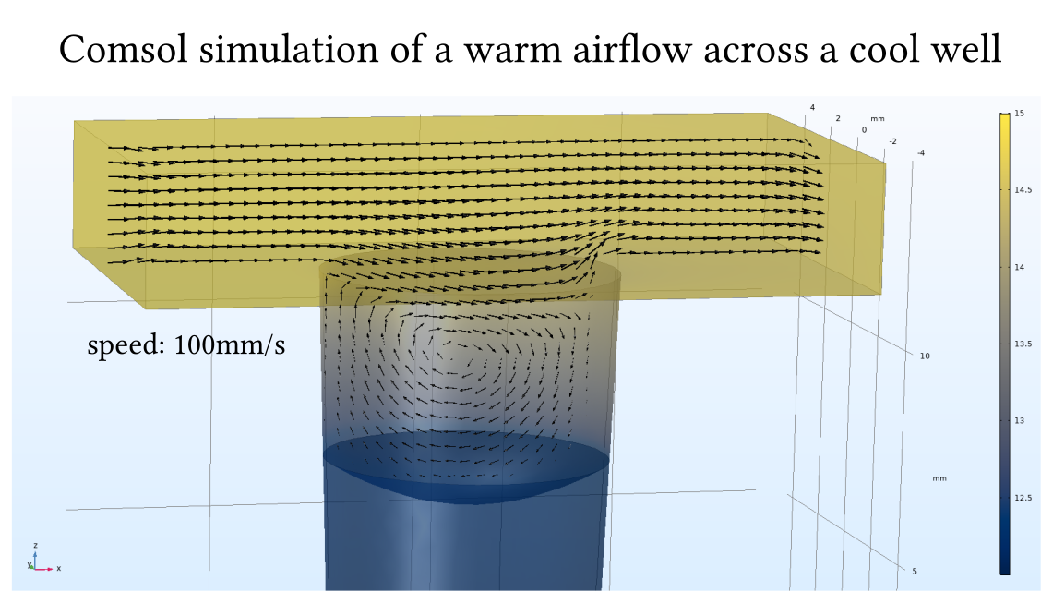

Slide 8
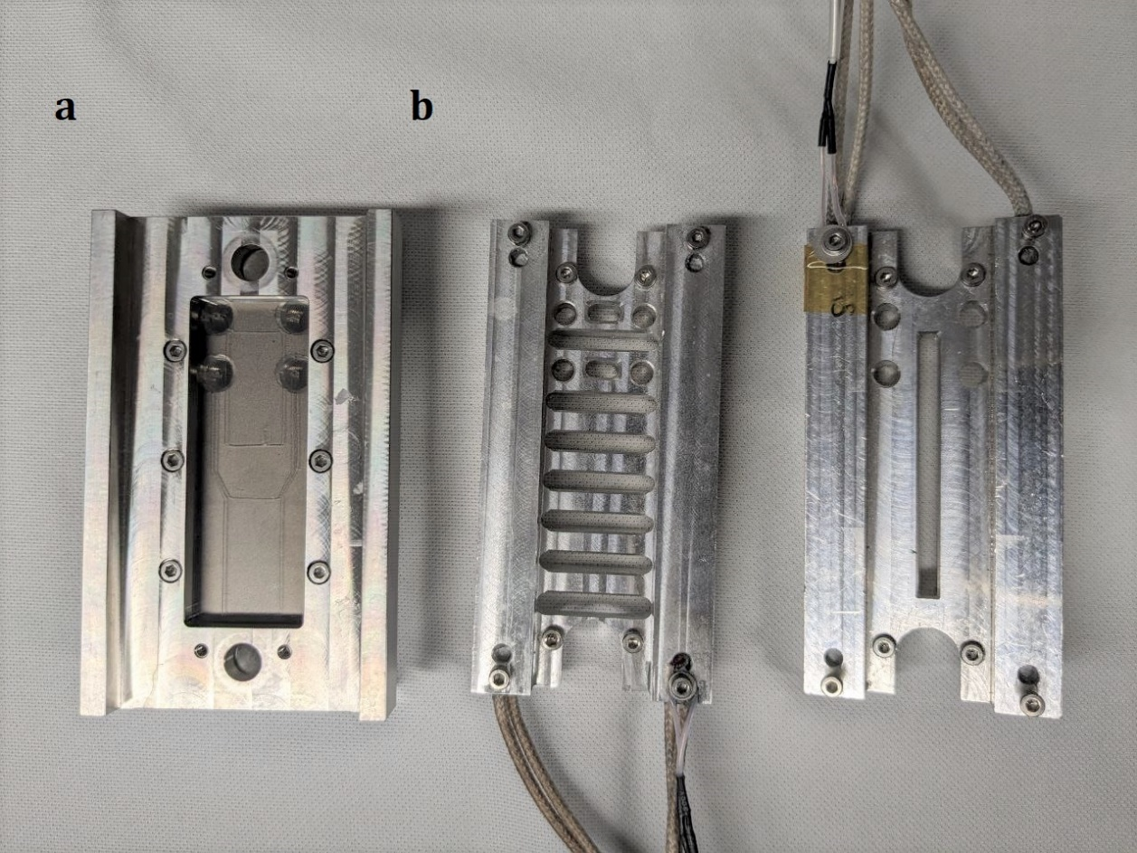
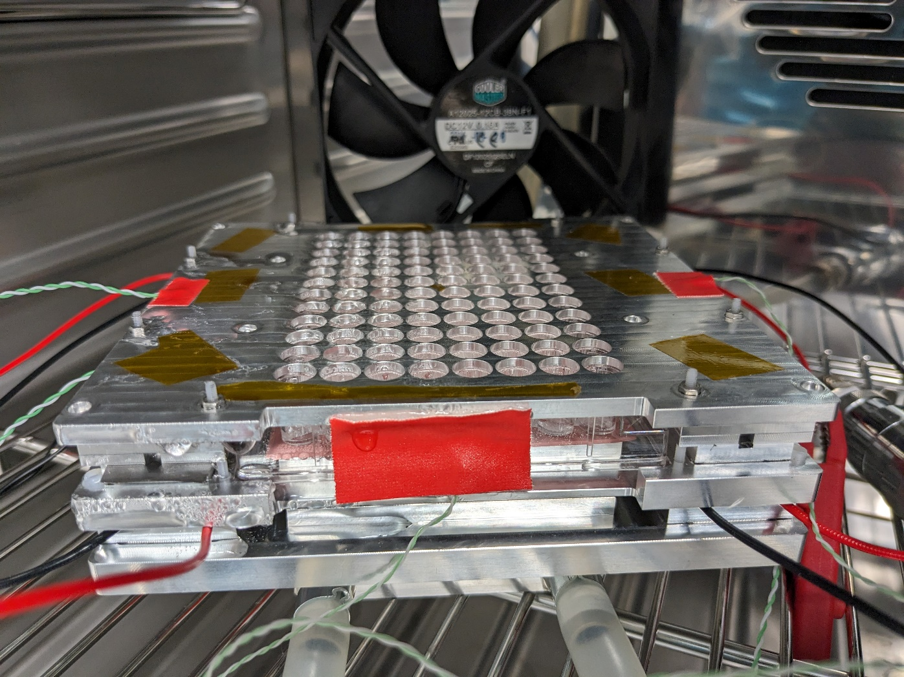
Thermal traps or wellplates?

Slide 9
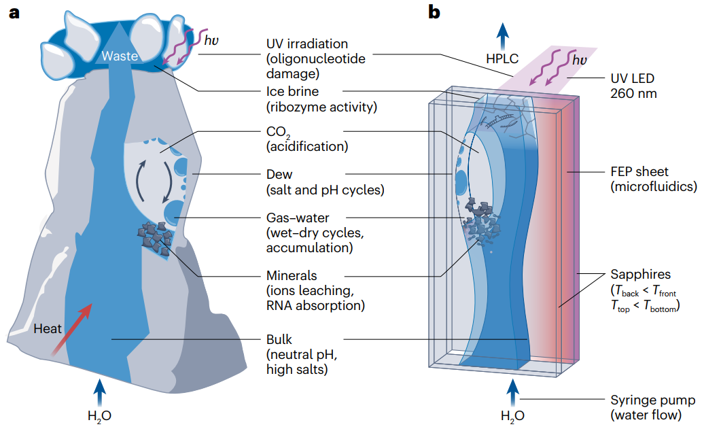
Ianeselli et al. 2023

Slide 10
