Slide 1
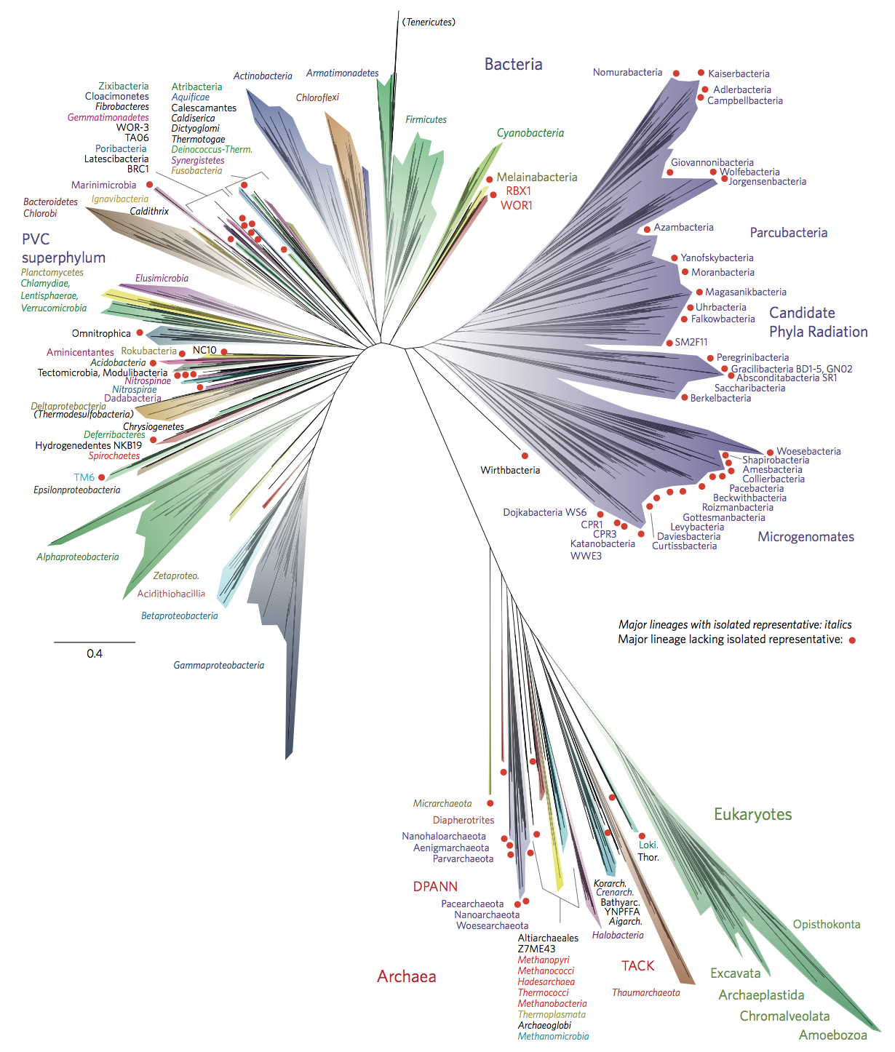
v
Finite element simulations in
Emergence of life
research

Slide 2
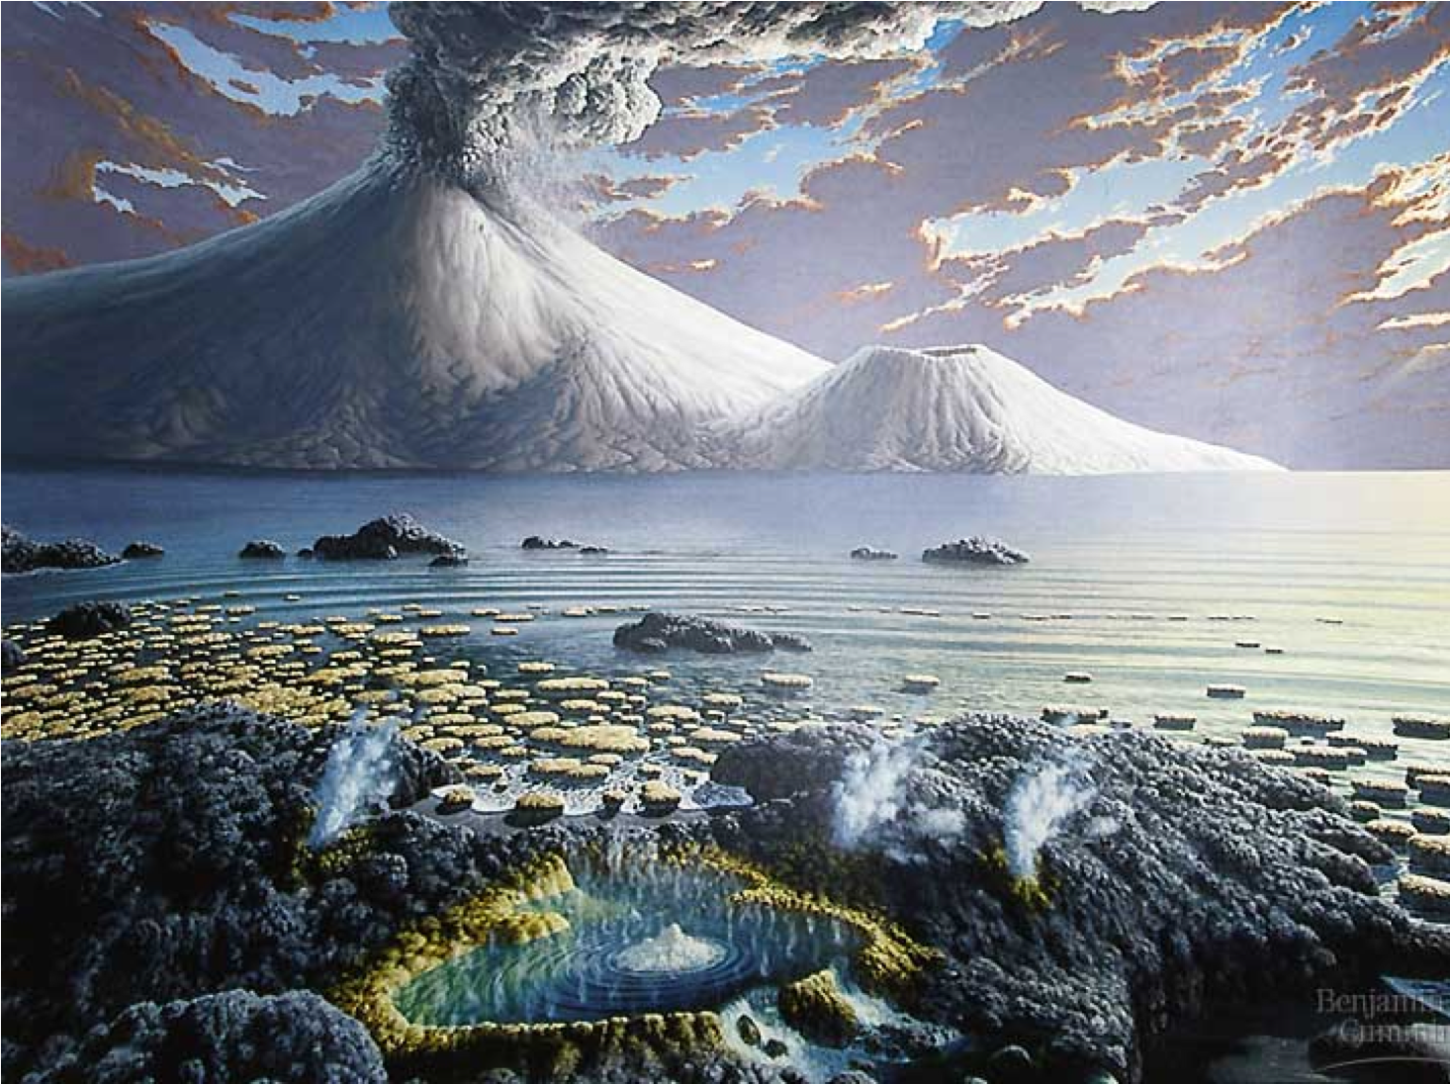
Emergence of life

Slide 3
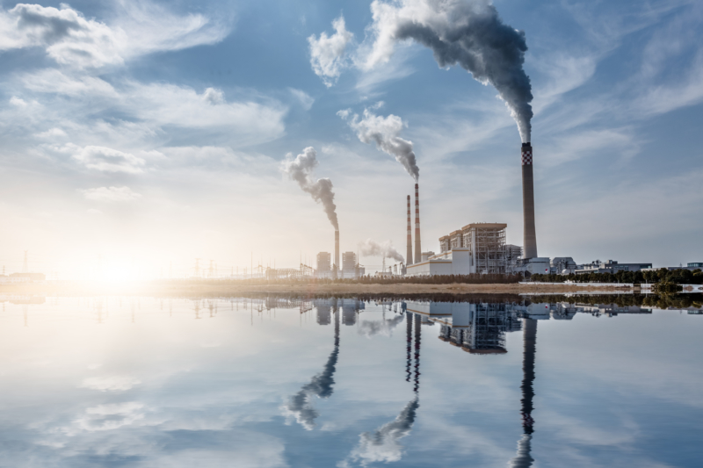

Slide 4
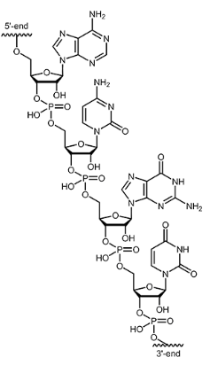
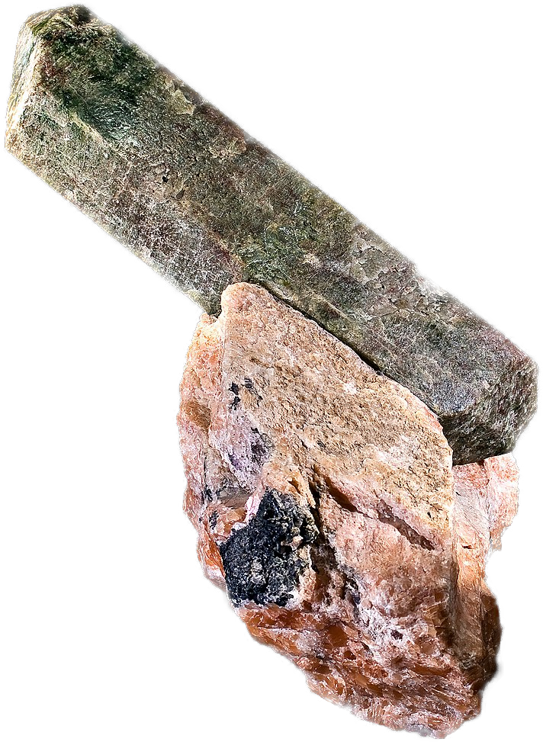
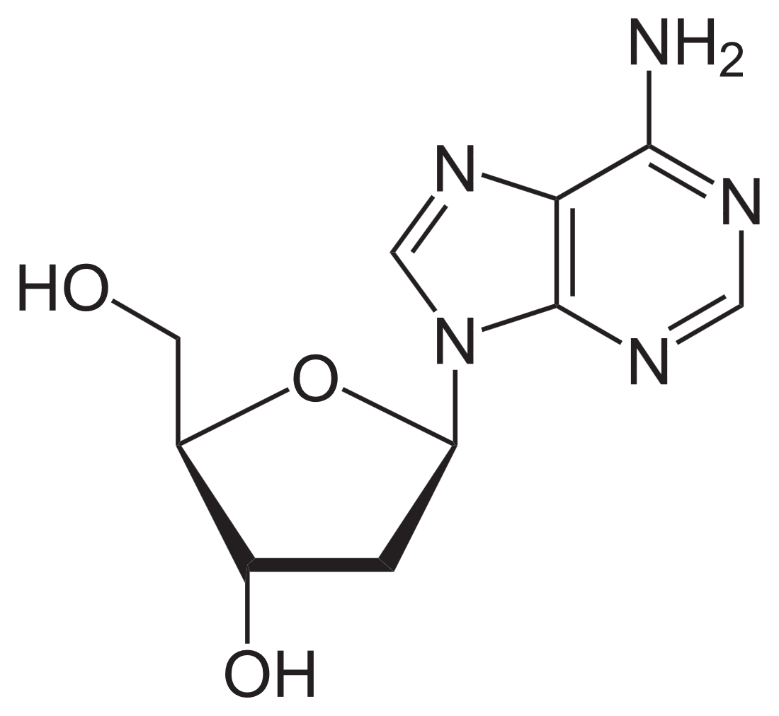
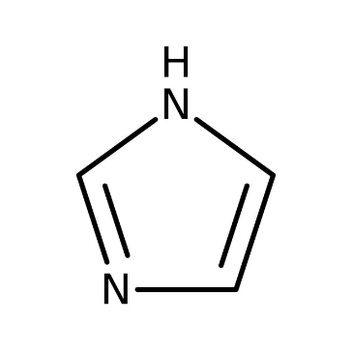
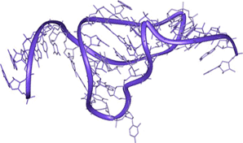
Prebiotic chemistry
time
4 GYa
Nucleotides
& fatty acids
RNA
mol. evolution
early life
Phosphor enrichment
Molecular
evolution
RNA
Nucleotides
e.g. Nucleoside
synthesis
Ribozymes
Phosphorylation
Activating
chemicals
Powner, Gerland, Sutherland, Nature vol 459, 239-242 (2009)
Notes:
Quick explanation why RNA -> molecular evolution
You need interacting strands!
Going through these steps is not like walking on a plane – its hard
Molecular evolution ->

Slide 5

It‘s hard!
time
4 GYa
Nucleotides
RNA
mol. evolution
early life

Slide 6
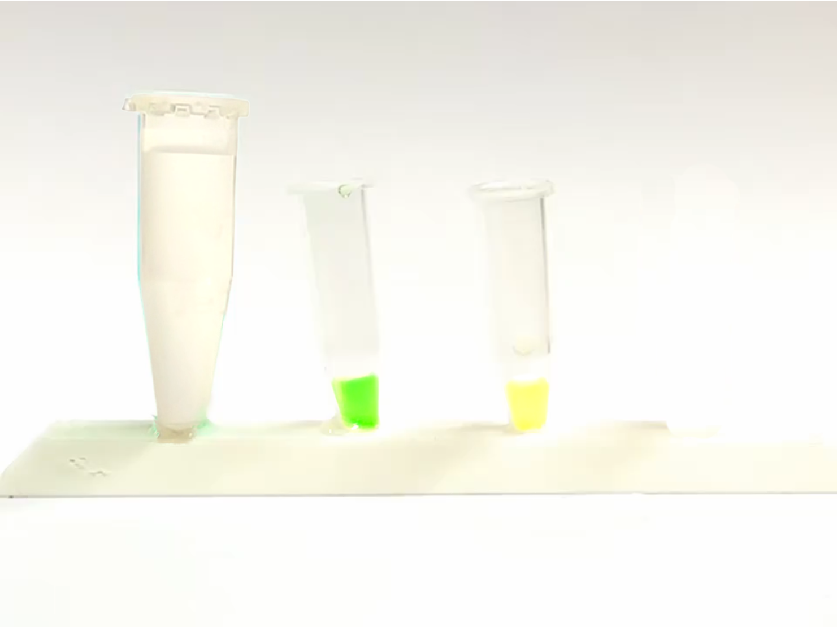
A
+
B
pH 7
pH 5

Slide 7
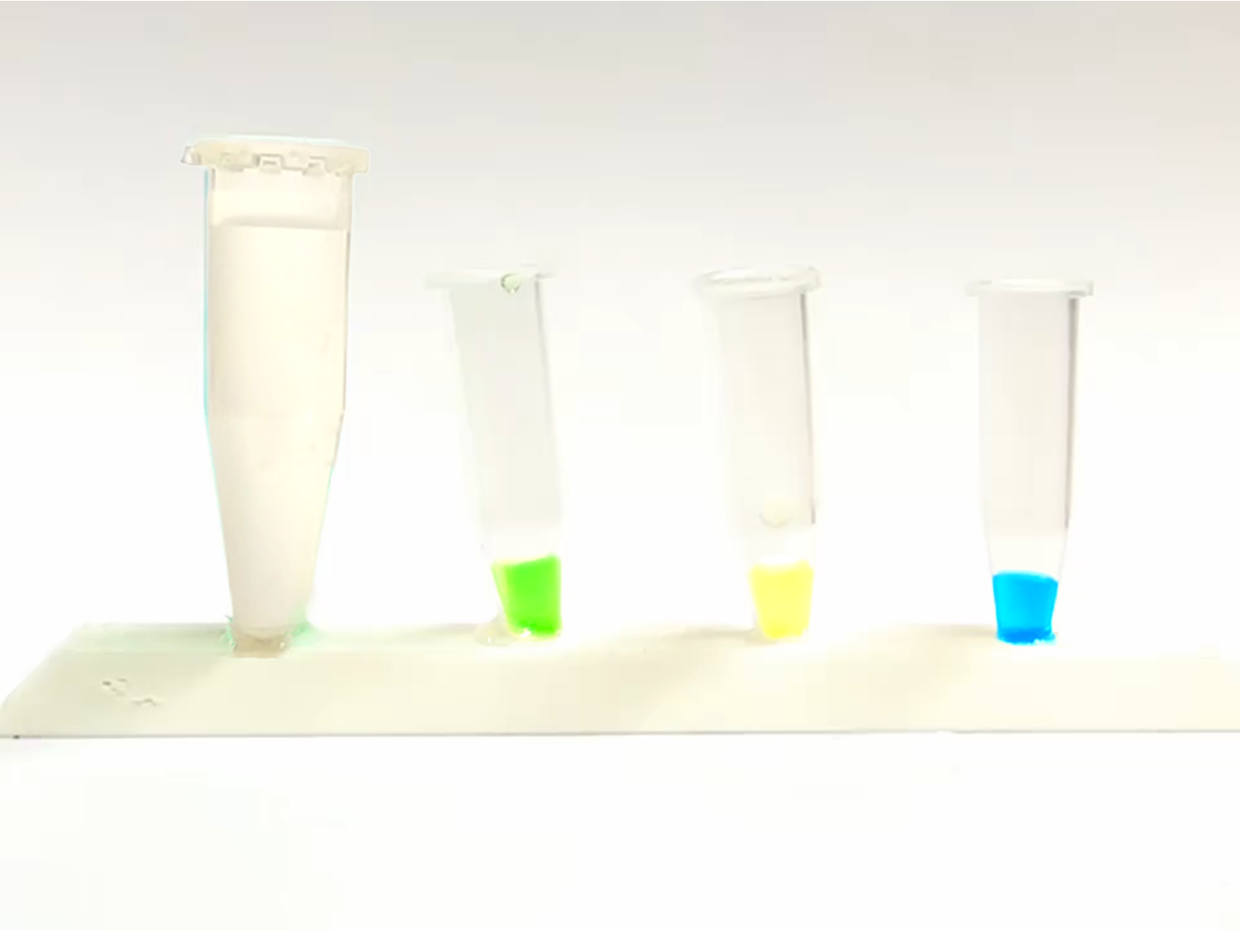
desired product
(high yield)
A
+
B
+
C
pH 7
pH 5
pH 2

Slide 8
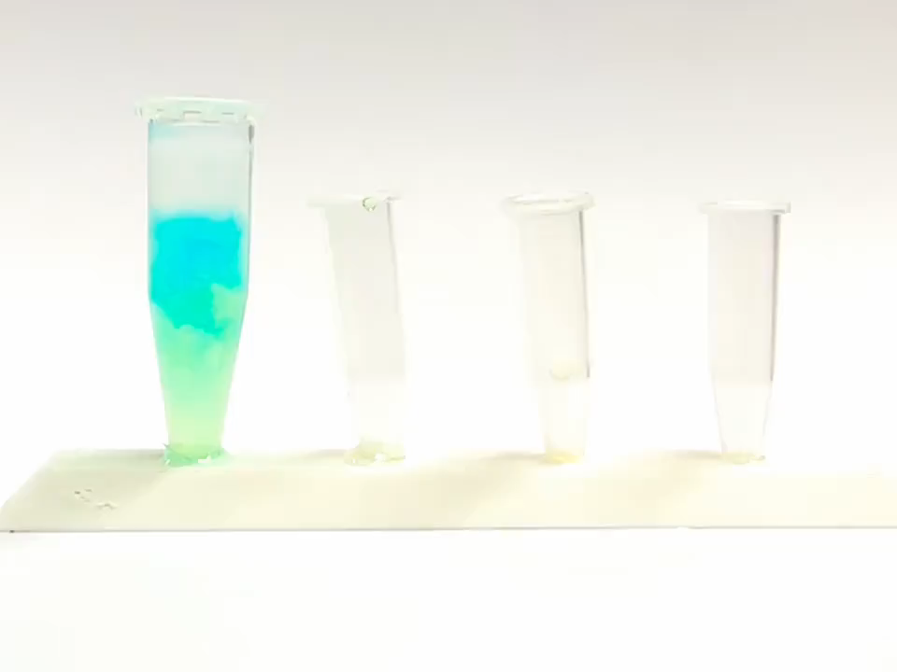
Nature:

Slide 9
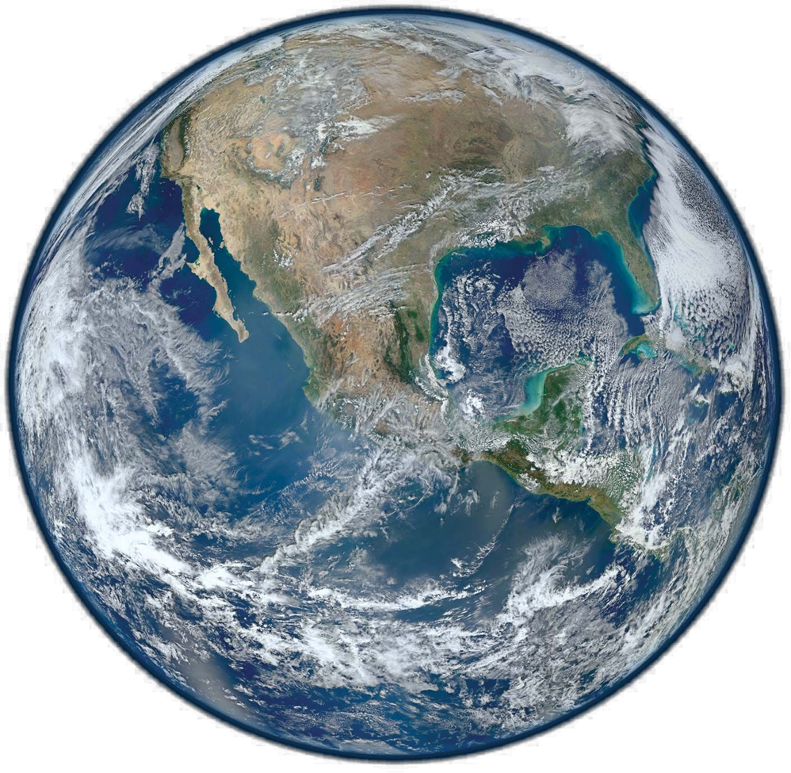
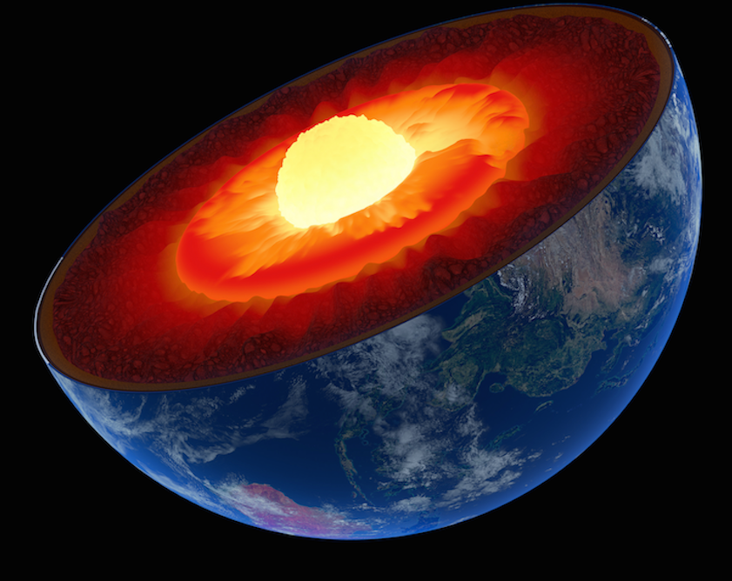
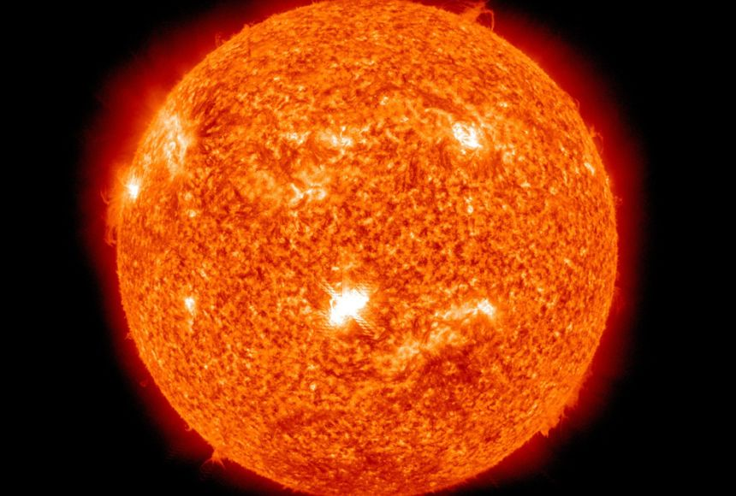
Non-equilibria are necessary!
Just right for life

Slide 10
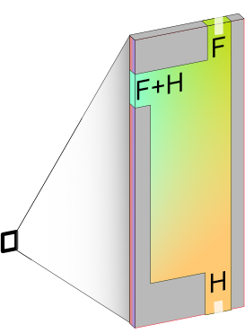
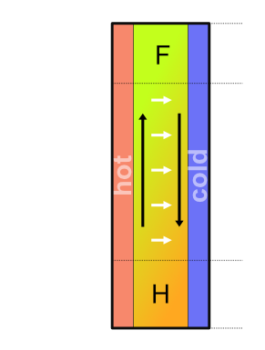
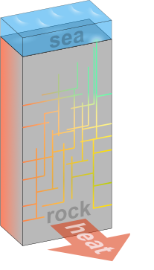
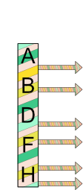
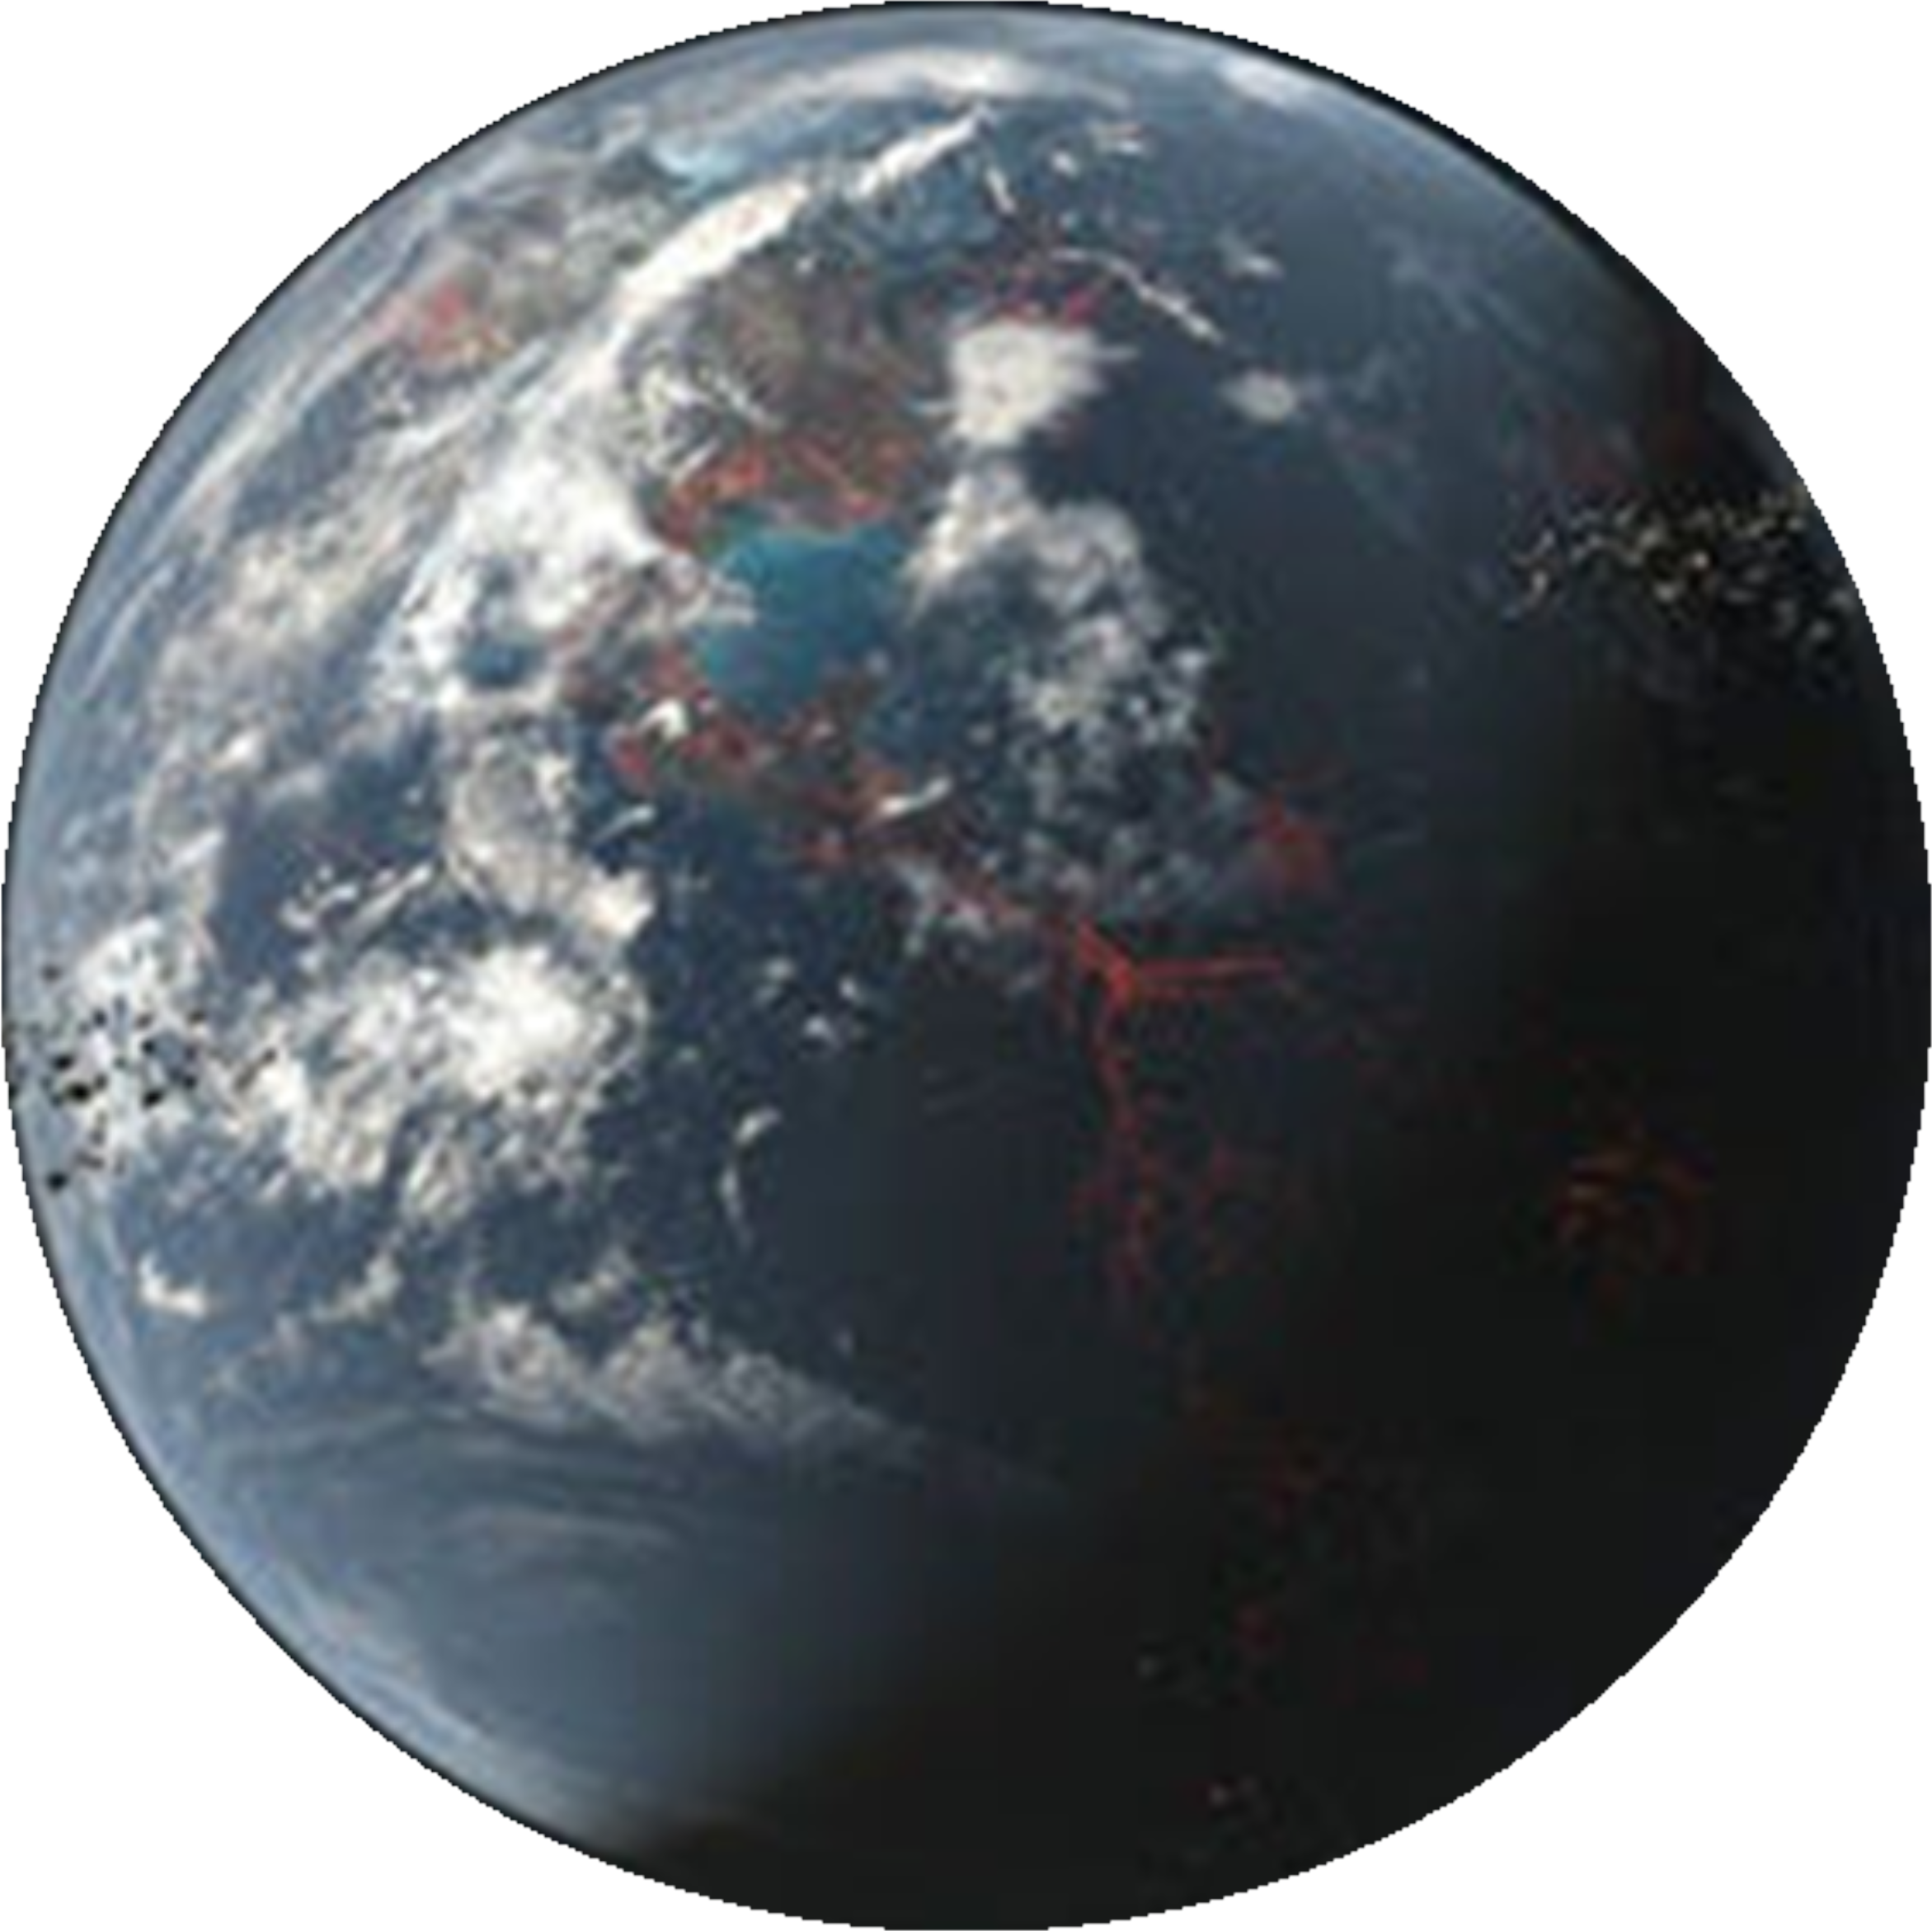


Heat flows help..
Matreux, LeVay, .., Scheu, Dingwell, Braun, Mutschler, Mast, Heat flows in rock cracks naturally optimize salt compositions for ribozymes, Nature Chemistry (2021)

Slide 11
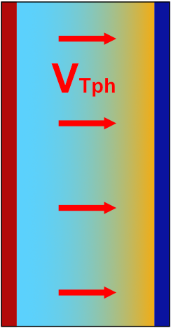


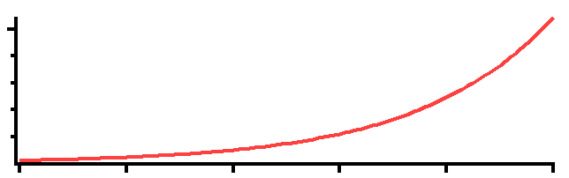
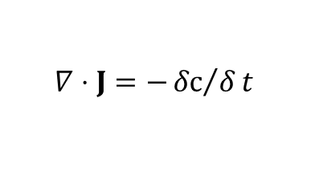










Thermophoresis: The „capacitor effect“
Continuity equation
$$∇⋅J=−{δc}/δt$$
$$J=J_{drift}+J_{díff}$$
Steady
state
$$c_{high}$$
$$J_{drift}=v_{Tph}⋅c$$
$$J_{diff}=−D⋅∇c$$
$$v_{Tph}≡{−D}_{T}⋅∇T$$
heat
$$∇⋅J=0$$
$$∇⋅\left(−D⋅∇c−D_{T}∇T⋅c\right)=0$$
$$concentration$$
No drift
$$=const.$$
$$\frac{∇c}{c}=−\frac{D_{T}}{D}≡S_{T} \sim {10}^{−2} to {10}^{−3}1/K$$
$$even: J=0$$
$$0$$
c
1.05x
x
$$\frac{c_{hot}}{c_{cold}}=exp⁡\left(−S_{T}⋅ΔT\right)$$

Slide 12
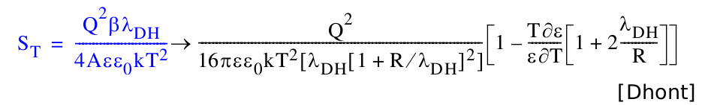
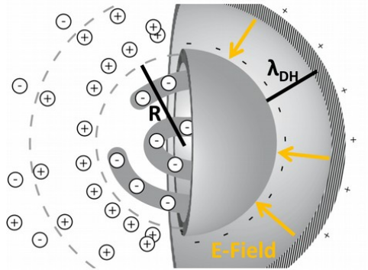
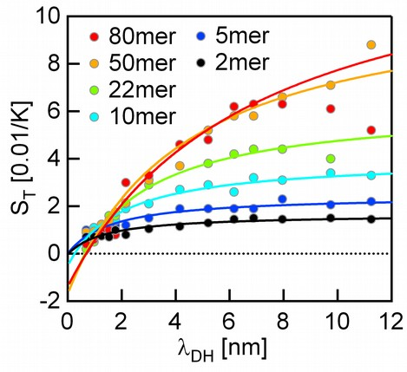
Thermophoresis: The „capacitor effect“
$$c_{high}$$
$$concentration$$
heat
$$0$$
c
1.05x
x
$$\frac{c_{hot}}{c_{cold}}=exp⁡\left(−S_{T}⋅ΔT\right)$$

Slide 13
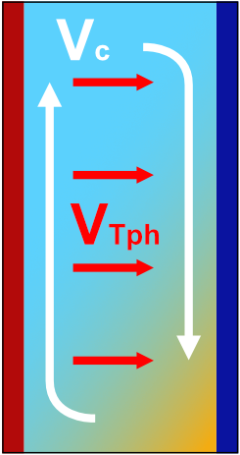

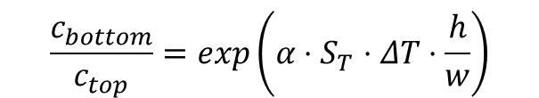
Enhance thermophoretic effect by convection
Thermophoresis only:
(no g, thin vessel, g same direction..)
Thermophoresis + convection:
[Debye 1939]
c
g
heat
heat
c
1.05x
h
1000x
x
$$\frac{c_{bottom}}{c_{top}}=exp\left(α⋅S_{T}⋅ΔT⋅\frac{h}{w}\right)$$
$$\frac{c_{hot}}{c_{cold}}=exp⁡\left(−S_{T}⋅ΔT\right)$$
Notes:
Also include convection! -> make this slide new for non-preqbiotic intro.
13

Slide 14
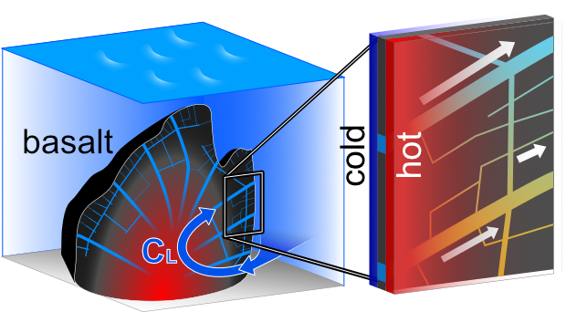
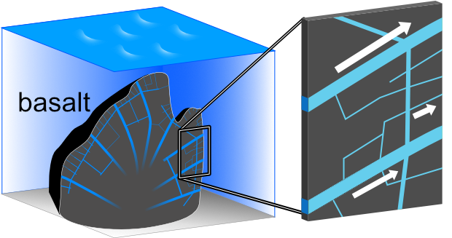
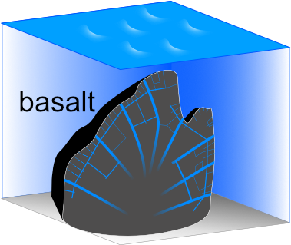

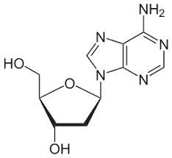
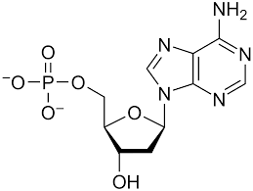
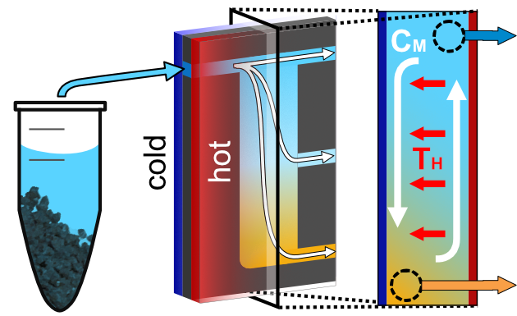
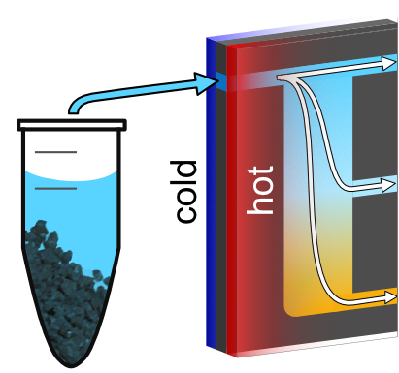
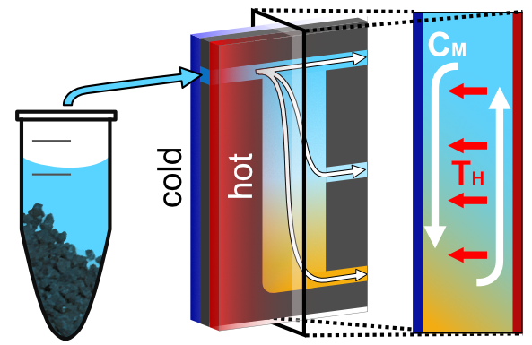
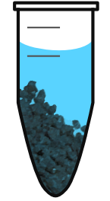
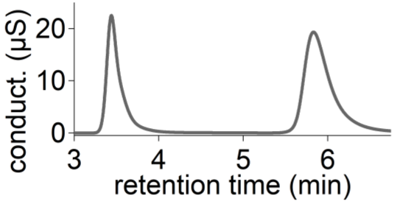
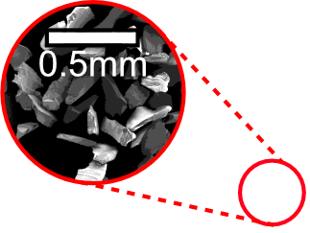
Scenario
Basalt:
Ribozyme
function
$$\frac{\left[Mg^{2+}\right]}{\left[Na^{+}\right]}=1 to 100$$
$$\frac{\left[Mg^{2+}\right]}{\left[Na^{+}\right]}=0.001 to 0.1$$
apatite
Apatite @pH2:
$$\frac{6\left[PO_{4}\right]}{10\left[Ca^{2+}\right]}\sim 1$$
$$\frac{6\left[PO_{4}\right]}{10\left[Ca^{2+}\right]}>10$$
Experiment
Ion chromatography:

Slide 15
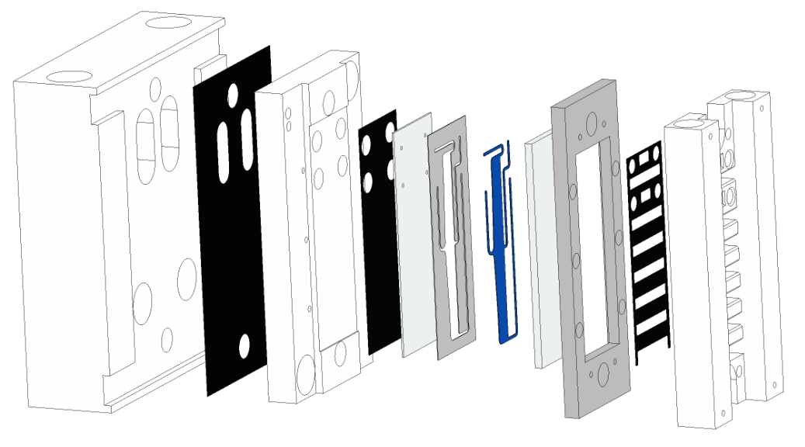
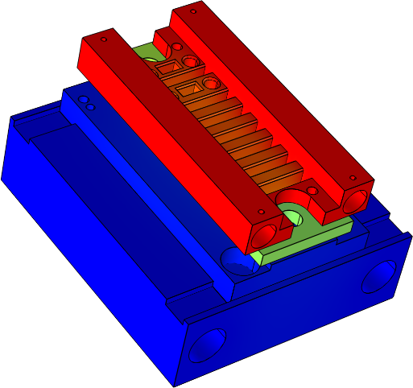
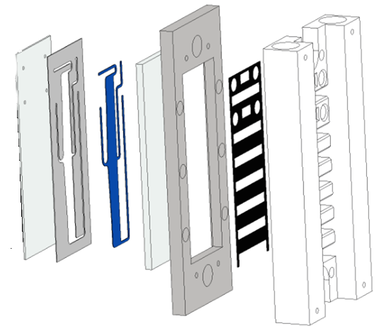
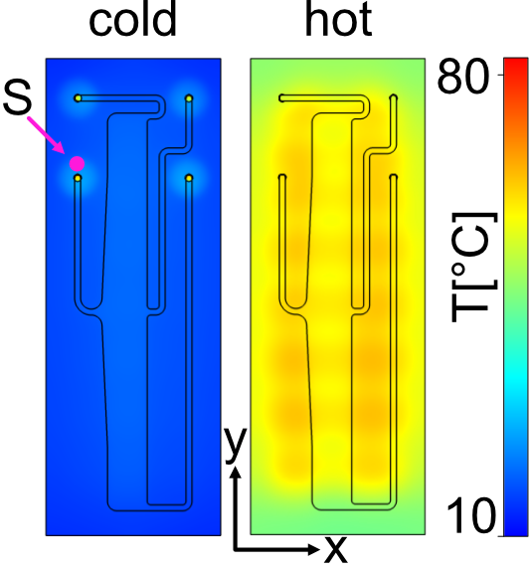
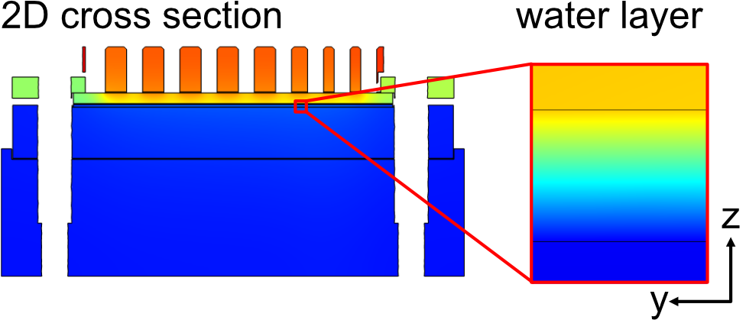
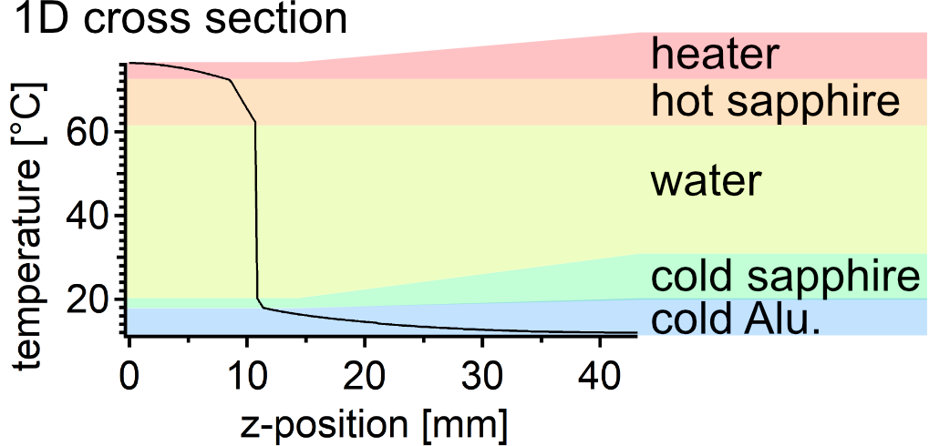
Thermal setup

Slide 16
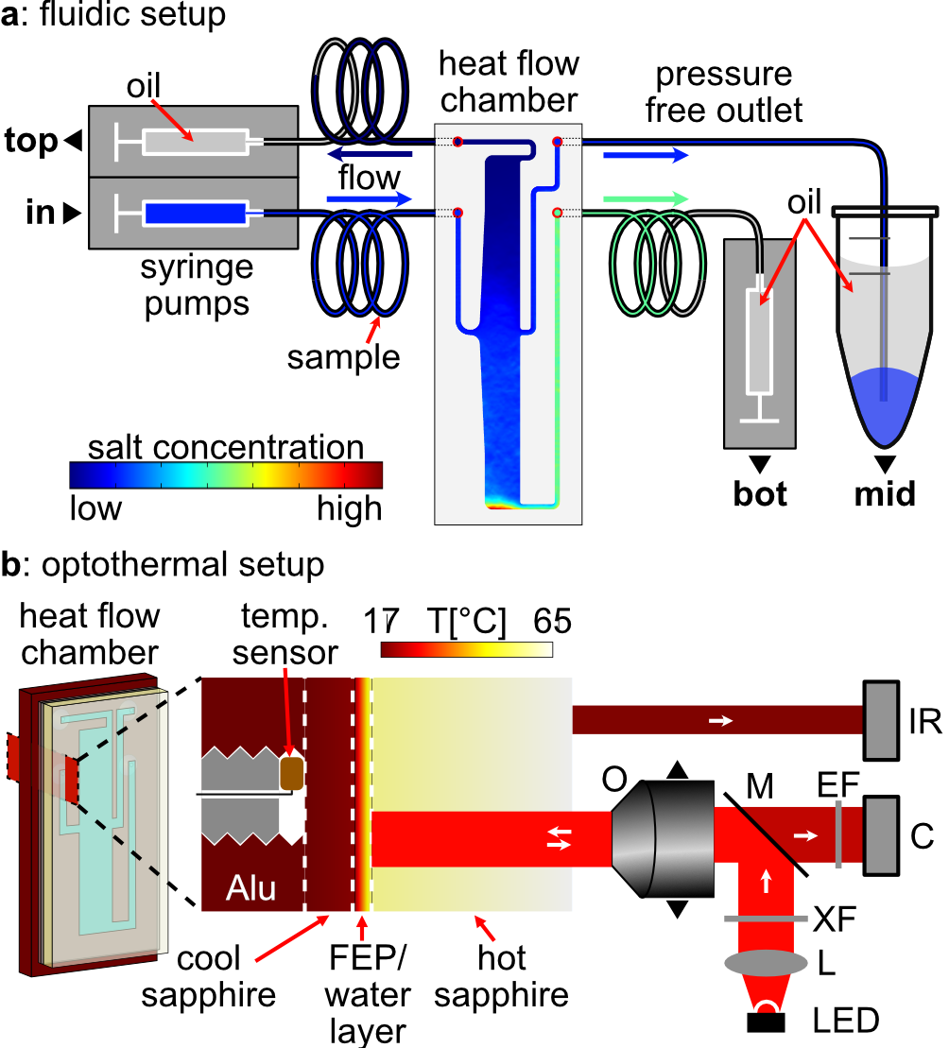
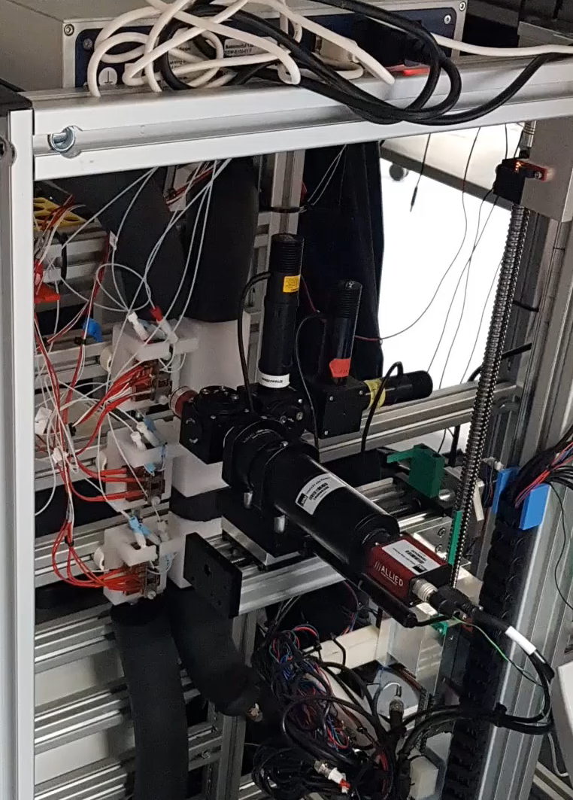
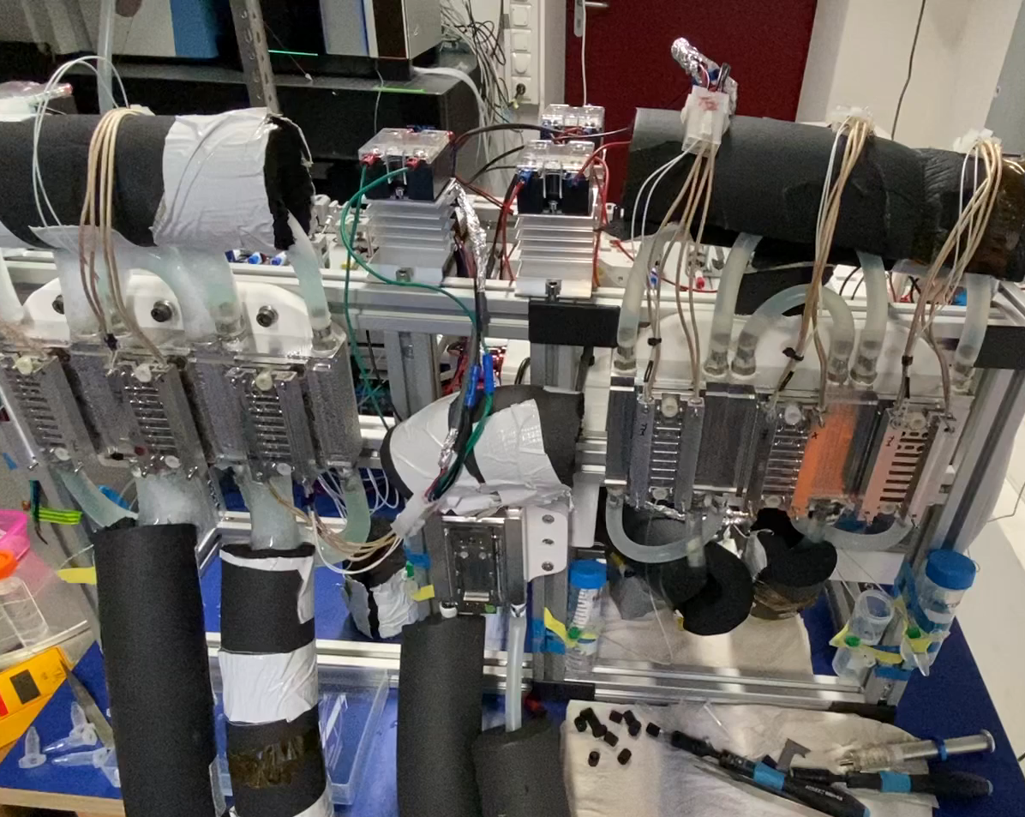
Microfluidic & optical setup

Slide 17
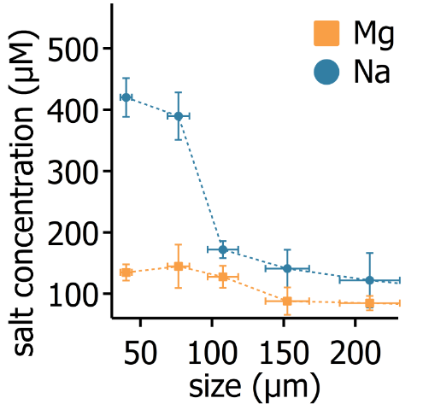
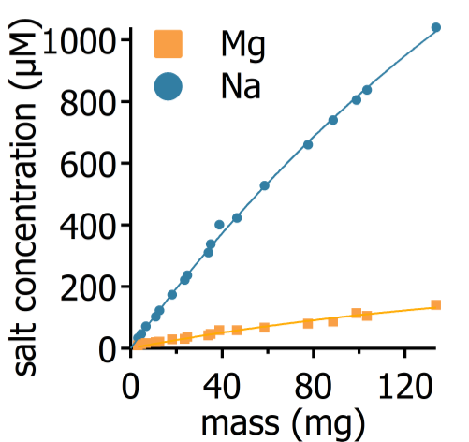
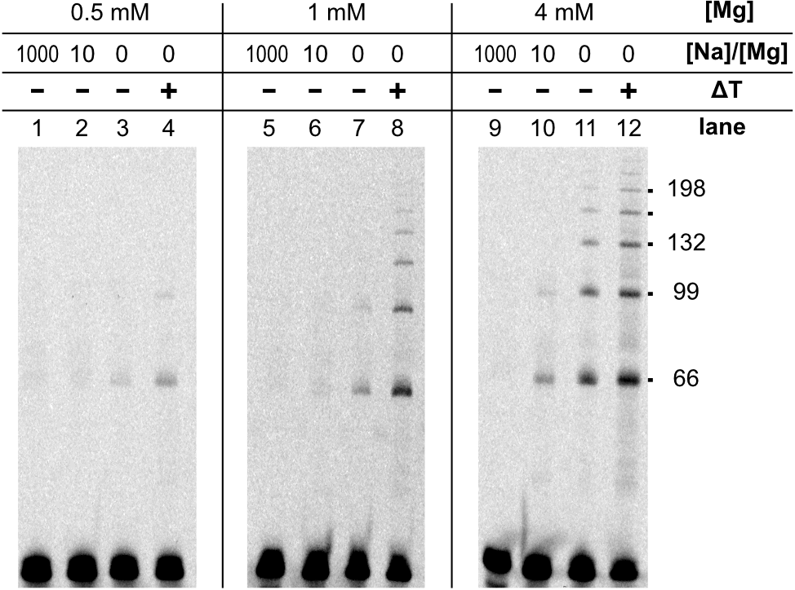


Results: Heat flows boost Mg/Na
Leaching only:
Ribozyme function:
Matreux, LeVay, .., Scheu, Dingwell, Braun, Mutschler, Mast, Heat flows in rock cracks naturally optimize salt compositions for ribozymes, Nature Chemistry (2021)

Slide 18




Results: Heat flows boost Mg/Na
Cascade of thermal traps:
Ribozyme function in the trap:
Matreux, LeVay, .., Scheu, Dingwell, Braun, Mutschler, Mast, Heat flows in rock cracks naturally optimize salt compositions for ribozymes, Nature Chemistry (2021)

Slide 19


Results: Heat flows boost Mg/Na
Cascade of thermal traps:
Ribozyme function in the trap:
Matreux, LeVay, .., Scheu, Dingwell, Braun, Mutschler, Mast, Heat flows in rock cracks naturally optimize salt compositions for ribozymes, Nature Chemistry (2021)

Slide 20






Apatite as phosphorous source?

Slide 21

Apatite as phosphorous source?

Slide 22

Apatite as phosphorous source?

Slide 23



Demixing complex soups
2. ..to enrich compounds from complex mixtures
Thermophoresis measurement
low volume
low conc.
no label
multiple compounds
HPLC

Slide 24









Thermophoretic parameters
The origins of life..
2‘-CMP
position
3‘-CMP
5‘-CMP
Make it vertical
2‘3‘-AMP
2‘3‘-GMP
2‘3‘-UMP
And many more:
Bases: A,G,C,G,U
P: 2‘-, 3‘-, 5‘-, 2‘3‘-, 3‘5‘-
Solvent: water, formamide
pH: 3 – 11
AAs: His, Asn, Ser, Gln, Arg, Asp, Glu, Thr, Ala, Pro, Cys, Lys, Tyr, Arg, Val, Ile, Leu, Phe
2-AO, 2-AT, 2-AI
Adenine
Cytosine
Guanine

Slide 25






Selective concentration
AMP (% enrichment):
AAs (% enrichment):
±10%
±4%
ΔT: 22K
top
bottom
Notes:
25

Slide 26





Networks (Model)

Slide 27




Networks (Experiment)
Notes:
When analyzing different prebiotic compounds, we realized that energy rich species such as TMP are massively favoured by thermal trapping.
27

Slide 28






Boosting reactions
Network model:
Calibration @ equilibrium:
Notes:
insert reaction model

Slide 29

Boosting reactions
Network model:
Calibration @ equilibrium:

Slide 30

Boosting reactions
Network model:
Experiment in single chamber:

Slide 31

At July 19th-20th, the Molecular Origins of Life Munich conference addresses one of the most fundamental questions of science: How could life originate?
With 24 talks by renowned scientists accompanied by panel discussions and poster sessions, this international conference brings together scientists from a wide range of disciplines, namely: astronomy, bio-/chemistry, bio-/physics, geosciences and theoretical chemistry and physics.
Website: www.lmu.de/mom2024

Slide 32

How to do these simulations?
Trial available via www.comsol.com/contact
If you are interested -> contact me f. 1 month classroom licences.
Permanent licences ~ 5k - 10k€
Interface with 3D cad tools (e.g. Inventor)

Slide 33

Step 0: Check out the user interface

Slide 34

Step 0: Check out the user interface
Commands (top), Tree (left), Settings (mid), Viewport (right), Progress/Notes (bottom)
make advanced sections visible -> important f. advanced physics (f. conservative form), equation view
Show help

Slide 35
Step 1: Define the geometry (2D, 3D, symmetries)
Create component
Always use lowest dimension size / highest symmetry possible.
Create 2D geometry with simple entities
  Different shapes
  Precise control
  Domains, Edges, Points
Geometric operations on geometry:
  Transforms: Array, copy, mirror, move, rotate, scale
  Boolean ops: Union, intersect, difference, compose
Create 2nd file for 3D example:
Create 3D geometry
  Same operations -> it gets tedious
Better: work with workplanes -> 3D operations (extrude etc.)
External CAD tools -> Inventor (free for University/students)
  Load full chamber f. heat flow sim (later continue with 2D due to speed) via live-links
  Upon import -> select repair-options

Slide 36











Step 2: Determine the necessary physics
1. Heat transport
2. Fluid motion
$$∇⋅q=−\frac{ρC_{p}∂T}{∂t}+Q$$
$$∇⋅\left(ρu\right)=−\frac{∂ρ}{∂t}$$
$$q≡−k∇T \\ Q≡heat source$$
$$\frac{ρ∂u}{∂t}⋅ρ\left(u⋅∇\right)u=∇⋅\left[−pI+τ\right]+F$$
Accel., convection
Hydrostatics, tension, ext force
3. Motion of dilute species
4. Reactions of species
$$∇⋅J=−{δc}/δt$$
$$J_{diff}=−D⋅∇c$$
$$∇⋅J=−{δc}/δt−Q_{R} \\ Q_{R} ≡source term$$
$$J_{drift}=v_{NS}⋅c+D_{T}∇T⋅c$$
e.g.
$$J=J_{diff}+J_{drift}$$
$$\frac{∂c_{2}}{∂t}=c_{1}^{2}⋅k_{on}−c_{2}⋅k_{off}=Q_{R,1}$$
$$\frac{∂c_{1}}{∂t}=−c_{1}^{2}⋅k_{on}+c_{2}⋅k_{off}=Q_{R,2}$$
lets add them stepwise – start with heat transport

Slide 37
Step 3: Material, boundary & initial conditions
Add blank materials:
PTFE:
0.27 W/mK
2200 kg/m^3
960 J/(kg*K )
Sapphire:
40 W/mK
4000 kg/m^3
750 J/(kg*K )
Assign material groups from inventor
Add „Heat transfer in solids“ -> add material properties
Set boundary temperatures (in experiment: defined by PID electronics)
Use parameters -> prevent „magic numbers“
units added in brackets: e.g. [m^2], also non-UI units possible.
Duplicate boundary cond-nodes to save time
Mesh-error -> make finer mesh

Slide 38
Step 4: Set solution type
Steady state for heat transfer
Parametric sweep f. multiple runs

Slide 39
Step 5: Analyse results
Temperature
3D surface
3D Slices
Data-set -> Cut-planes, cut-lines
Heat flux:
Arrow-volume
Isosurface -> multiple, or 1 (with slider)

Slide 40

Improving the mesh
Rule: Reduce number of elements as much as possible to maintain the projected precision.

Slide 41

Improving the mesh
set in component -> „shape order“ & discretization node in physics nodes
Notes:
Comsol always uses 2nd order elements by default

Slide 42



Element order - visualization
Example: 1D solution
this is the „correct“ result
Better: same order, but more elements & not uniform
Bad: low number, low order
Notes:
Comsol always uses 2nd order elements by default

Slide 43

Element order - visualization
Example: 1D solution
this is the „correct“ result
Even better: higher order, very low number of
Notes:
Comsol always uses 2nd order elements by default, except NS bc of stabilization.

Slide 44

Notes:
Comsol always uses 2nd order elements by default, except NS bc of stabilization.

Slide 45


Slide 46

Basic „tricks“
Set appropriate repair tolerance on union operation (example: 2_3D..)
Use „de-featuring“ operations on geometry node
Also use domains to assign mesh nodes with size-subnodes
Try around with other mesh types (quad, mapped w. distribution subnode)
Hard to predict which mesh types are optimal (depends on problem)
Plot mesh quality to verify (with element filter), mesh quality histogram
Use Geometry -> Virtual operations -> Mesh control edges to use edges only for meshing (without being its own domain)!
Composite faces (e.g. cylinder) -> unify faces to simplify meshing (use explicit selection)

Slide 47
Step N: Repeat steps 1-5 f. other physics models@2D
Redo sim 2D with simple rectangle geometry
Global vs local parameter
Setting local parameters (D = 100e-12[m^2/s], ST=0.03[1/K], DT)
Setting up geometry (parametrized dimensions -> to global parameters)
Add Materials (water), show properties, also Temp dependent etc.
Setup heat conduction, navier stokes equation, movement of dissolved species (go through all elements)
Compressible flow + Conservative particle flux
Zero pressure boundary conditions
Concentration boundary condition
Setup solver -> subsequent solution instead of „all in one“
2x steady state + 1x time dependent
Visualize results
Add flow through boundary @ NS
Add simple reaction term using 2 species (kon: 1e-2[1/(Ms)], koff: 1e-3[1/s]), 24[h] (using 2nd TDS node)
Timefact:0.0001, DT1=10x DT2
Evaluate using integration
Width: 170um, Height: 20mm

