Slide 1
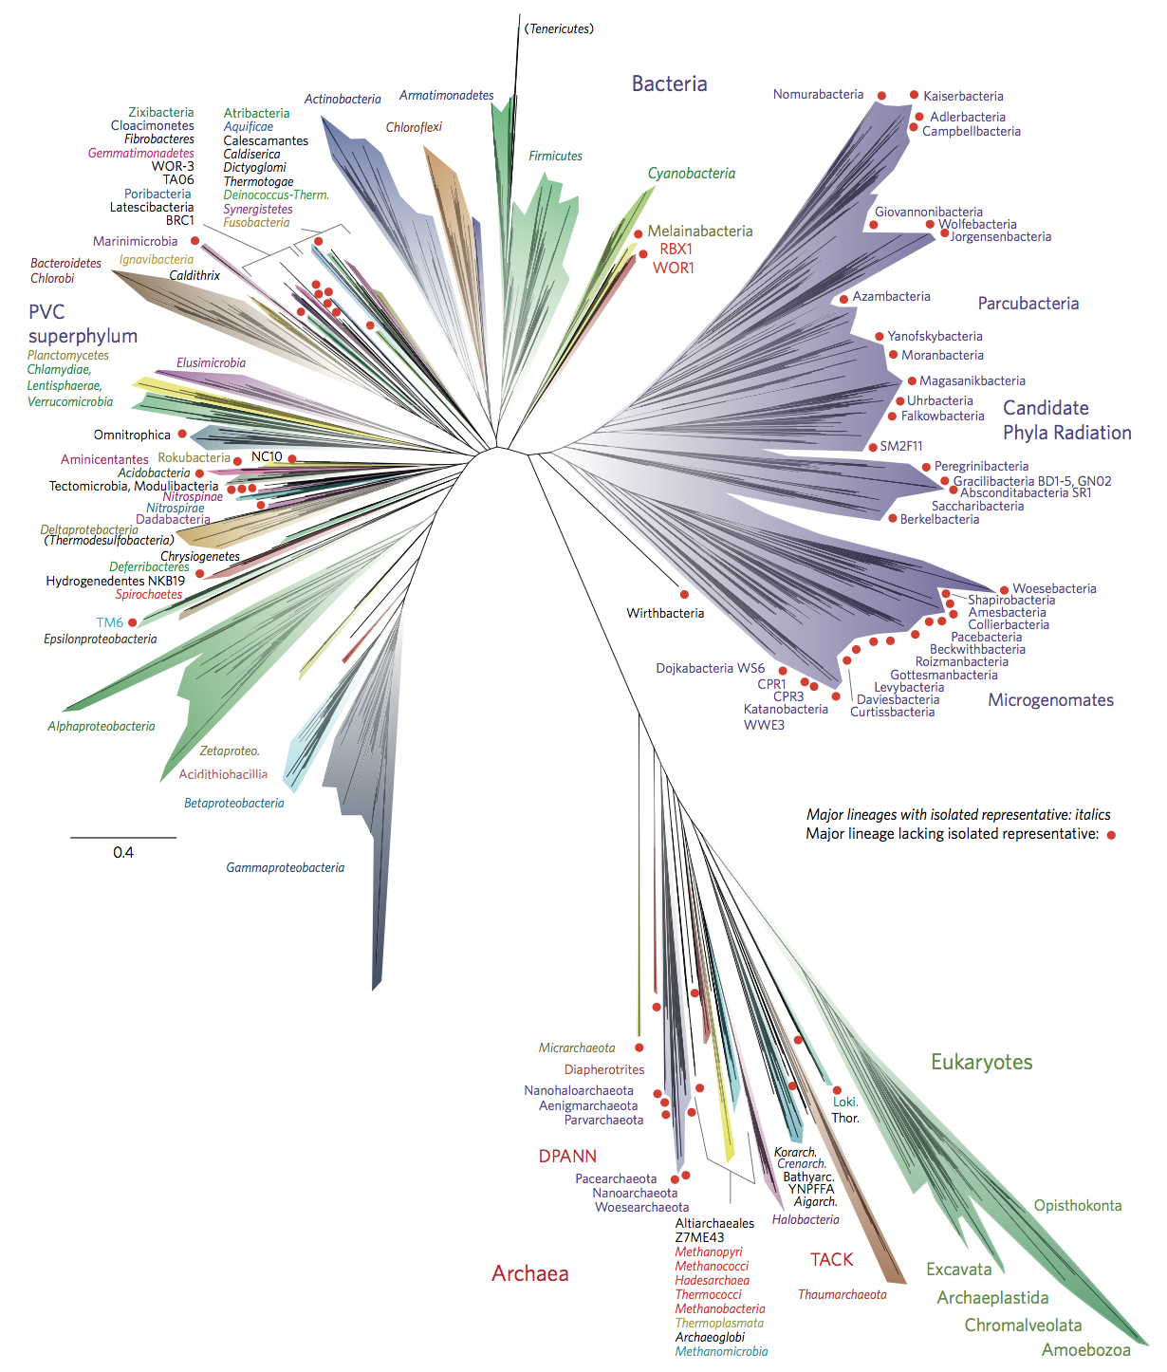
v
Finite element simulations in
Emergence of life
research

Slide 2
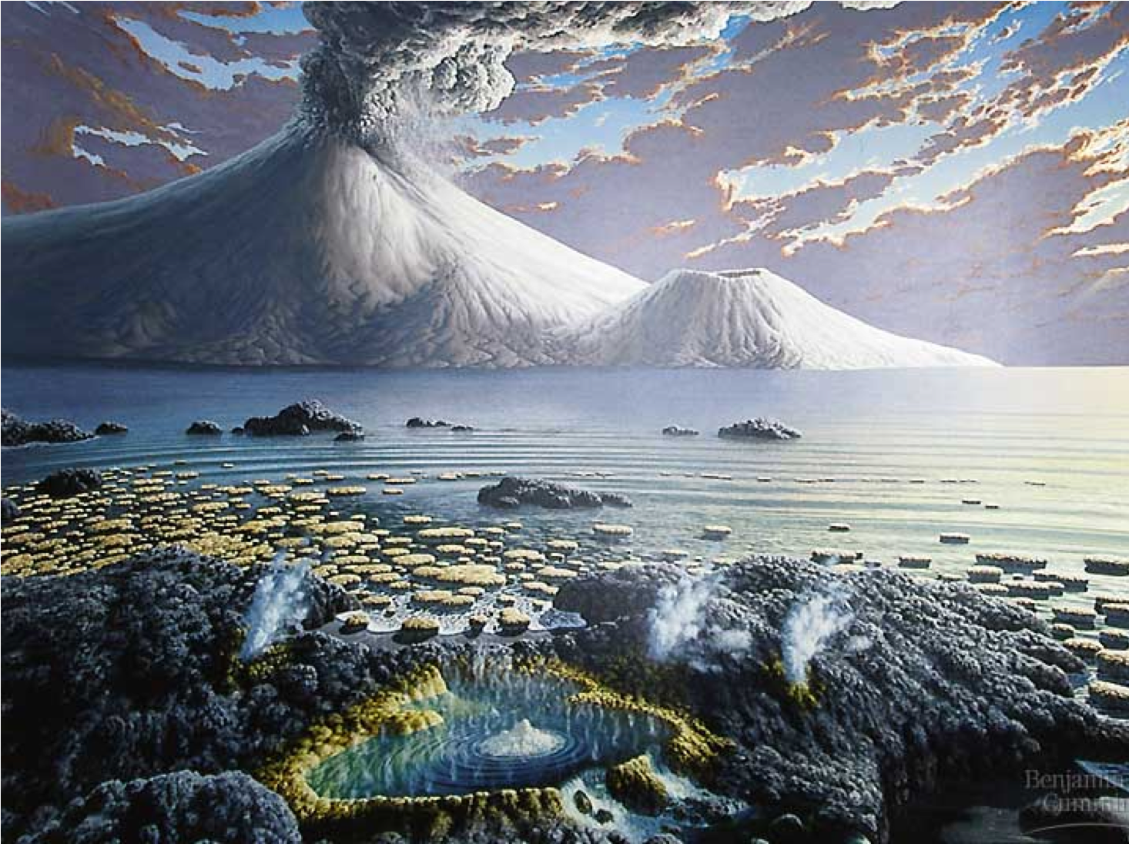
Emergence of life

Slide 3
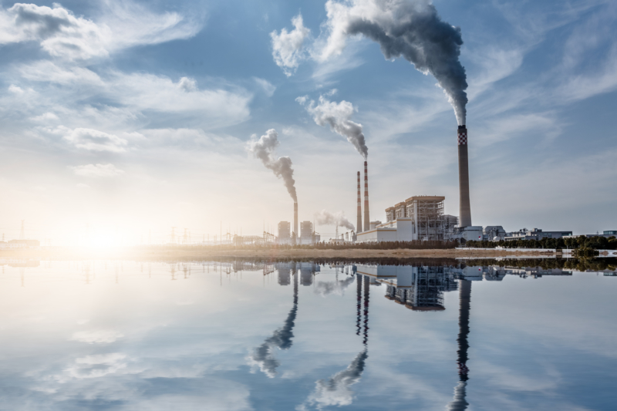

Slide 4
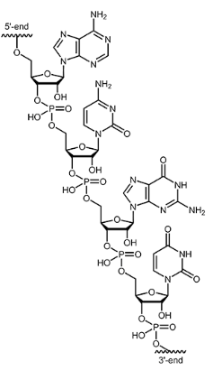
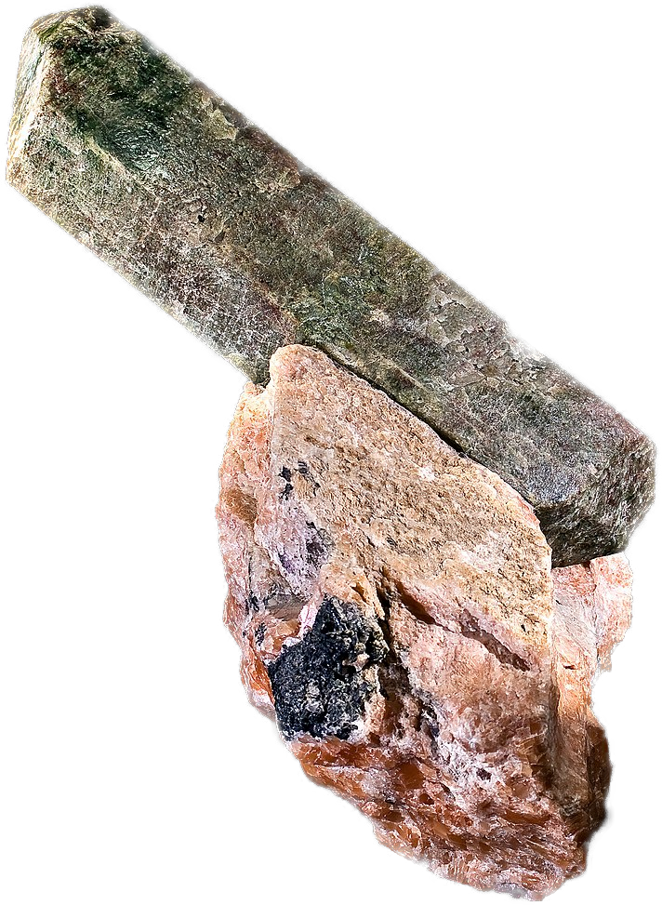
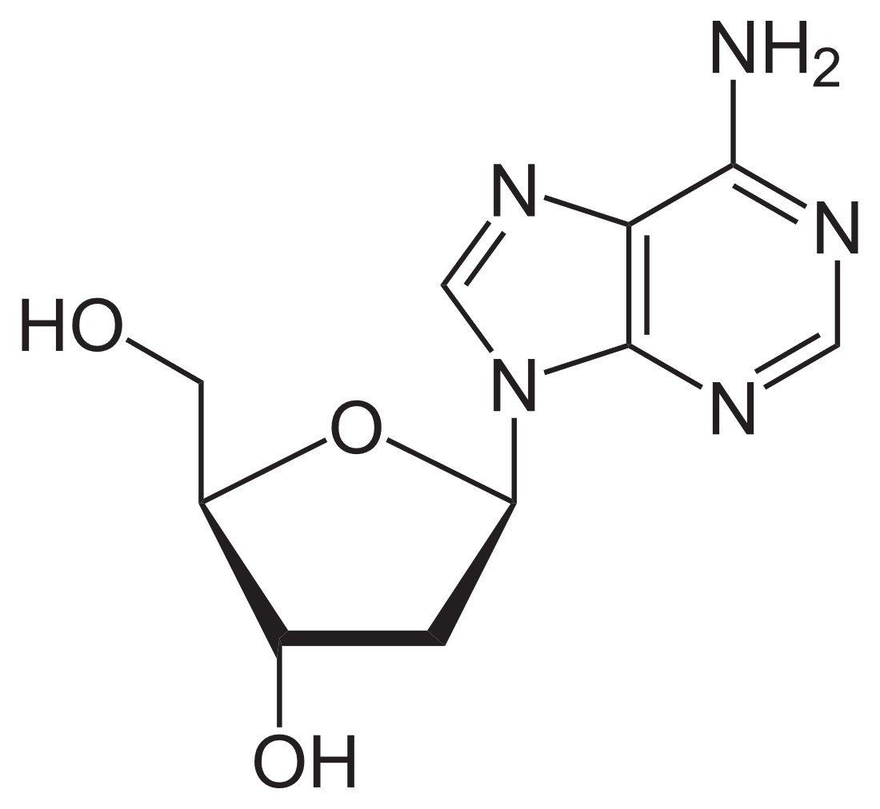
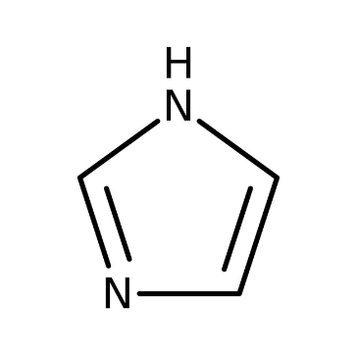
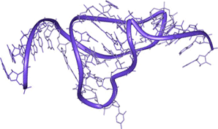
Prebiotic chemistry
time
4 GYa
Nucleotides
& fatty acids
RNA
mol. evolution
early life
Phosphor enrichment
Molecular
evolution
RNA
Nucleotides
e.g. Nucleoside
synthesis
Ribozymes
Phosphorylation
Activating
chemicals
Powner, Gerland, Sutherland, Nature vol 459, 239-242 (2009)
Notes:
Quick explanation why RNA -> molecular evolution
You need interacting strands!
Going through these steps is not like walking on a plane – its hard
Molecular evolution ->

Slide 5

It‘s hard!
time
4 GYa
Nucleotides
RNA
mol. evolution
early life

Slide 6
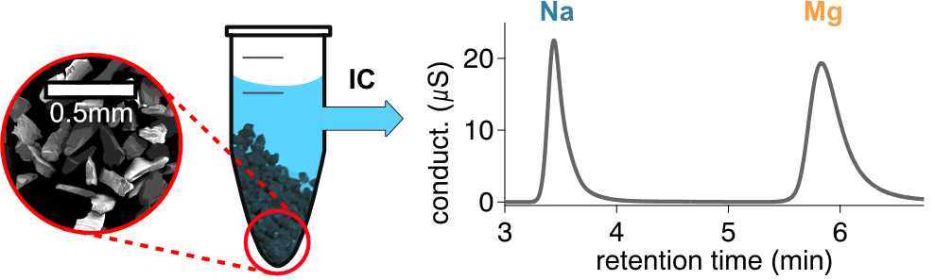
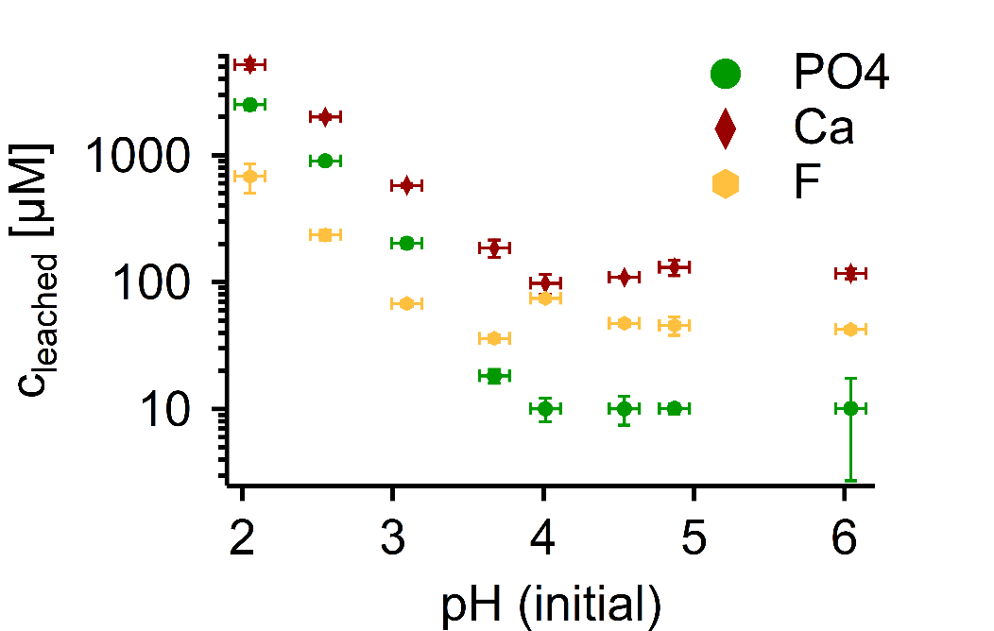
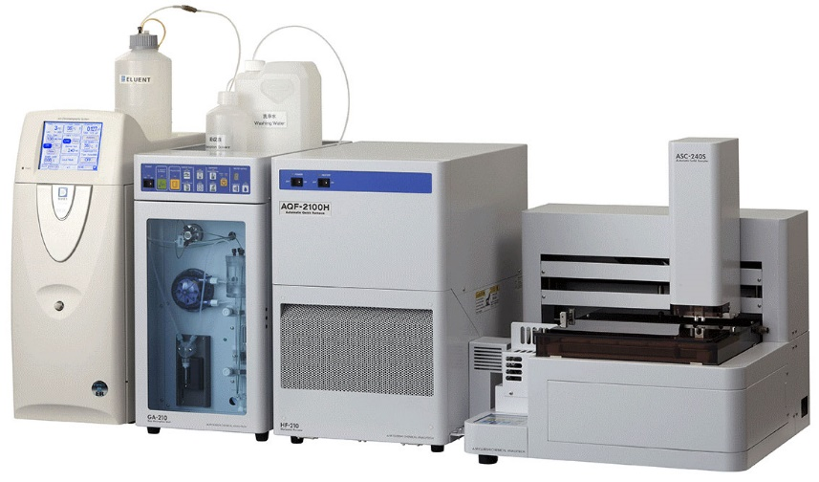
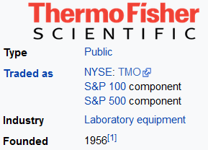
Ionic boundary conditions
Phosphor enrichment
Nucleotides
Phosphorylation
Not available
Notes:
so to fulfill all these

Slide 7
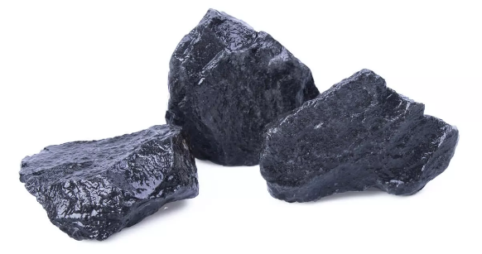
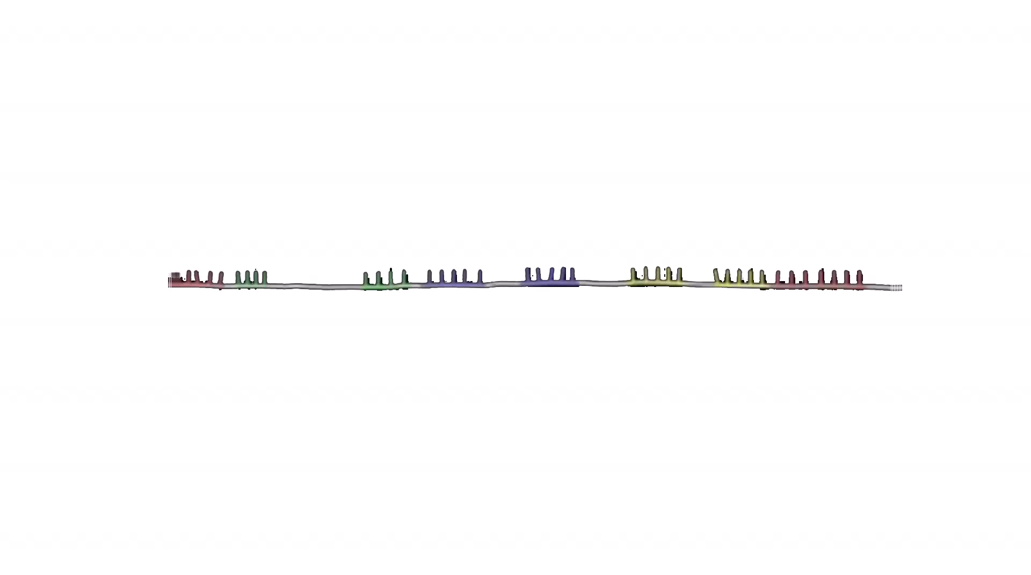
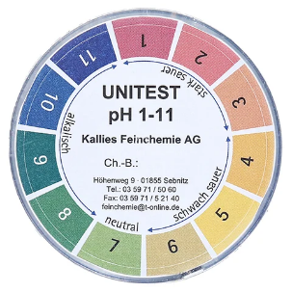
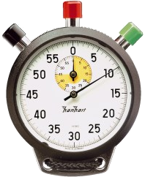
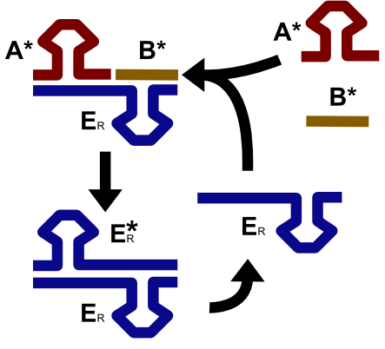

Ionic boundary conditions
$$\frac{\left[Mg^{2+}\right]}{\left[Na^{+}\right]}=0.001 to 0.1$$
Molecular
evolution
RNA
Ribozymes
Notes:
Quick explanation why RNA -> molecular evolution
You need interacting strands!
Going through these steps is not like walking on a plane – its hard
Molecular evolution ->

Slide 8
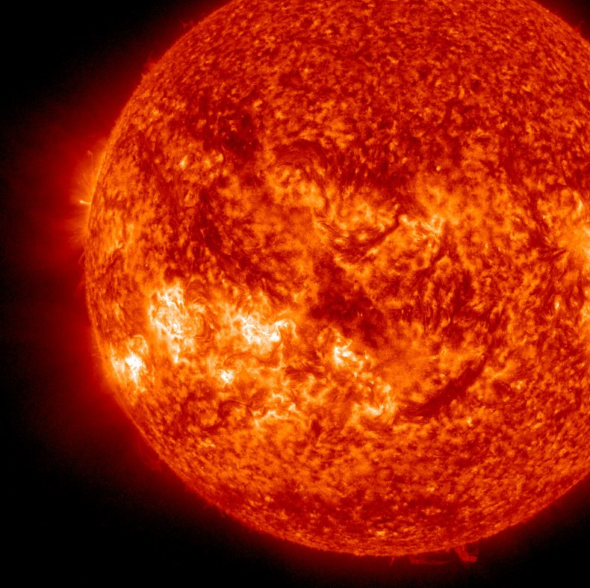
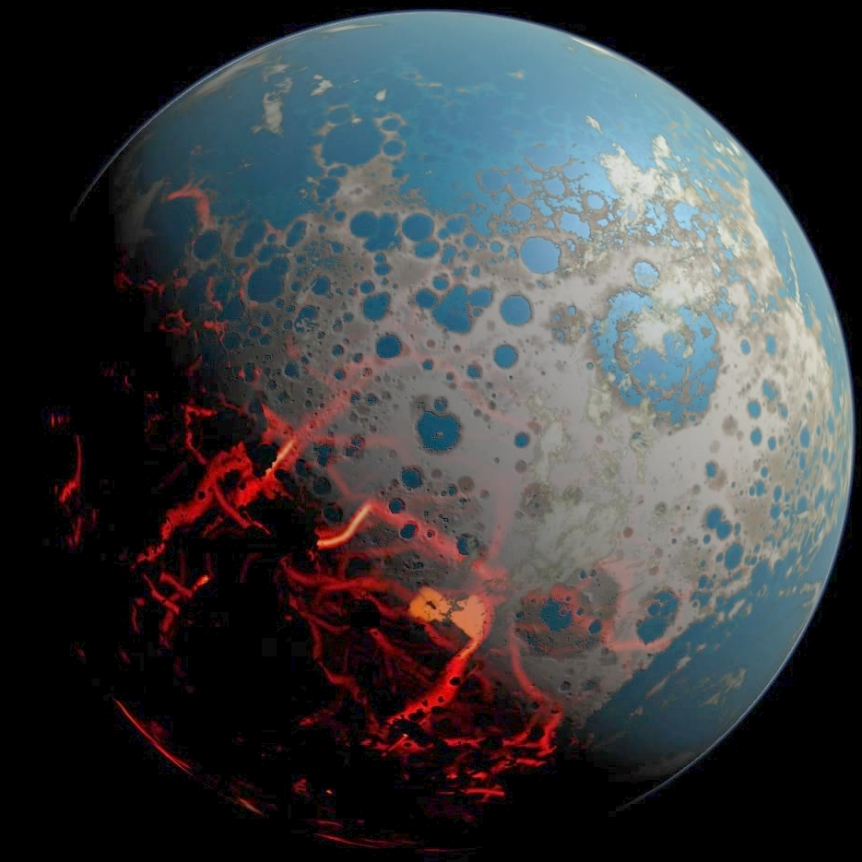

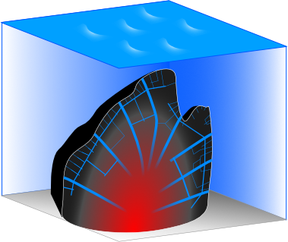
Systems Pre-Biophysics
Coupling between physical non-equilibria and prebiotic chemistry & geology
scale not correct
Notes:
8

Slide 9
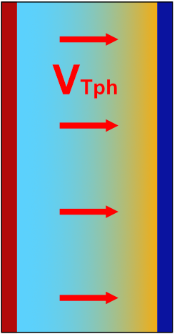


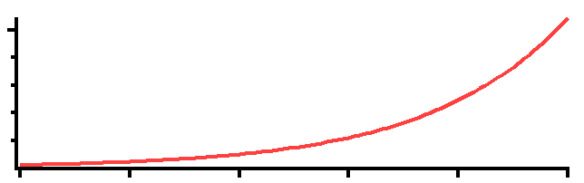
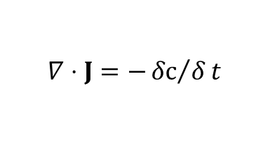










Thermophoresis: The „capacitor effect“
Continuity equation
$$∇⋅J=−{δc}/δt$$
$$J=J_{drift}+J_{díff}$$
Steady
state
$$c_{high}$$
$$J_{drift}=v_{Tph}⋅c$$
$$J_{diff}=−D⋅∇c$$
$$v_{Tph}≡{−D}_{T}⋅∇T$$
heat
$$∇⋅J=0$$
$$∇⋅\left(−D⋅∇c−D_{T}∇T⋅c\right)=0$$
$$concentration$$
No drift
$$=const.$$
$$\frac{∇c}{c}=−\frac{D_{T}}{D}≡S_{T} \sim {10}^{−2} to {10}^{−3}1/K$$
$$even: J=0$$
$$0$$
c
1.05x
x
$$\frac{c_{hot}}{c_{cold}}=exp⁡\left(−S_{T}⋅ΔT\right)$$

Slide 10
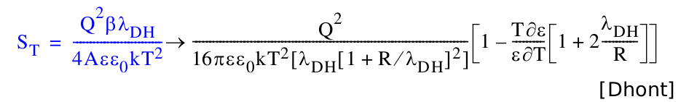
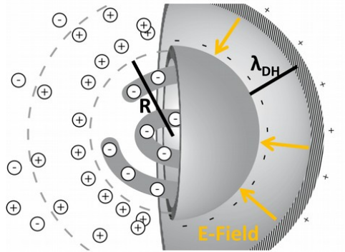
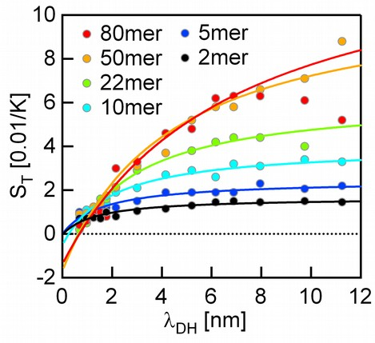
Thermophoresis: The „capacitor effect“
$$c_{high}$$
$$concentration$$
heat
$$0$$
c
1.05x
x
$$\frac{c_{hot}}{c_{cold}}=exp⁡\left(−S_{T}⋅ΔT\right)$$

Slide 11
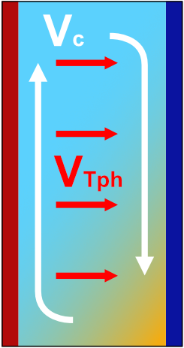

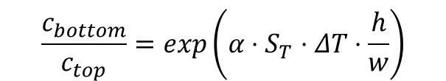
Enhance thermophoretic effect by convection
Thermophoresis only:
(no g, thin vessel, g same direction..)
Thermophoresis + convection:
[Debye 1939]
c
g
heat
heat
c
1.05x
h
1000x
x
$$\frac{c_{bottom}}{c_{top}}=exp\left(α⋅S_{T}⋅ΔT⋅\frac{h}{w}\right)$$
$$\frac{c_{hot}}{c_{cold}}=exp⁡\left(−S_{T}⋅ΔT\right)$$
Notes:
Also include convection! -> make this slide new for non-preqbiotic intro.
11

Slide 12
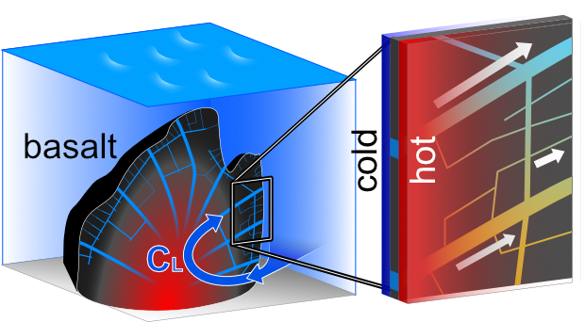
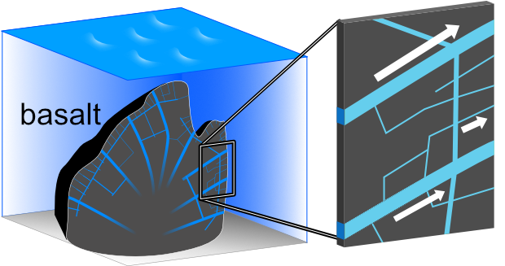
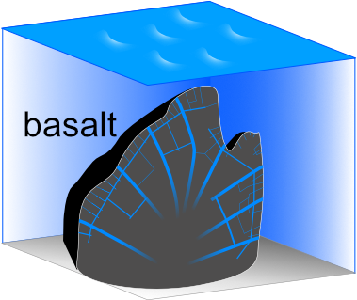

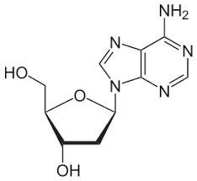
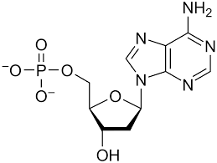
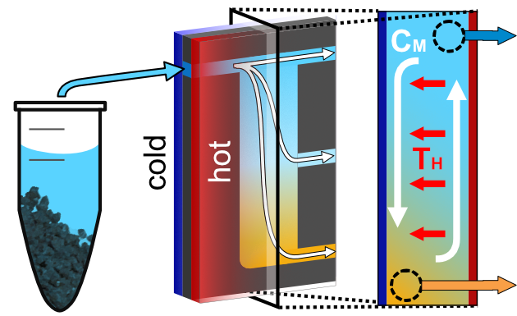
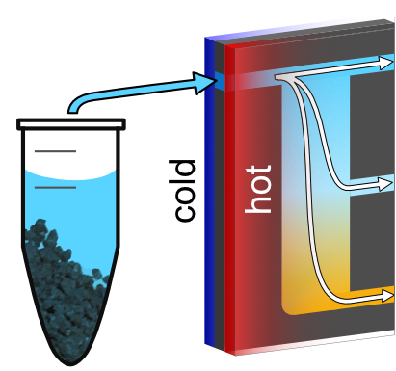
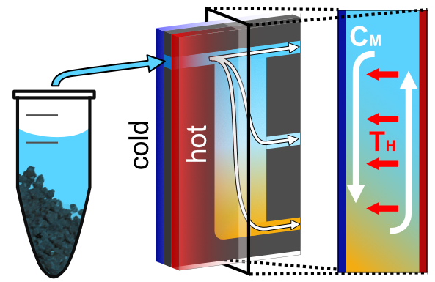
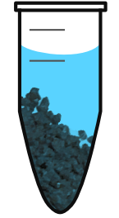
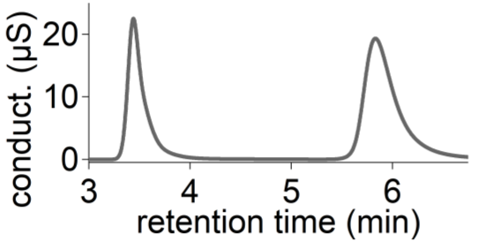
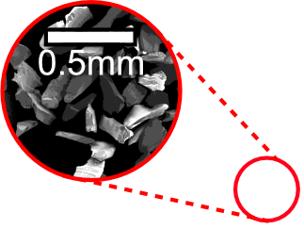
Scenario
Basalt:
Ribozyme
function
$$\frac{\left[Mg^{2+}\right]}{\left[Na^{+}\right]}=1 to 100$$
$$\frac{\left[Mg^{2+}\right]}{\left[Na^{+}\right]}=0.001 to 0.1$$
apatite
Apatite @pH2:
$$\frac{6\left[PO_{4}\right]}{10\left[Ca^{2+}\right]}\sim 1$$
$$\frac{6\left[PO_{4}\right]}{10\left[Ca^{2+}\right]}>10$$
Experiment
Ion chromatography:

Slide 13
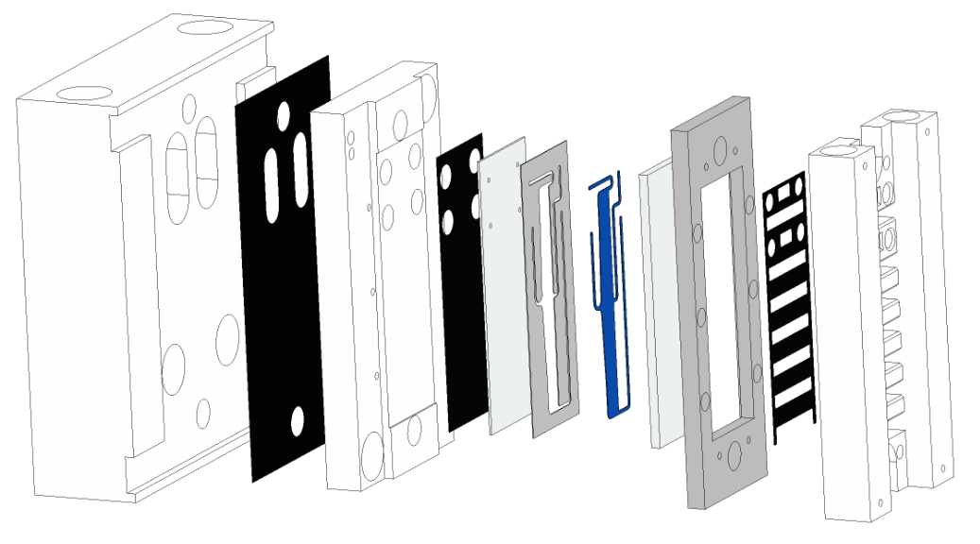
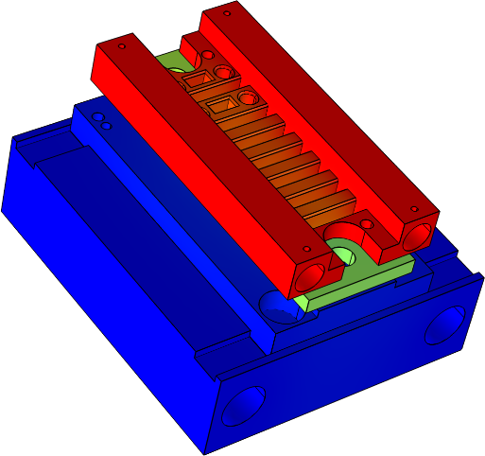
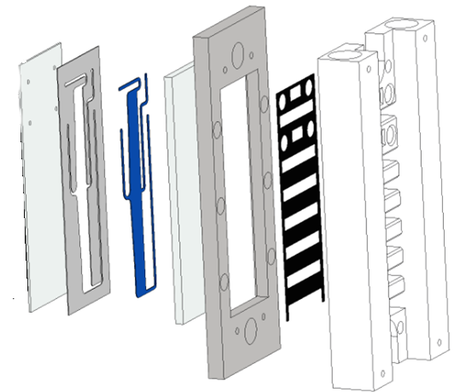
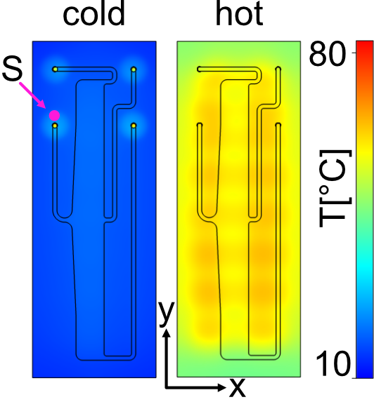
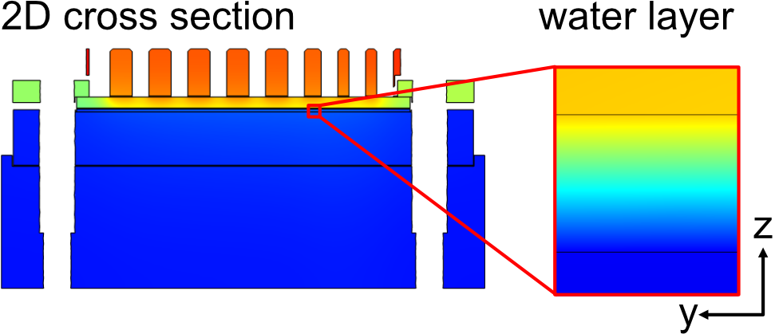
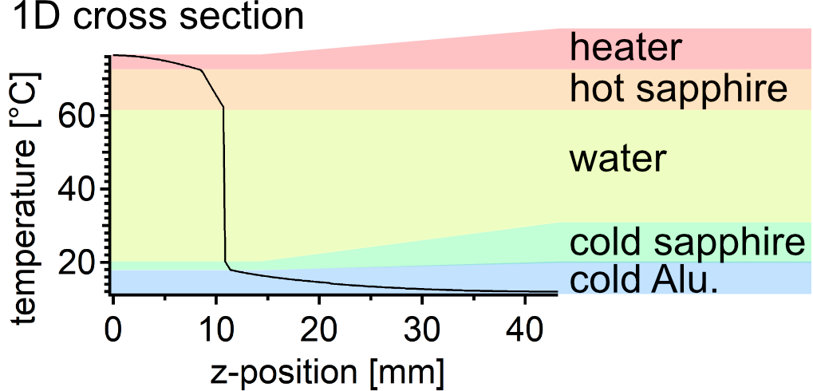
Thermal setup

Slide 14
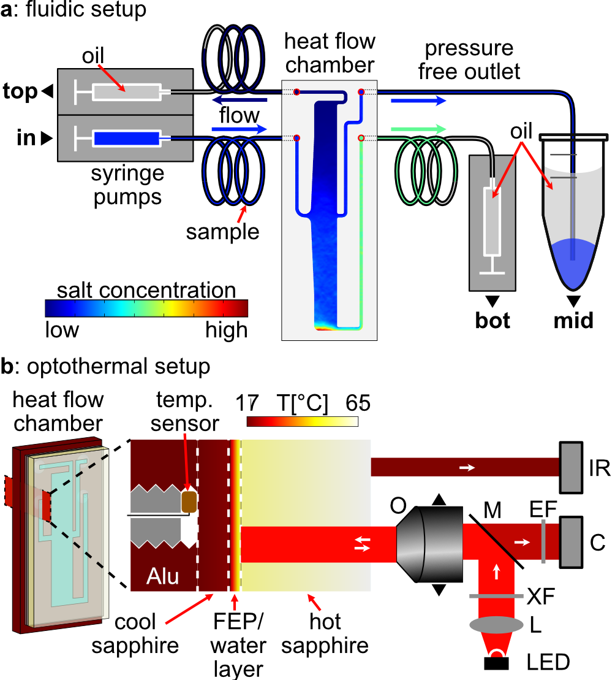
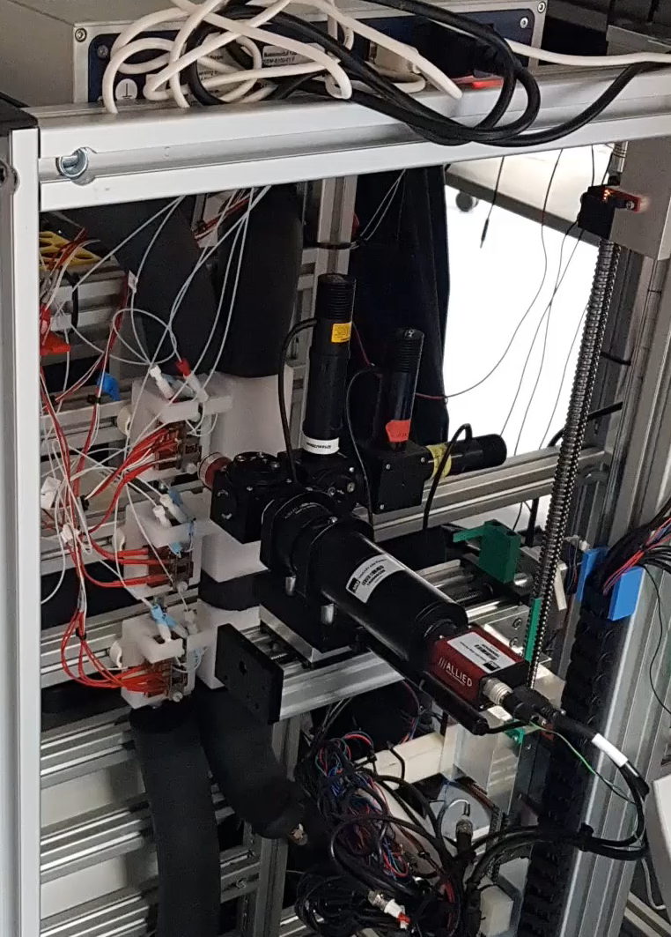
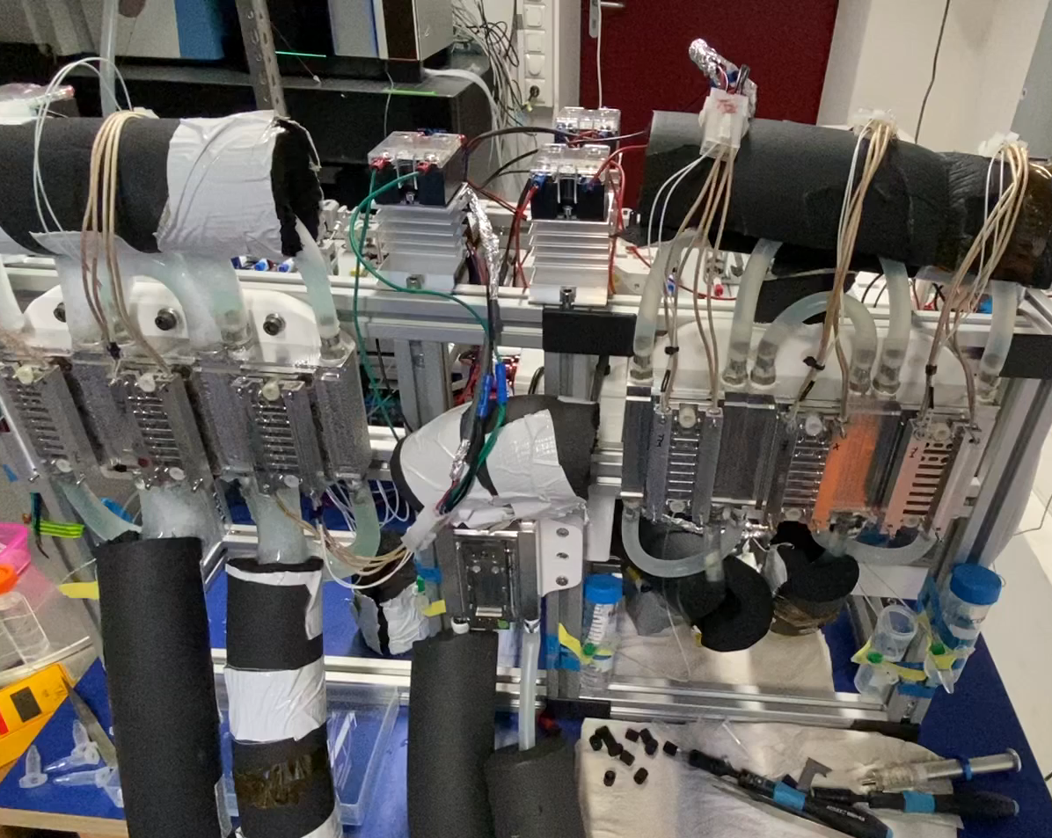
Microfluidic & optical setup

Slide 15
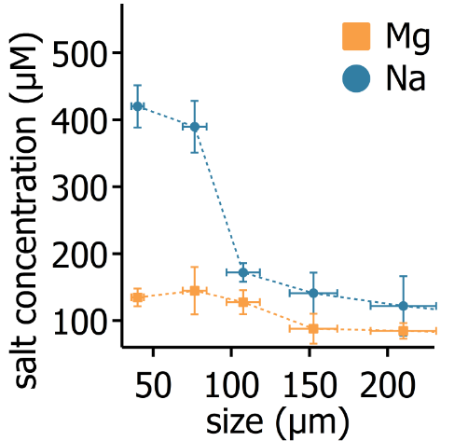
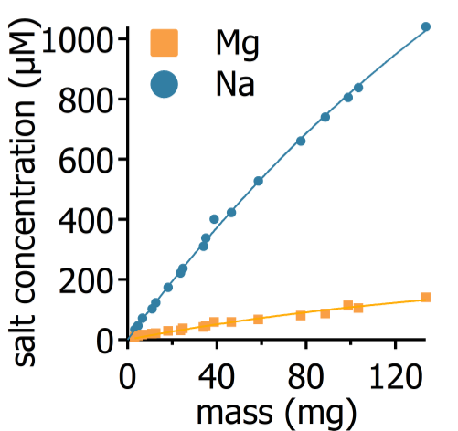



Results: Heat flows boost Mg/Na
Leaching only:
Ribozyme function:
Matreux, LeVay, .., Scheu, Dingwell, Braun, Mutschler, Mast, Heat flows in rock cracks naturally optimize salt compositions for ribozymes, Nature Chemistry (2021)

Slide 16




Results: Heat flows boost Mg/Na
Cascade of thermal traps:
Ribozyme function in the trap:
Matreux, LeVay, .., Scheu, Dingwell, Braun, Mutschler, Mast, Heat flows in rock cracks naturally optimize salt compositions for ribozymes, Nature Chemistry (2021)

Slide 17


Results: Heat flows boost Mg/Na
Cascade of thermal traps:
Ribozyme function in the trap:
Matreux, LeVay, .., Scheu, Dingwell, Braun, Mutschler, Mast, Heat flows in rock cracks naturally optimize salt compositions for ribozymes, Nature Chemistry (2021)

Slide 18






Heat flows could help..
2. ..to enrich compounds from complex mixtures
Thermophoresis measurement
low volume
low conc.
no label
multiple compounds
HPLC

Slide 19









Thermophoretic parameters
The origins of life..
2‘-CMP
position
3‘-CMP
5‘-CMP
Make it vertical
2‘3‘-AMP
2‘3‘-GMP
2‘3‘-UMP
And many more:
Bases: A,G,C,G,U
P: 2‘-, 3‘-, 5‘-, 2‘3‘-, 3‘5‘-
Solvent: water, formamide
pH: 3 – 11
AAs: His, Asn, Ser, Gln, Arg, Asp, Glu, Thr, Ala, Pro, Cys, Lys, Tyr, Arg, Val, Ile, Leu, Phe
2-AO, 2-AT, 2-AI
Adenine
Cytosine
Guanine

Slide 20






Selective concentration
AMP (% enrichment):
AAs (% enrichment):
±10%
±4%
ΔT: 22K
top
bottom
Notes:
20

Slide 21


Scaling

Slide 22



Scaling
20 x 20 chambers ~ 0.5$m^{2}$
ΔT: 22K
Update plots:
dT dependence & flow dependence
More examples -> grid behaviour
Include new fig 4 (realistic rock)
Also add Phosphate story and pH of NaCl

Slide 23


Scaling
20 x 20 chambers ~ 0.5$m^{2}$
ΔT: 5K
Update plots:
dT dependence & flow dependence
More examples -> grid behaviour
Include new fig 4 (realistic rock)
Also add Phosphate story and pH of NaCl
Notes:
Bottom line -> increase concentration and implement a LOT of different compositions

Slide 24

How to do these simulations?
Trial available via www.comsol.com/contact
If you are interested -> contact me f. 1 month classroom licences.
Permanent licences ~ 5k - 10k€
Interface with 3D cad tools (e.g. Inventor)

Slide 25
short break

Slide 26

Step 0: Check out the user interface

Slide 27

Step 0: Check out the user interface
Commands (top), Tree (left), Settings (mid), Viewport (right), Progress/Notes (bottom)
make advanced sections visible -> important f. advanced physics (f. conservative form), equation view
Show help

Slide 28
Step 1: Define the geometry (2D, 3D, symmetries)
Create component
Always use lowest dimension size / highest symmetry possible.
Create 2D geometry with simple entities
  Different shapes
  Precise control
  Domains, Edges, Points
Geometric operations on geometry:
  Transforms: Array, copy, mirror, move, rotate, scale
  Boolean ops: Union, intersect, difference, compose
Create 2nd file for 3D example:
Create 3D geometry
  Same operations -> it gets tedious
Better: work with workplanes -> 3D operations (extrude etc.)
External CAD tools -> Inventor (free for University/students)
  Load full chamber f. heat flow sim (later continue with 2D due to speed) via live-links
  Upon import -> select repair-options

Slide 29











Step 2: Determine the necessary physics
1. Heat transport
2. Fluid motion
$$∇⋅q=−\frac{ρC_{p}∂T}{∂t}+Q$$
$$∇⋅\left(ρu\right)=−\frac{∂ρ}{∂t}$$
$$q≡−k∇T \\ Q≡heat source$$
$$\frac{ρ∂u}{∂t}⋅ρ\left(u⋅∇\right)u=∇⋅\left[−pI+τ\right]+F$$
Accel., convection
Hydrostatics, tension, ext force
3. Motion of dilute species
4. Reactions of species
$$∇⋅J=−{δc}/δt$$
$$J_{diff}=−D⋅∇c$$
$$∇⋅J=−{δc}/δt−Q_{R} \\ Q_{R} ≡source term$$
$$J_{drift}=v_{NS}⋅c+D_{T}∇T⋅c$$
e.g.
$$J=J_{diff}+J_{drift}$$
$$\frac{∂c_{2}}{∂t}=c_{1}^{2}⋅k_{on}−c_{2}⋅k_{off}=Q_{R,1}$$
$$\frac{∂c_{1}}{∂t}=−c_{1}^{2}⋅k_{on}+c_{2}⋅k_{off}=Q_{R,2}$$
lets add them stepwise – start with heat transport

Slide 30
Step 3: Material, boundary & initial conditions
Add blank materials:
PTFE:
0.27 W/mK
2200 kg/m^3
960 J/(kg*K )
Sapphire:
40 W/mK
4000 kg/m^3
750 J/(kg*K )
Assign material groups from inventor
Add „Heat transfer in solids“ -> add material properties
Set boundary temperatures (in experiment: defined by PID electronics)
Use parameters -> prevent „magic numbers“
units added in brackets: e.g. [m^2], also non-UI units possible.
Duplicate boundary cond-nodes to save time
Mesh-error -> make finer mesh

Slide 31
Step 4: Set solution type
Steady state for heat transfer
Parametric sweep f. multiple runs

Slide 32
Step 5: Analyse results
Temperature
3D surface
3D Slices
Data-set -> Cut-planes, cut-lines
Heat flux:
Arrow-volume
Isosurface -> multiple, or 1 (with slider)

Slide 33

Improving the mesh
Rule: Reduce number of elements as much as possible to maintain the projected precision.

Slide 34

Improving the mesh
set in component -> „shape order“ & discretization node in physics nodes
Notes:
Comsol always uses 2nd order elements by default

Slide 35



Element order - visualization
Example: 1D solution
this is the „correct“ result
Better: same order, but more elements & not uniform
Bad: low number, low order
Notes:
Comsol always uses 2nd order elements by default

Slide 36

Element order - visualization
Example: 1D solution
this is the „correct“ result
Even better: higher order, very low number of
Notes:
Comsol always uses 2nd order elements by default, except NS bc of stabilization.

Slide 37

Notes:
Comsol always uses 2nd order elements by default, except NS bc of stabilization.

Slide 38


Slide 39

Basic „tricks“
Set appropriate repair tolerance on union operation (example: 2_3D..)
Use „de-featuring“ operations on geometry node
Also use domains to assign mesh nodes with size-subnodes
Try around with other mesh types (quad, mapped w. distribution subnode)
Hard to predict which mesh types are optimal (depends on problem)
Plot mesh quality to verify (with element filter), mesh quality histogram
Use Geometry -> Virtual operations -> Mesh control edges to use edges only for meshing (without being its own domain)!
Composite faces (e.g. cylinder) -> unify faces to simplify meshing (use explicit selection)

Slide 40
Step N: Repeat steps 1-5 f. other physics models@2D
Redo sim 2D with simple rectangle geometry
Global vs local parameter
Setting local parameters (D = 100e-12[m^2/s], ST=0.03[1/K], DT)
Setting up geometry (parametrized dimensions -> to global parameters)
Add Materials (water), show properties, also Temp dependent etc.
Setup heat conduction, navier stokes equation, movement of dissolved species (go through all elements)
Compressible flow + Conservative particle flux
Zero pressure boundary conditions
Concentration boundary condition
Setup solver -> subsequent solution instead of „all in one“
2x steady state + 1x time dependent
Visualize results
Add flow through boundary @ NS
Add simple reaction term using 2 species (kon: 1e-2[1/(Ms)], koff: 1e-3[1/s]), 24[h] (using 2nd TDS node)
Timefact:0.0001, DT1=10x DT2
Evaluate using integration
Width: 170um, Height: 20mm

