Slide 1
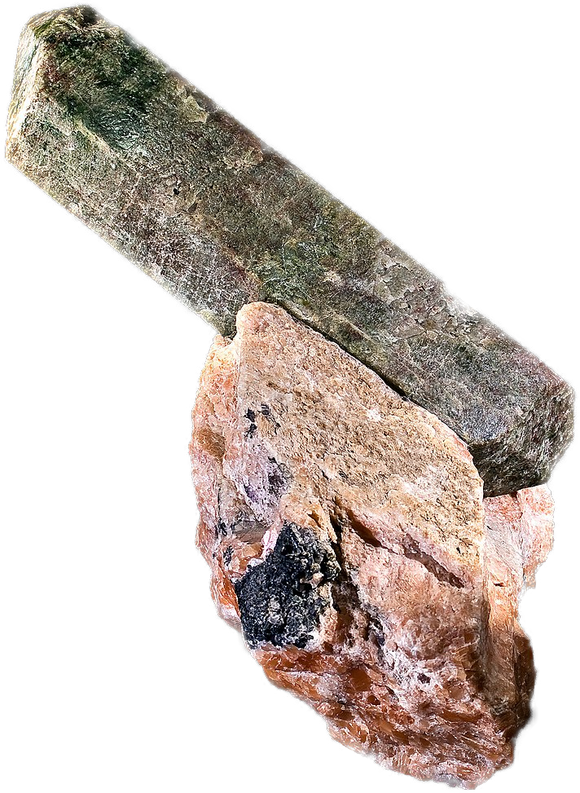
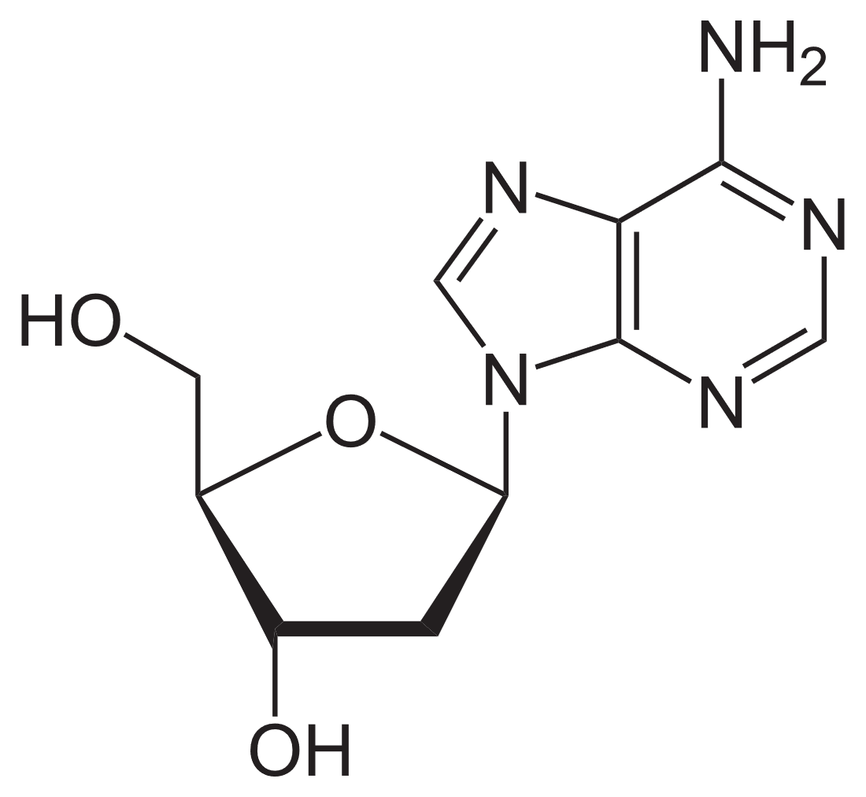
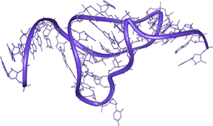
Motivation: prebiotic microfluidics
time
4 GYa
Nucleotides
& fatty acids
RNA
mol. evolution
early life
Phosphor enrichment
Molecular
evolution
RNA
Nucleotides
e.g. Nucleoside
synthesis
Ribozymes
Phosphorylation
Activating
chemicals
Powner, Gerland, Sutherland, Nature vol 459, 239-242 (2009)
Notes:
Quick explanation why RNA -> molecular evolution
You need interacting strands!
Going through these steps is not like walking on a plane – its hard
Molecular evolution ->

Slide 2
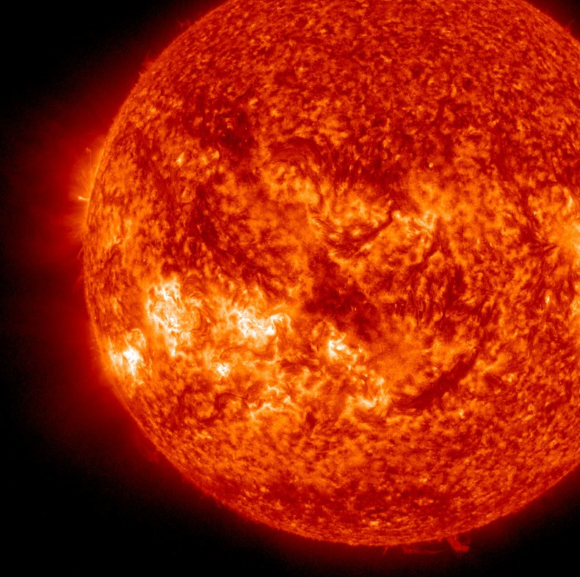
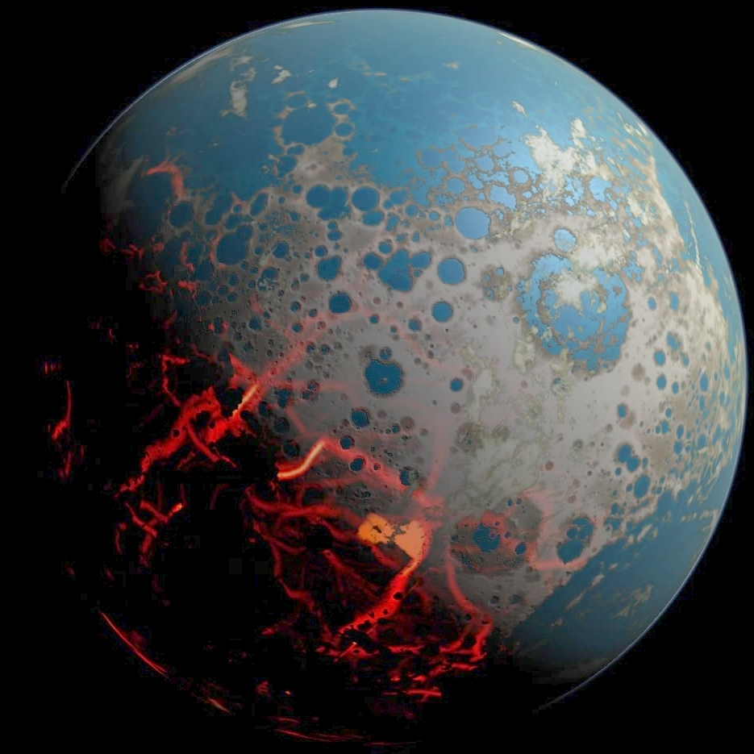
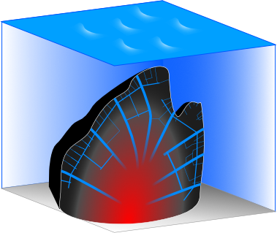
Systems Pre-Biophysics
Coupling between physical non-equilibria and prebiotic chemistry & geology
scale not correct

Slide 3
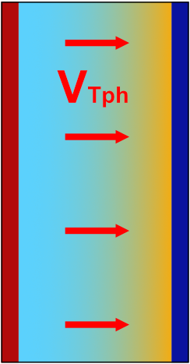
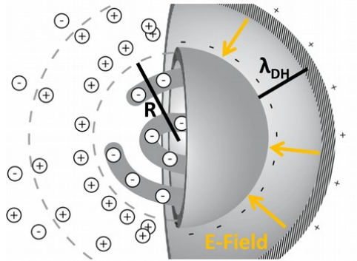
Thermophoresis: The „capacitor effect“
$$v_{Tph}={−D}_{T}⋅∇T, S_{T}=D_{T}/D$$
$$c_{high}$$
$$concentration$$
heat
$$0$$
c
1.05x
x
$$\frac{c_{hot}}{c_{cold}}=exp⁡(−S_{T}⋅ΔT)$$

Slide 4
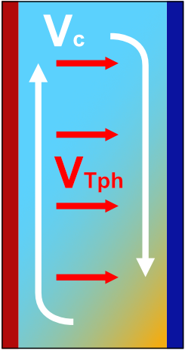
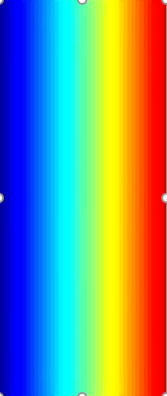
Enhance thermophoretic effect by convection
Thermophoresis only:
(no g, thin vessel, g$\&∇T$ same direction..)
Thermophoresis + convection:
$$v_{Tph}={−D}_{T}⋅∇T, S_{T}=D_{T}/D$$
c
g
heat
heat
c
1.05x
h
1000x
x
$$\frac{c_{bottom}}{c_{top}}=\exp\left(α⋅S_{T}⋅ΔT⋅\frac{h}{w}\right)$$
$$\frac{c_{hot}}{c_{cold}}=exp⁡(−S_{T}⋅ΔT)$$
Notes:
Also include convection! -> make this slide new for non-preqbiotic intro.

Slide 5
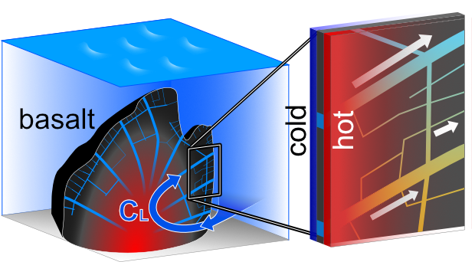
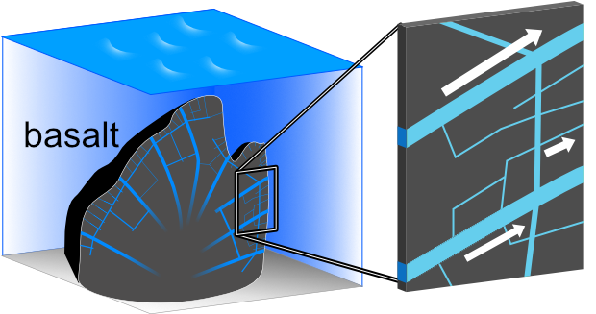
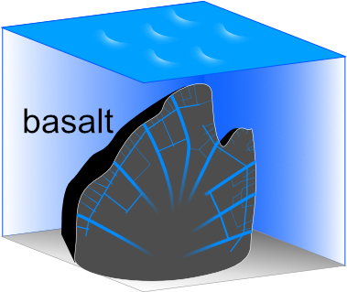
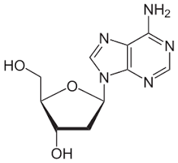
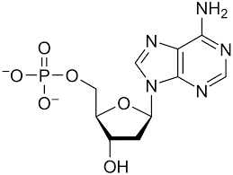
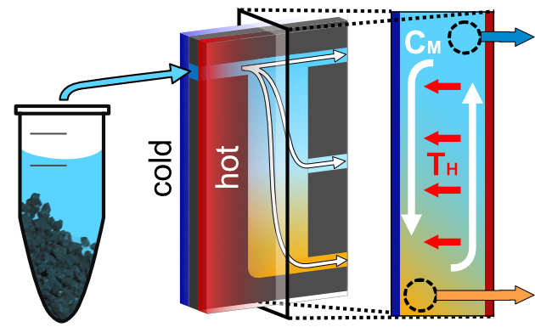
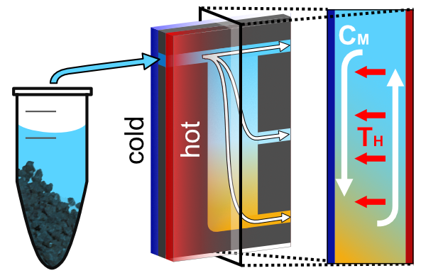
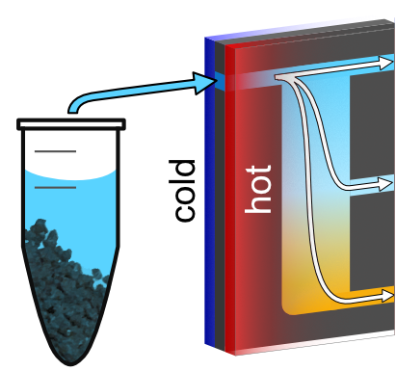
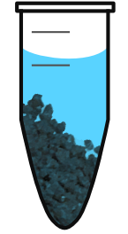
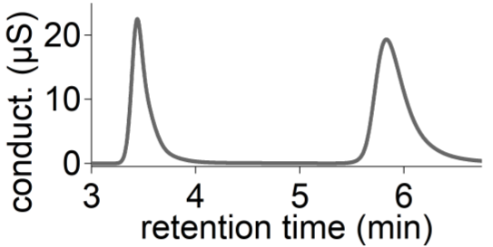
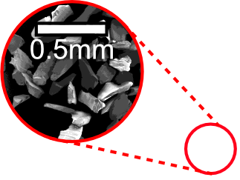
Scenario
Basalt:
Ribozyme
function
$$\frac{\left[Mg^{2+}\right]}{\left[Na^{+}\right]}=1 to 100$$
$$\frac{\left[Mg^{2+}\right]}{\left[Na^{+}\right]}=0.001 to 0.1$$
apatite
Apatite @pH2:
$$\frac{6\left[PO_{4}\right]}{10\left[Ca^{2+}\right]}\sim 1$$
$$\frac{6\left[PO_{4}\right]}{10\left[Ca^{2+}\right]}>10$$
Experiment
Ion chromatography:

Slide 6
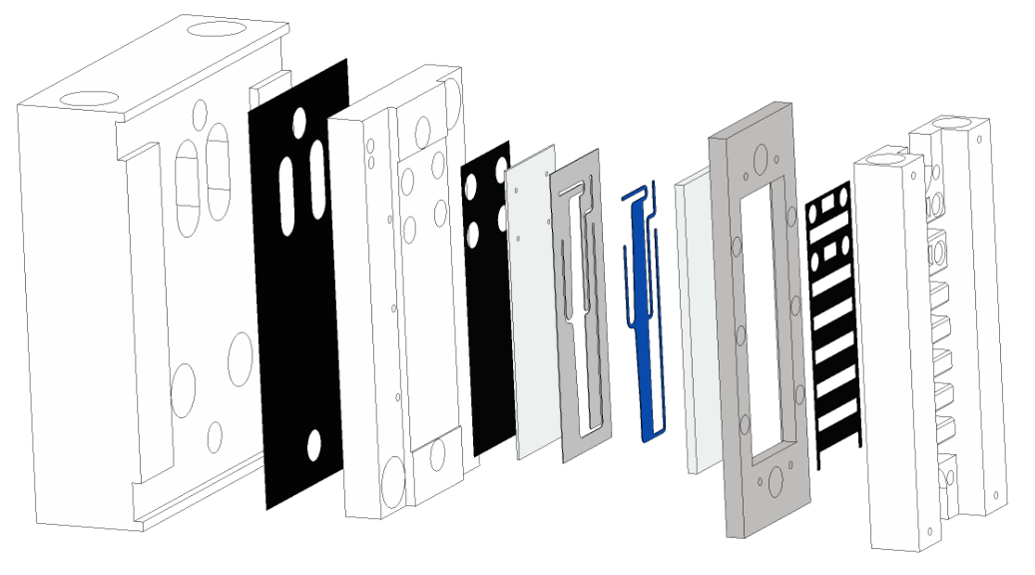
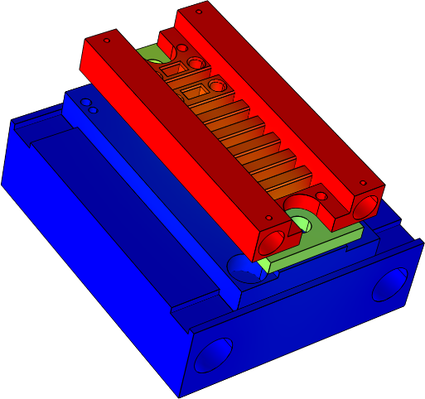
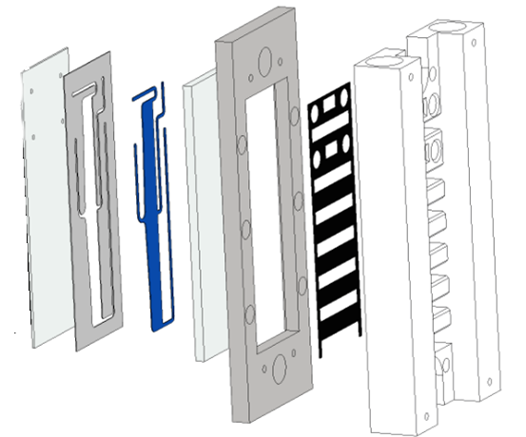
Setup

Slide 7
How to get from here:
?
naïve pool
..to here:
e.g. from polymerization
optimized pool
Solution: select phenotype, NOT genotype
Higher relative amount of folding sequences

Slide 8
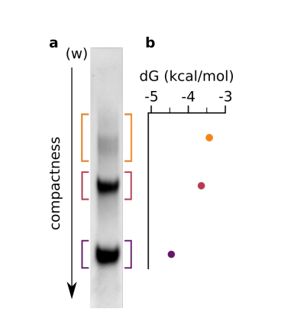
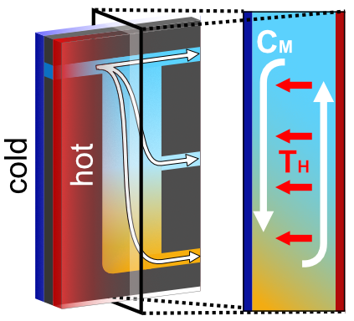
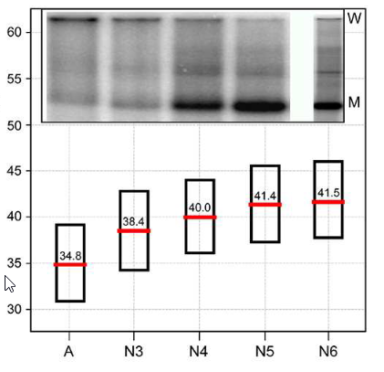
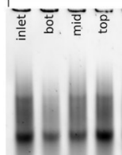
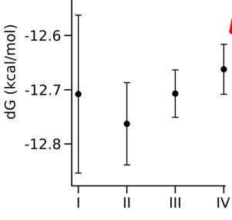
Szostak/Luptak did it already:
(kinda)
How could we do it „prebiotically“?
phenotypic potential
RNA:
Luptak, Szostak et al. J. Am. Chem. Soc. 2020, 142, 4, 1941–1951
(from PhD thesis Alex Kühnlein)

Slide 9
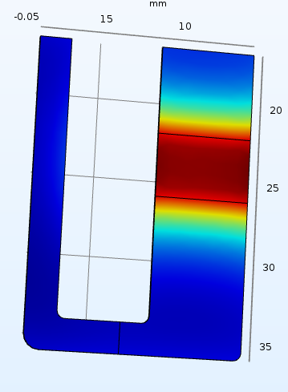
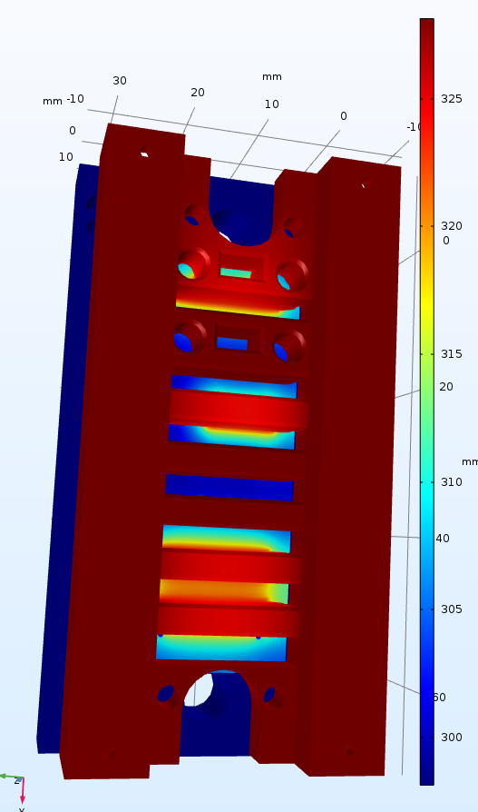
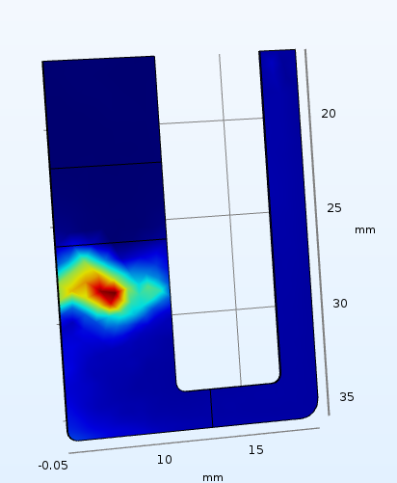
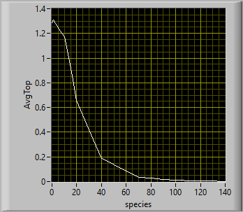
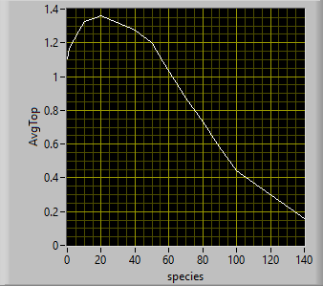
Better setting f. Oligomers:
The „heat-step“
(see NatChem 2015)
Temperature
Concentration (oligo)
Length selection
low flow speed
High flow speed

Slide 10
Selective effect „under“ the heater:
140mer
Oligo length
NTP
time
20h

Slide 11
How to do these simulations?

Slide 12
Thermophoresis: The „capacitor effect“
$$v_{Tph}={−D}_{T}⋅∇T, S_{T}=D_{T}/D$$
Continuity equation & Ficks law
$$∇⋅J=−δρ/δt$$
$$J_{diff}=−D⋅∇c$$
$$J=J_{diff}+J_{drift}$$
$$J_{drift}=v_{NS}⋅c+v_{Tph}⋅c$$
Navier stokes equation
$$ρ\left(x,t,T\right)⋅\frac{Dv_{ns}(x,t)}{Dt}=ρ⋅\left(\frac{δv_{ns}}{δt}+\left(v_{ns} ⋅∇\right)v_{ns}\right)=$$
=$−∇p+μ\left(T\right)Δv_{ns}+\left(λ\left(T\right)+μ\left(T\right)\right)∇\left(∇⋅v_{ns}\right)+f(..)$

